Slide 1
SurfingAttack: Interactive Hidden Attack on Voice Assistants Using Ultrasonic Guided Waves
Qiben Yan, Kehai Liu, Qin Zhou, Hanqing Guo, Ning Zhang
NDSS 2020 February 23-26 – San Diego, CA

Slide 2
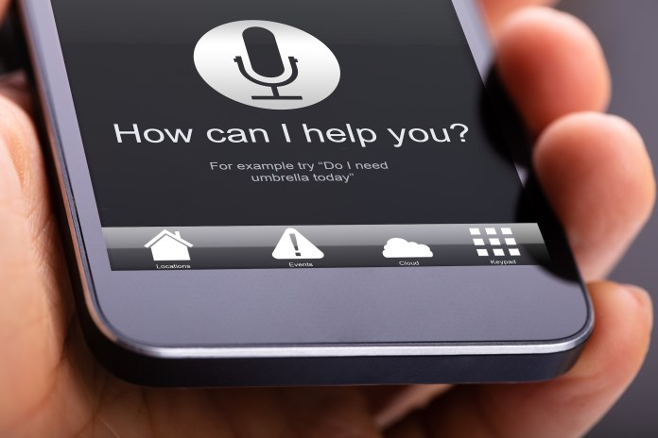
Voice Assistants
Read my message
Take a selfie
Calling Sam
Send a message to Sam

Slide 3
Inaudible Attack
Recent works show that microphone can hear inaudible voice (>25 kHz)
> 25 kHz (Hey Siri)
？？？
Yes, how can I help you?
Amp
f
Input
Amplifier
Low Pass filter
ADC

Slide 4
Inaudible Attack
Ideally
$$V_{in}$$
$${A_{1}V}_{in}$$
Amp
Actually
$$V_{in}$$
${A_{1}V}_{in}$+ $A_{2}{V^{2}}_{in}+…$
f
Input
Amplifier
Low Pass filter
ADC
For Example
$V_{in}=SinF_{1}+$ $SinF_{2}$
$${V^{2}}_{in}=aCos2F_{1}+bCos2F_{2}+cCos\left(F_{1}+F_{2}\right)+dCos\left(F_{1}−F_{2}\right)$$
Amp
If the $F_{1}−F_{2}$ locates to low frequency range of the filter, then the Mic can hear this Inaudible attack.
f

Slide 5
Outline of Inaudible Attack
Backdoor[1]
Dolphin Attack[2]
Lipread [3]
Inject
Commands
Longer
Range
[1] Roy, N., Hassanieh, H., & Roy Choudhury, R. (2017, June). Backdoor: Making microphones hear inaudible sounds. In Proceedings of the 15th Annual International Conference on Mobile Systems, Applications, and Services (pp. 2-14).
[2] Zhang, G., Yan, C., Ji, X., Zhang, T., Zhang, T., & Xu, W. (2017, October). Dolphinattack: Inaudible voice commands. In Proceedings of the 2017 ACM SIGSAC Conference on Computer and Communications Security (pp. 103-117).
[3] Roy, N., Shen, S., Hassanieh, H., & Choudhury, R. R. (2018). Inaudible voice commands: The long-range attack and defense. In 15th {USENIX} Symposium on Networked Systems Design and Implementation ({NSDI} 18) (pp. 547-560).

Slide 6
SurfingAttack: Features
None Line of Sight: we use solid media to propagate attack signal
Long Range Attack: the longest attack distance can be longer than 30ft
Attack multiple devices simultaneously

Slide 7
Ultrasonic Guided Waves
Ultrasonic Guided waves is known as Lamb waves
It has two modes based on the wave motion in both sides:
Symmetric modes
Anti-symmetric modes

Slide 8
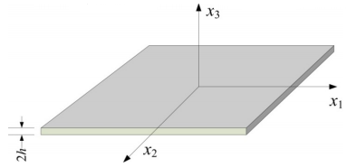
Ultrasonic Guided Waves
To understand how waves propagate in solid media:
We should discuss the vibrations on two directions
(x1 and x3) for both modes.
Symmetric modes
Anti-symmetric modes

Slide 9
Ultrasonic Guided Waves
Symmetric modes
Anti-symmetric modes
Rayleigh-Lamb Equations
Phase-velocity
Wave frequency
material

Slide 10
Attack Waves Selection
Requirements
Low dispersion
Low attenuation
Easy excitability
High attack signal reachability
narrowband input signals are most effective in restricting wave dispersal in large and thick plates
lower-order Lamb wave modes(A0)
use a circular piezoelectric disc to generate the signal for its energy efficiency and omni-directivity

Slide 11
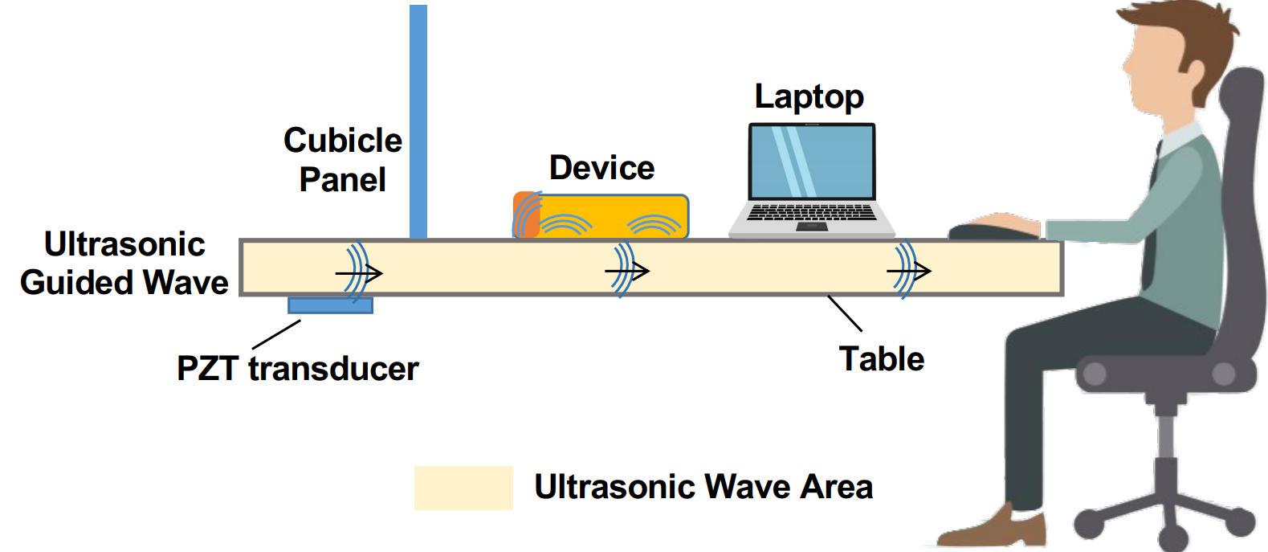
Consider a realistic scenario

Slide 12
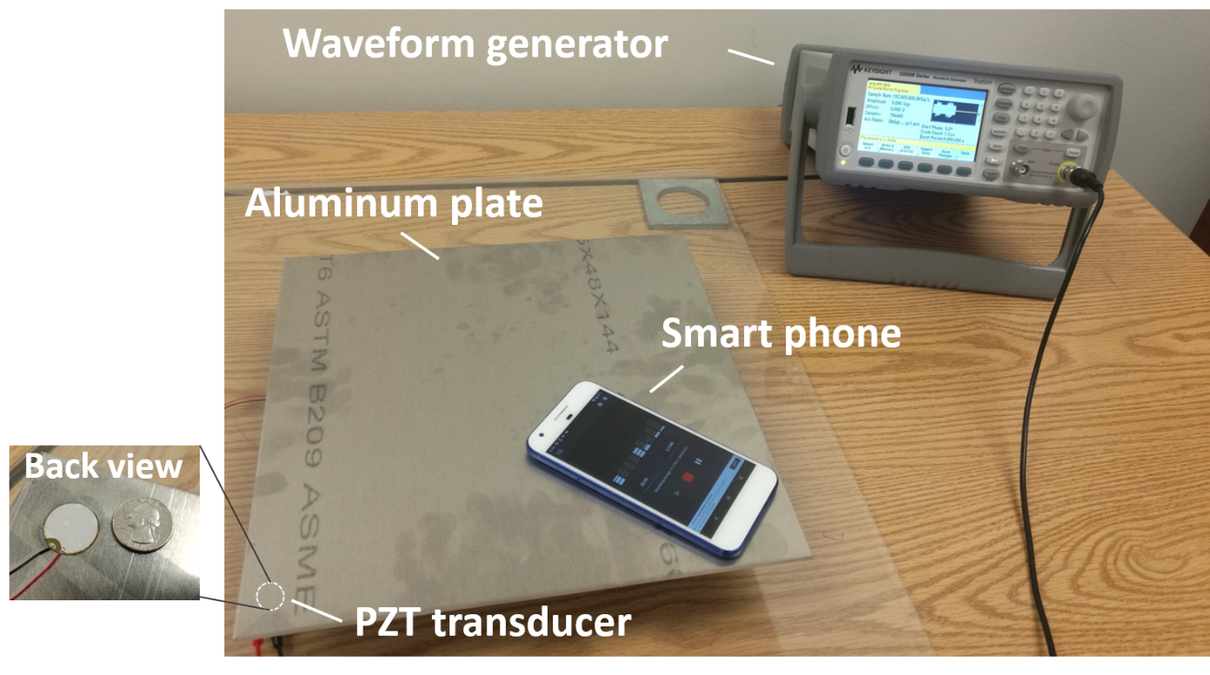
Trigger Non-linearity Effect
Design
Baseband signal : 50Hz to 5kHz
Modulated to 25.3kHz
Excite Lamp Wave

Slide 13
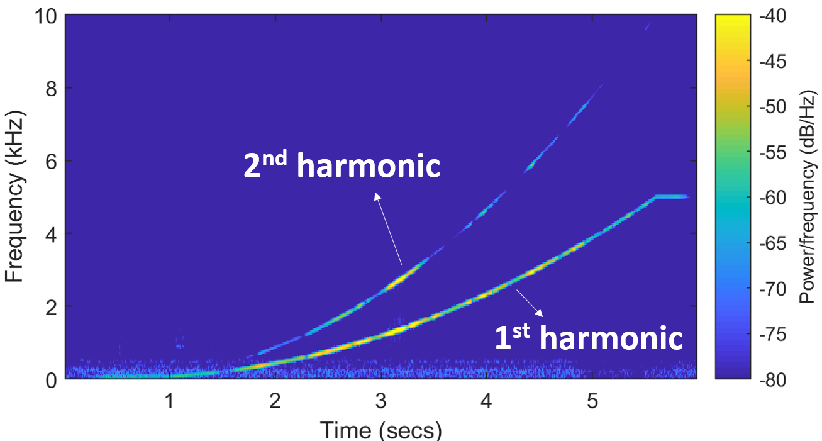
Trigger Non-linearity Effect

Slide 14
Attack Waves Generation
To preserve the similarity between the recovered voice signal and the original signal, we choose Tukey window for modulation:
$$e\left(t\right)= \left(1 +m∗v\left(t\right)\right)∗w\left(t\right)∗cos⁡(2πf_{c}t)$$
Depth of modulation 0.8~1.0
Baseband Signal
Tukey Window
Carrier Frequency
3 Key Factors
$$m$$
$$r$$
$$f_{c}$$

Slide 15
Feasibility
To tackle the 3 factors, we can attack phones as below:
Manufacture | Model | Assistants | Attacks
 |  |  | Recording | Activation | Recognition
Google | Pixel 1, 2, 3 | Google
Moto | G5 | Google
 | Z4 | Google
Samsung | Galaxy S7 | Google
 | Galaxy S9 | Google
 | Galaxy Note 10+ | Google
Xiaomi | Mi 5, 8 | Google
Huawei | Honor 10 | Google
Apple | iPhone 5, 5s, 6+, X | Siri

Slide 16
Attack System Design
Controller
Attack Device Package
Voice
Recording
Voice Response
Signal Modulation
& Voice Recording
Tapping Device
Voice
Commands
TTS
Module
Speech Synthesis
Signal
Processor
Interactive Voice Commands
Transducer

Slide 17
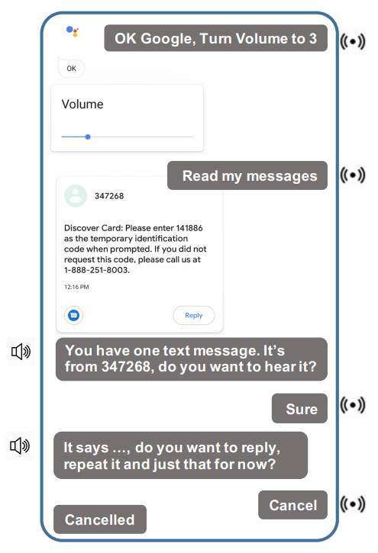
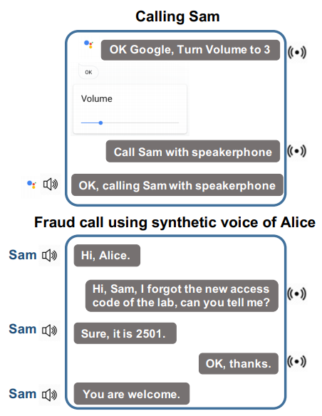
Attacks
SMS Passcode Hacking
Fraud Call

Slide 18
Stealthiness
You cannot sense the attack:
No sound
No vibration
PZT transducer and waveform generator
are hide under the desk

Slide 19
Impact of Noise
Attack Distance
30cm
Attack Voltage
9V
Google Pixel 1
Scene | Noises (dB) | “OK google” | “Read my message”
Office | 55-65 | 100% | 100%
Café | 65-75 | 100% | 90%
Restaurant | 75-85 | 100% | 80%

Slide 20
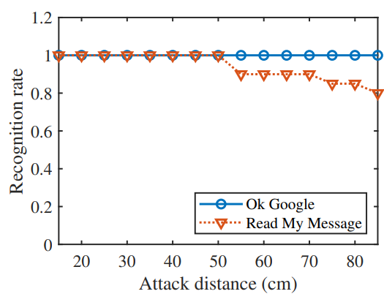
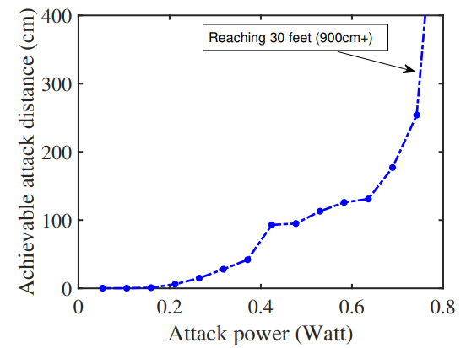
Impact of Distance
No Amplifier
With Amplifier
$6inch×30 feet$ Aluminum coil

Slide 21
Impact of Thickness
Aluminum Metal
Glass
Thickness (inch) | Recognition Rate (9V) | Recognition Rate (30V) | Recognition Rate (9V) | Recognition Rate (30V)
1/16 | 100% | 100% | 100% | 100%
1/8 | - | - | 100% | 100%
3/16 | 100% | 100% | 50% | 90%
1/4 | 70% | 100% | 10% | 90%
3/8 | - | - | 0% | 100%
1/2 | 0% | 100% | - | -
1 or 1.5 | 0% | 100% | - | -
The thicker materials requires higher transmit power

Slide 22
Impact of Thickness

Slide 23
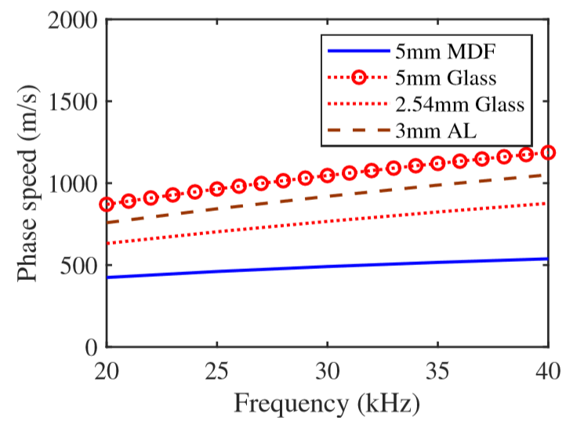
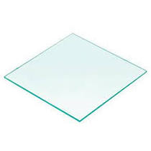
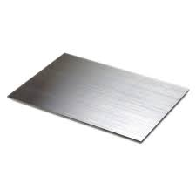
Impact of Different Materials
To measure the materials difference, we test
the achievable attack distance on those
materials with 3 phones.
 | Aluminum Metal Sheet (0.3 mm) | Steel Metal Sheet (0.8 mm) | Glass (2.54 mm) | MDF (5 mm)
Xiaomi Mi 5 | 910+ cm | 95+ cm | 85+ cm | 50cm
Google Pixel | 910+ cm | 95+ cm | 85+ cm | 45cm
Samsung Galaxy S7 | 910+ cm | 95+ cm | 85+ cm | 48cm

Slide 24
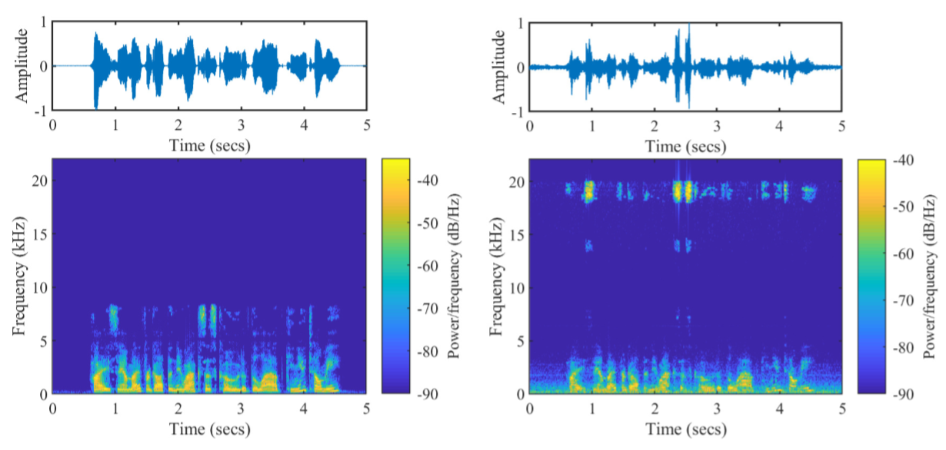
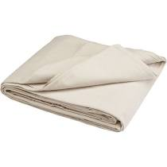
Countermeasure
Hardware Layout Enhancement
Enhance microphone to suppress any acoustic high frequency vibration
Interlayer-based Defense
Place device on a soft woven fabric or a multilayers term.
Software-based Defense
Difference between recovered signal and the baseband signal

Slide 25
Conclusion
We proposed a voice assistant attack which is:
Low power
Cheap
Inaudible
Long distance interaction
No vibration
Reliable on different tables that have different materials and thickness
Noise resistant
None line of sight

Slide 26
Thank you!

