Slide 1
SpecPatch: Human-in-the-Loop Adversarial Audio Spectrogram Patch Attack on Speech Recognition
Hanqing Guo, Yuanda Wang, Nikolay Ivanov, Li Xiao, Qiben Yan
Michigan State University
SEIT Lab
Notes:
Hello everyone, I am hanqing guo, a phd student from Michigan state university, today I am glad to share our work, SpecPatch XXX, this work is done with my labmate XX, XX
Too much “we”, as victim or the adversary; “I will introduce XXX”
Limit to 13~14 minutes; Cut some slides; 15 minutes including everything.

Slide 2
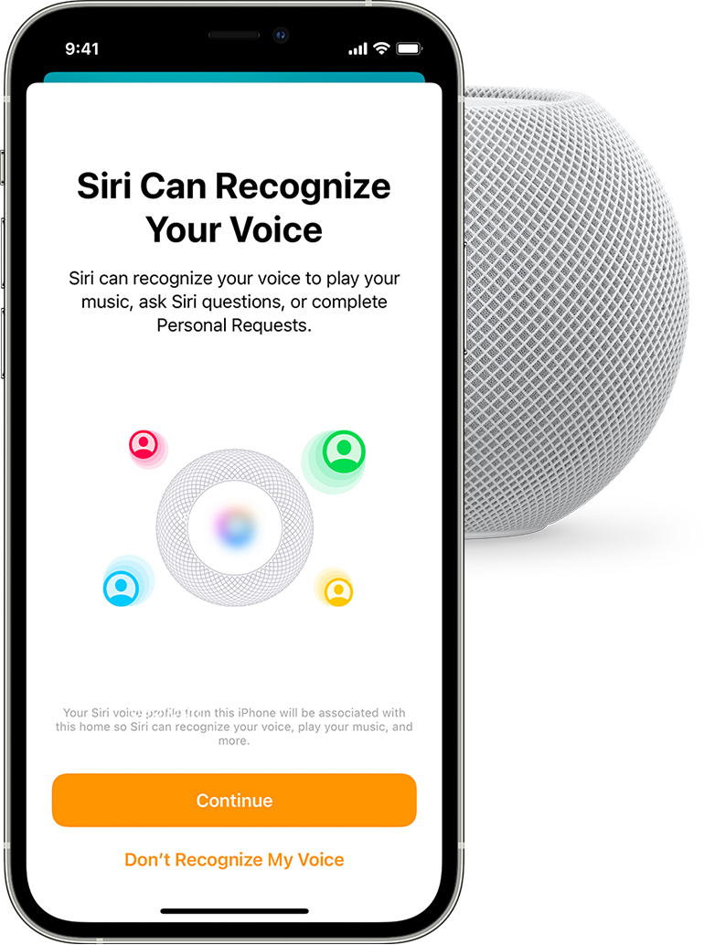
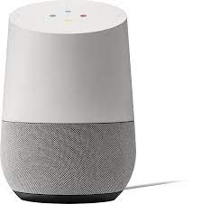
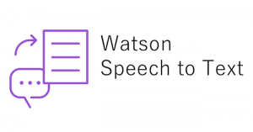
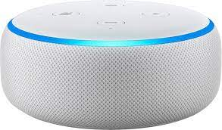
Automated Speech Recognition (ASR) in our life
Siri
Google Home
IBM Watson
Amazon Echo
Read my message
Send a message to Bob
Calling Alice
Open the door
Notes:
Automated Speech recognition models are very popular in our daily life to make our lives easier. For example, Siri, google home, IBM Watson, and amazon echo, they can listen to the users’ command and conduct it like read my message, send a message to someone, call someone, or even help you open the door and turn on the lights.

Slide 3
Threats for ASR models
USENIX ’20: Devil’s Whisper NDSS ’19: Metamorph
CCS ’21: OCCAM
“Turn off light”
Attack by playing the adversarial examples
Attack by playing the perturbations
CCS ’20: AdvPulse
“open”
“close”
Notes:
However, those ASR models are proved to be vulnerable to adversarial attacks, the adversary craft perturbations, and inject the hidden command to mislead the ASR model, and conduct false operations.

Slide 4
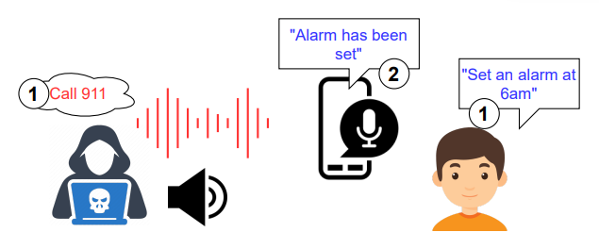
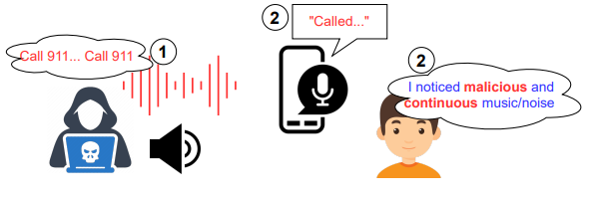
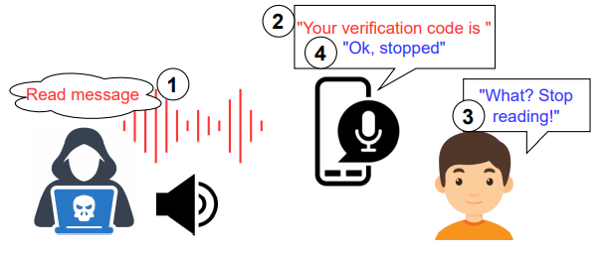
Failure cases of existing attacks
User Interference
User Perception
User Interaction
Notes:
Display one by one; prou: audio sample;
User Interference: while the adversary and the user pronounce commands concurrently (e.g., the AE says, “call 911”, and the user speaks, “set an alarm at 6 am” at stage ①), the ASR system tends to accept the user’s command rather than the AEs; in this case, it will respond with “Alarm has been set”.
User Perception: Although the adversary might craft imperceptible AEs by encoding the adversary command into songs or different speeches, the user is still able to locate the source of skeptical sound because of the long duration and repeated appearance of common audio adversarial attacks.
User Interaction: the adversary launches the attack by playing the “read message” adversarial audio at stage ① , followed by the successful response from the ASR system reading the message containing a personal verification code at stage ② . However, when the user is present, he/she is conscious of the abnormal behavior of the ASR device and tries to interact with the ASR system by sending a halting command (such as “stop reading”) at stage ③ to regain the control. Consequently, the ASR system follows the user’s benign command and terminates the reading process.

Slide 5
How do we resolve these failure cases?

Slide 6
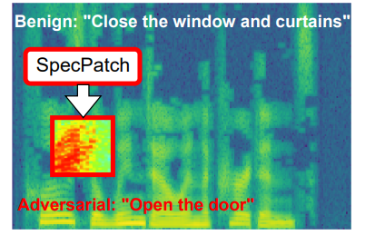
SpecPatch idea
Robust to environmental changes
Imperceptible
Denial of services
Notes:
Motivated to the computer vision domain that place a patch on the picture and changes the picture’s classification result, we expect to place a patch in spectrogram domain and change the commands from the user. There are three major benefits of utilizing patch to attack the ASR model.
Robust: it is robust to any benign commands from the users.
Imperceptible: Patch is short in time range and limited in frequency band. if it is carefully crafted on specific frequency for example human insensitive hearing frequency band, it will be hard to be noticed.
Denial of service: small patches can mislead the spectrogram to silent prediction, and therefore prevent the users from correcting their commands, causing denial of service attack after deliver the melicious commands.

Slide 7
Challenges
Inside patch region
outside patch region
Single patch cannot impact input outside the patch region
0.5s
Short patch cannot impact long sentence
Only perturb Single word in previous work
Patch need to work for all user’s input context
Notes:
Inside the patch length, outside of patch region

Slide 8
How do we address these challenges?

Slide 9
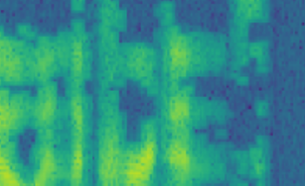
System design
Generating Patch
Muting user interaction
Generating universal patch
Over-the-air patch
0.5s
“stop open my door”
“open the door”
“stop open my door”
Any context
Notes:
make as animation; system architecture design in every page. Highlight the current page in the design.

Slide 10
Generating Patch
Muting user interaction
Generating universal patch
Over-the-air patch
Benign: “Close the window and curtains”
o p e n
w i n dow
Target: “open the door”
Node inter-transition is not enough to deliver long commands because the CTC loss is not converged

Slide 11
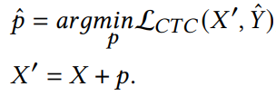
Generating Patch
Muting user interaction
Generating universal patch
Over-the-air patch
Partial matching
Reduce CTC searching space
Before: “open curtains”
After: “open the door window and curtains”
Extend impact length

Slide 12
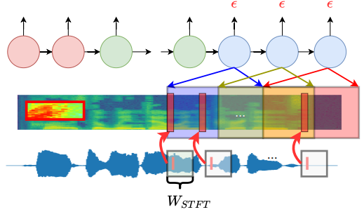
Generating Patch
Muting user interaction
Generating universal patch
Over-the-air patch
Mute patch only perturb single sample to affect the entire window
Notes:
Add title for this page

Slide 13
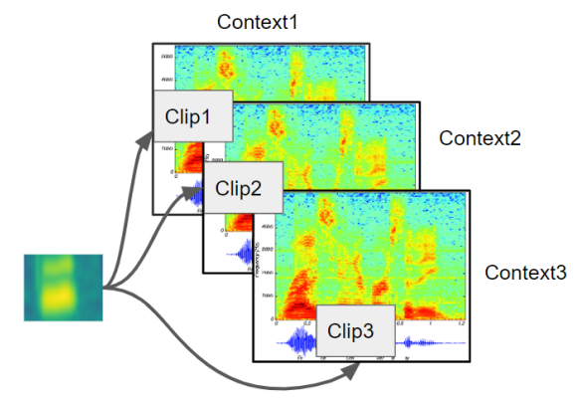
Generating Patch
Muting user interaction
Generating universal patch
Over-the-air patch
Notes:
Third step of the system.

Slide 14
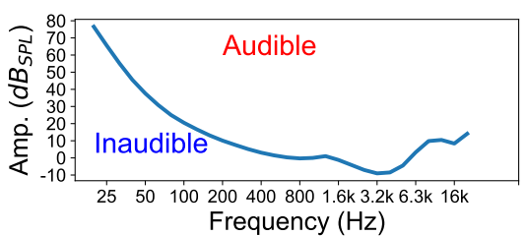
Generating Patch
Muting user interaction
Generating universal patch
Over-the-air patch
H(f): human equal loudness contour
Find patch frequency band
Penalize the auditory perceptual level
Notes:
Summary for the whole procedure. Make block bigger; Recap 1-4 steps; Then goes to the evaluation

Slide 15
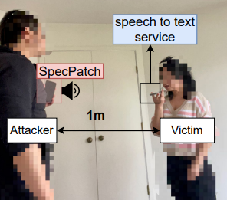
Evaluation setup
Target model: DeepSpeech2
Benign dataset: TIMIT
Target dataset: ok-google.io
- Commonly used commands
Implementation: Tensorflow
Over-the-line: Attack with the patched audio file
Over-the-air: Attack the DeepSpeech service that embedded on phone
Notes:
Evaluation setup; Dataset, target model, how many round;

Slide 16
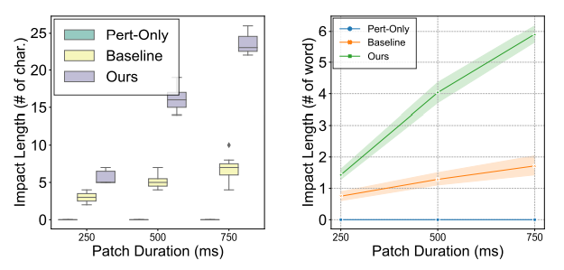
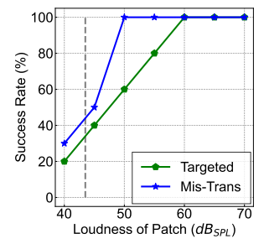
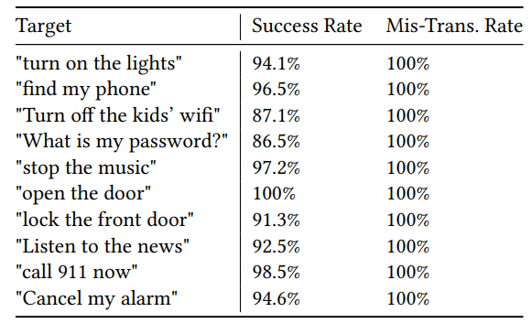
Evaluation
Mute patches appears periodically
SpecPatch shows low volume
Patch only takes 0.5s with limited frequency
Over-the-line: High success rate
Patch extends the impact length to 3~4 words
Over-the-air: Succeed when patch is loud
Notes:
Evaluation setup; Dataset, target model, how many round;

Slide 17
Conclusion
We propose an adversarial patch-based spectrogram-level attack
We enable using a single patch to deliver long command
We design mute signals to alleviate human interaction during attack
We perform our attack in real world scenario

Slide 18
More demos
Questions?
SEIT@MSU

Slide 19
Demos
Benign
Adversarial
“Turn on the lights”
“open the door ----”
“close the window and curtains”
“open the door window and curtains”
“Turn on the lights”
“---------------------”
Notes:
After the demo, need a conclusion

