Slide 1
SUPERVOICE: Text-Independent Speaker Verification Using Ultrasound Energy in Human Speech
Hanqing Guo, Qiben Yan, Nikolay Ivanov, Ying Zhu, Li Xiao, Eric J. Hunter
Michigan State University
SEIT Lab
Notes:
Hello everyone, my name is Hanqing Guo, a Phd student in Michigan State University. Today, I am glad to share our work: SuperVoice …

Slide 2
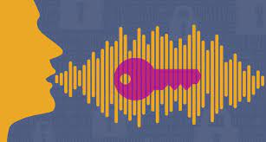
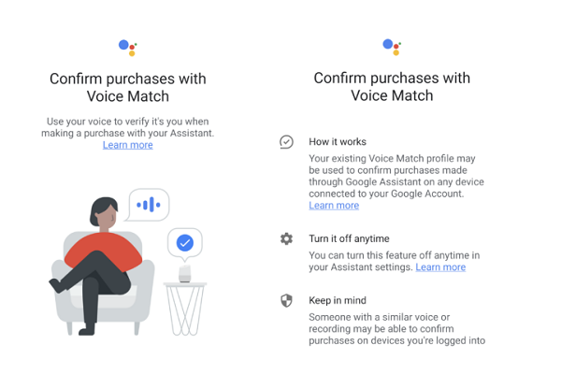
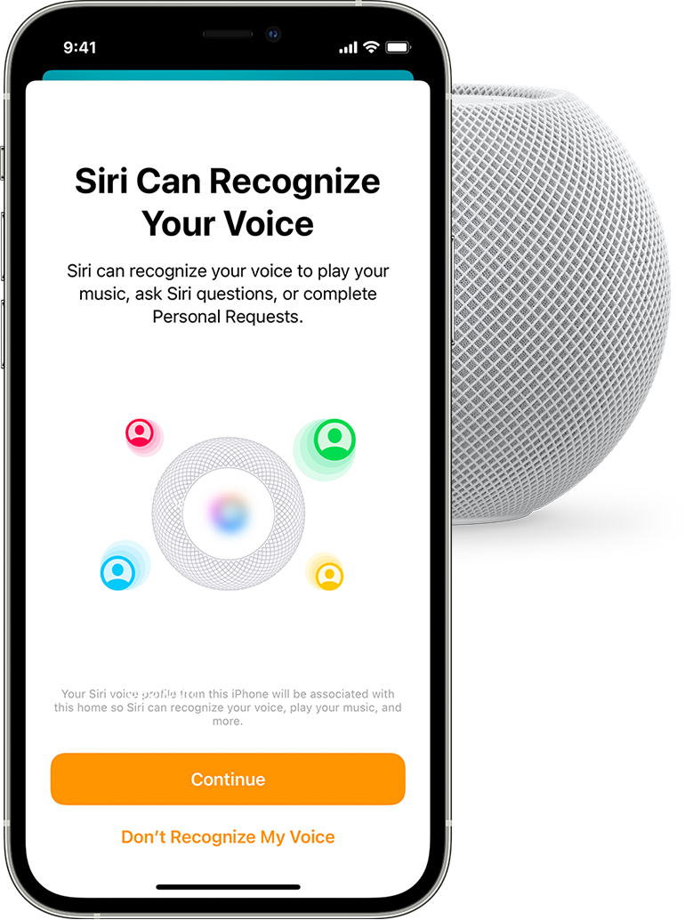
Voice Biometrics
Usability: Talk to verify
Convenience: Anywhere; Anytime; Hand-free
Accuracy: Need improvement
Security: Need improvement
Google Assistant
Navy Federal Credit Union
Siri Voice Recognition
Notes:
Voice biometric is more and more popular because it’s usability and convenience. User can use their voice to secure their applications such as google assistant, banking service, and siri at anywhere, and anytime. However, the accuracy and the security of voice biometric are imperfect and need to be improved.

Slide 3
Security Risks
Replay Attack
Voice Synthesis
Voice Conversion
Adversarial Attack
Bob
Bob’s phone
Notes:
Generally, there are 4 critical risks exist. The replay attack collects victim’s (Bob) sound by hidden microphone, and replay it to attack bob’s application. The voice synthesis attack uses bobs audio clips from internet, and synthesis them together to perform the attack. The voice conversion attack use deep learning models to convert other speaker’s speech to Bob’s sound. While the adversarial attack craft perturbations to a benign audio, and deceive the Bob’s speaker identification model through a loudspeaker.

Slide 4
Voice Biometrics – Previous Work
Limit Usage & Heavy models
CaField CCS’ 19 [3]
GE2E ICASSP’ 18 [6]
Use More Data Source
Acceleration (Mobicom’ 17) [1]
Field (ICDCS’ 17) [2]
articulatory (CCS’ 17) [4]
Wi-fi (MobiHoc’ 18) [5]
[1] Continuous Authentication for Voice Assistants
[2] You can hear but you cannot steal: Defending against voice impersonation attacks on smartphones
[3] The catcher in the field: A fieldprint based spoofing detection for text-independent speaker verification
[4] Hearing your voice is not enough: An articulatory gesture based liveness detection for voice authentication
[5] Wivo: Enhancing the security of voice control system via wireless signal in iot environment
[6] Generalized End-to-End Loss for Speaker Verification
Notes:
To address the security risks and improve the identification accuracy, prior works proposed to introduce complex machine learning model (for example, GE2E), or enrich the data source from acceleration, electronic field, ultrasound sensors, or wifi node to facilitate speaker identification. However, some of them limits the use position, and computational cost, while the others require external hardware and cause inconvenience in use.

Slide 5
Our Findings High Frequency Energy can be used to identify human users!

Slide 6
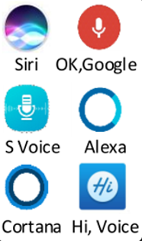
All Previous Work Neglects High Frequency Energy (HFE)
HFE takes more resources to store and process (high sampling rate)
HFE may contain noise
HFE is not proved to be representative for user identity
Notes:
We find that All Previous Work Neglects High Frequency Energy (HFE) in the signal processing steps. More specifically, the LPF and ADC will eliminate the HFE component. There are 3 reasons to reduce the HFE in conventional approaches.

Slide 7
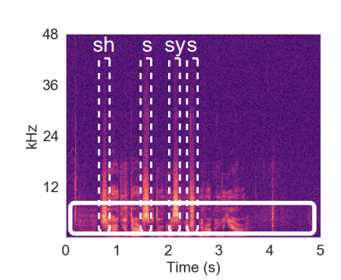
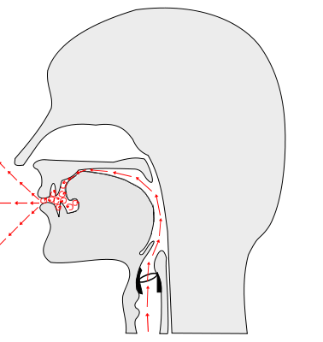
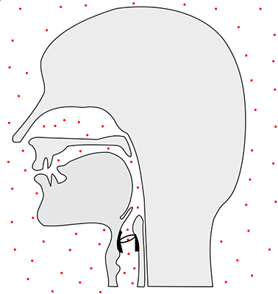
Is the HFE noise?
“She had your dark suit in greasy wash water all year”.
Fricatives
Stops
Human can produce HFE!
Notes:
First, we find that human can produce HFE. For specific phonemes such as fricative and stops, the speech organs narrow the airstream to cause friction, or stopped the airstream suddenly and then released, will produce high frequency components. We record an utterance from a volunteer says “She XXX” with ultrasound microphone, they find some phonemes such as sh, s, sy, indeed have energy up to 40kHz.

Slide 8
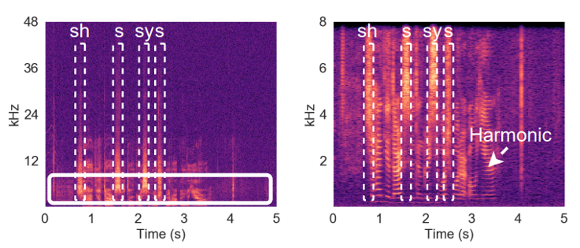
Only use Low frequency data may not be enough!
Many phonemes have HFE and show low amplitude of LFE. (e.g., [sh], [p], [t])
Neglecting HFE causes information loss!
Notes:
With known that human can produce HFE, we further analyze whether we need it. When we investigate the energy source of the HF component, we find that most phonemes with HFE are actually lack of LFE information shown with low amplitude in the second figure. If we only focus the LFE, those phonemes information will lost and causes incomplete speaker voice print.

Slide 9
Can HFE represents human identity?
Same person, different utterances
Diff person, same utterance
HFE contribute to represent human identity!
Notes:
We conduct preliminary study to answer the question “Can HFE represents human identity?”. We select the phonemes with HFE and present their cumulative energy over the frequency. We find In the left two figures, for same person and different utterences, it shows consistent trend for frequency between 18-40kHz. While the LF traces of those phonemes are dispersed with high variance. As for different persons, the phonemes with HFE shows distinguishable difference for same utterance. Then we can conclude that HFE contribute to represent human identity.

Slide 10
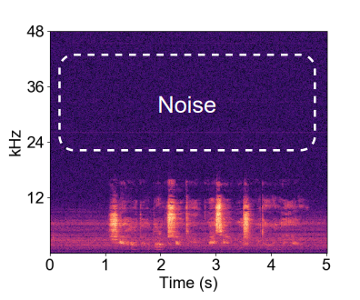
Is HFE present in loudspeaker-based attacks?
DAC
Digital Signal
DA Converter
Amplifier
HFE is not present in loudspeaker’s sound
Notes:
Many signal processing steps eliminate the HFE, for the data source, the LPF and ADC constrain the frequency band. In the attack side, the source data and DAC sampling rate limit the HFE present. As the result, HFE is not present in most loudspeaker-based attacks.

Slide 11
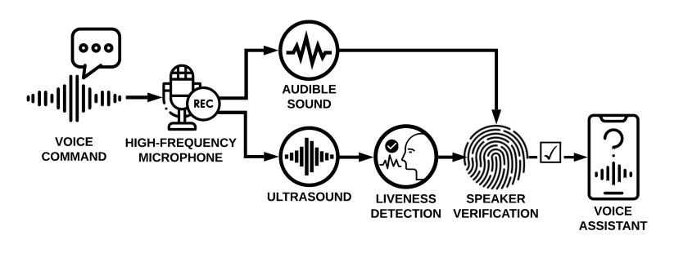
How to exploit HFE?

Slide 12
Workflow of SuperVoice
Notes:
In the verification step, given an unknown source, we first perform the liveness detection algorithm. If the sound is generated by a real person, this module returns True to further proceed to speaker embedding model, then we identify the sound source by comparing the current speaker embedding with the claimed embeddings. Otherwise, our model will reject the machine produced sound, or unauthorized speakers’ sound.

Slide 13
Design of SuperVoice
Notes:
The supervoice contains two model, liveness detection and speaker verification. We will explain the design of them step by step.

Slide 14
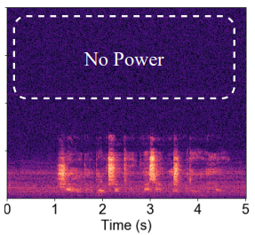
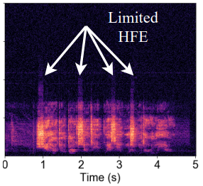
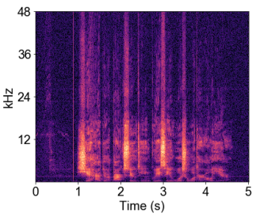
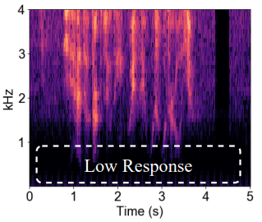
Liveness Detection
Attackers record and replay with commercial devices:
Attackers record with high-end microphones and replay with commercial speakers:
Attackers record with high-end microphones and replay with ultrasound speakers:
Notes:
At the third scenario, when the attacks record XX, we observed that there are low response of the ultrasound speaker at low frequency range. By exploiting this property, we can design algorithm to detect this attack.

Slide 15
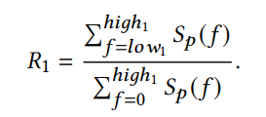
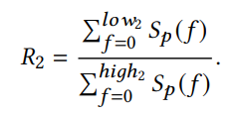
Liveness Detection
Assure HFE exist
Assure LFE exist
Notes:
We use two factors R1 and R2 to run our algorithm. The R1 computes the accumulative energy between frequency low 1 and high 1, it can assures the HFE exist. and R2 is designed to find the portion of low frequency energy, in the green pattern, it computes the accumulative energy of the selected green region, such that it prevent the powerful attacker who have ultrasound microphone and ultrasound speaker. When combine these two factors together, we can distinguish the sound source is from human or a machine.

Slide 16
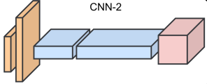
Speaker Verification
SincNet
LFE: waveform
HFE: spectrogram
Vertical filter
Horizontal filter
T-F filter
Notes:
For the speaker verification model, we use two different neural network architecture to process the LFE and HFE. For the LFE, we follow the design of SincNet, which takes LF waveform as input, and produce LF feature. For the HFE, we customize a CNN model that composed of three types of filters: vertical filter to extract frequency information, horizontal filter to compute the time information, and the spare filter to extract the spatial feature of spectrogram.

Slide 17
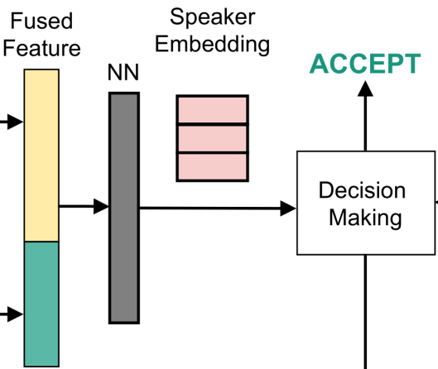
Speaker Verification
LFE Feature
HFE Feature
Liveness Detection
REJECT
Notes:
At the end, we concatenate the LFE feature and HFE feature together, and introduce a linear layer to shrink the feature size, resulting in a speaker embedding. By considering the liveness detection result and the speaker embedding difference between the current one and the exist embeddings, our model make final decision to accept of reject the unkonwn sound.

Slide 18
Experiments

Slide 19
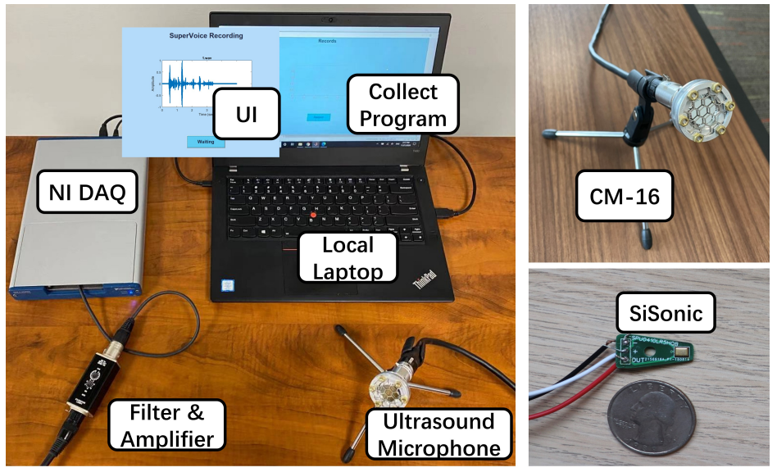
Data Collection
Notes:
Since there is no speech dataset that include HFE of human, we collect our own dataset with the shown setting.

Slide 20
Data Collection
Common: commonly used sentences
“Please recognize my voice”
Compact: rich phonetic contexts
“She had your dark suit in greasy wash water all year”
Fricative: commands include HFE
“Turn on my lights”
Non-fricative: commands without HFE
“Lock the door”
Notes:
There are 4 types of senetence we asked the volunteer to read. Common, compact, fricative, and non-fricative.

Slide 21
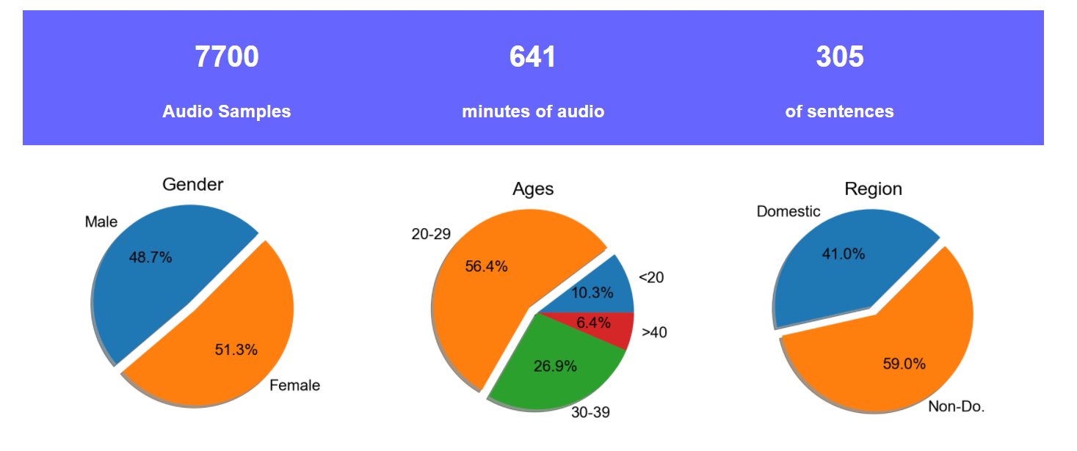
Data Collection – The first speech dataset with HFE!
https://supervoiceapp.github.io/
77
volunteers
Notes:
Website link (bigger link). (Add time span we collect data)

Slide 22
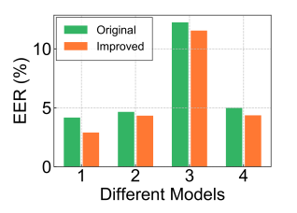
Results
Adopt HFE to existing models:
SincNet
VGGVox
GMM-UBM
GE2E
SuperVoice enhances existing models!
Notes:
We first validate that whether HFE can facilitate existing speaker verification model. With adding the HFE to 4 existing models: Gassian model, sincNet model, vgg model and GE2E model, we find that all the models achieve better performance with lower Equal error rate.

Slide 23
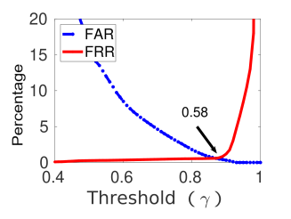
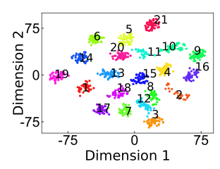
Results
EER
Speaker Embeddings
SuperVoice achieves SOAT performance!
Notes:
Next, we draw the EER result of our model by changing the similarity threshold, we achieve the best EER with 0.58, which outperform all the aforementioned models. We further compress the speaker embeddings to two dimension with 21 speakers, each contains 30 audio samples. We can find that all the speaker embeddings aggregate tightly and show clear boundary, which indicate the speaker embeddings are representive to different speaker identity.

Slide 24
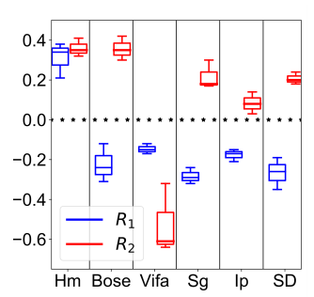
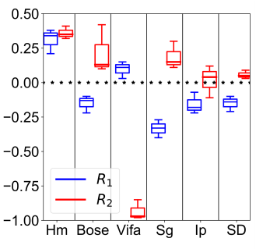
Results – Ability to detect attacks
Normal audio source
Ultrasound audio source
SuperVoice is efficient to perform liveness detection!
Notes:
We evaluate the liveness detection performance with 2 different setting and 5 loudspeakers (boss, vifa ultrasound speaker, Samsung s9, iphone x, Sada speaker). Compare to the human’s sound that have both R1 AND R2 greater than 0 for all cases, the attacker that only possesses normal audio source can never make R1 > 0 because the audio source does not contain HFE. In other case, if the attacker have the ultrasound source, regular loudspeakers cannot produce those HFE, result in low R1 value for 4 conventional speaker. As for the ultrasound speaker, even though it achieves positive R1, it failed to generate positive R2 due to lacking of low frequency energy. In total, we achieve 100% accuracy to differentiate between user and machine. Compares to all existing liveness detection models, we use only 4 features and achieve the best performance with fastest speed.

Slide 25
Discussion & Conclusion
We find the ultrasound in human voice can identify user
We collect the first dataset with ultrasound microphone and open source it. https://supervoiceapp.github.io/
We design a hybrid model to improve the performance
We achieve 0.58%EER for speaker verification and 0% EER for liveness detection.
Notes:
Website link

Slide 26
SEIT Lab@MSU
Questions?
Dataset
Notes:
QR code with link (QR Code)

