Slide 1
NEC: Speaker Selective Cancellation via Neural Enhanced Ultrasound Shadowing
Hanqing Guo, Chenning Li, Lingkun Li, Zhichao Cao, Qiben Yan, Li Xiao
Michigan State University
SEIT Lab
Notes:
Hello everyone, my name is Hanqing Guo, a Phd student in Michigan State University. Today, I am glad to share our work: NEC … This work is collaborate with Chenning Li, Lingkun Li,

Slide 2
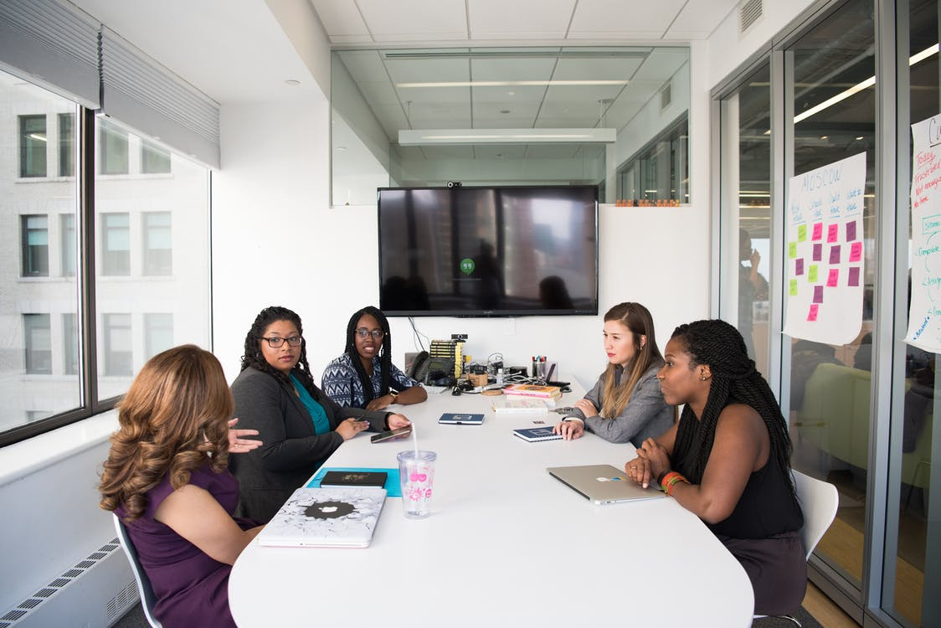
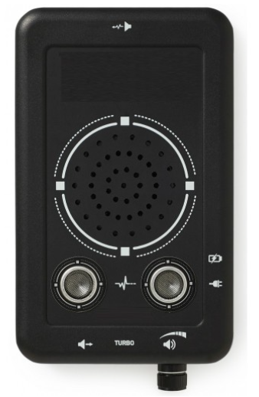
Microphone Jammer
Meeting Room
Home
Office Room
Jammer [1]
[1] https://thestealthmall.com/mall/home/140-audio-jammer-ultrasonic-supressor-noise-generator-gtg-2.html
Notes:
Microphone jammer is used for preventing unauthorized recording. They can be deployed on meeting room, personal home, and the office room to protect the privacy of your conversation.

Slide 3
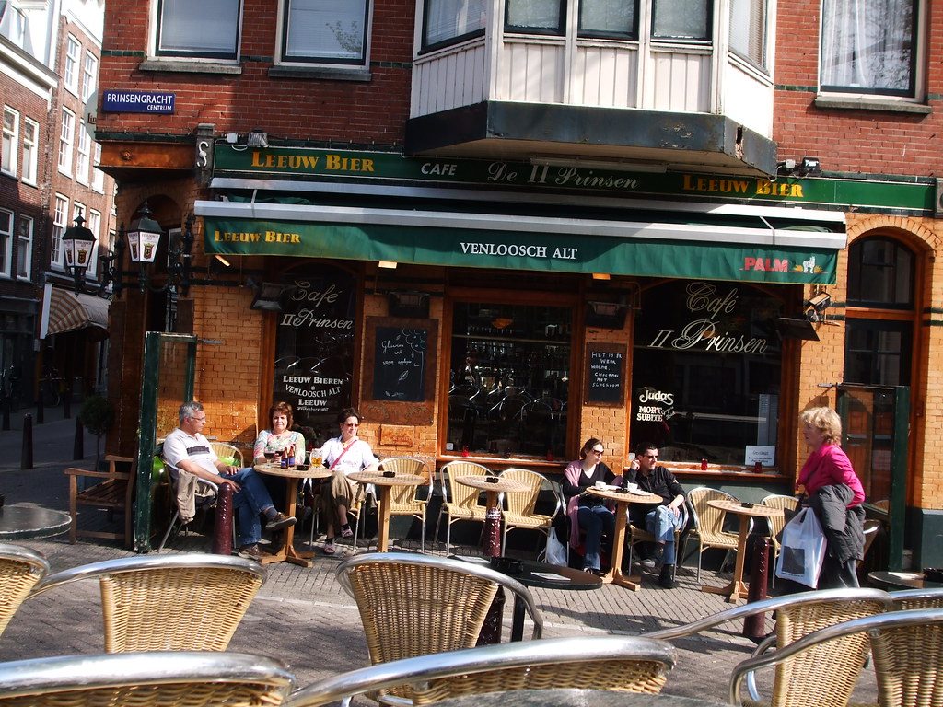
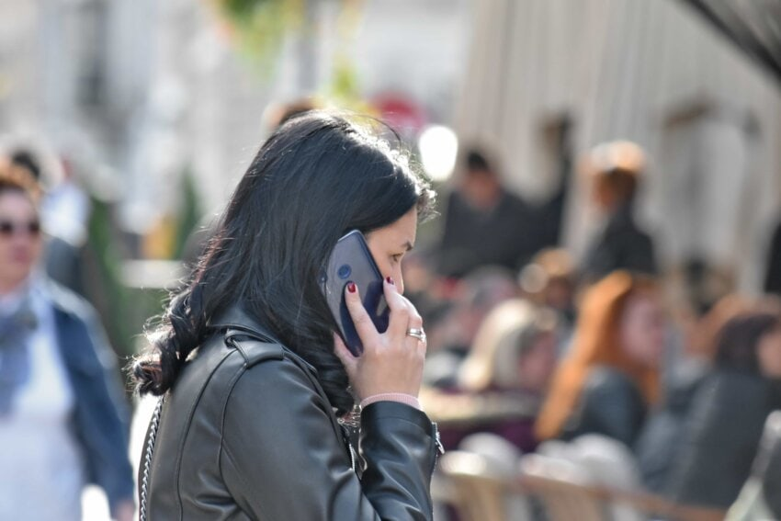
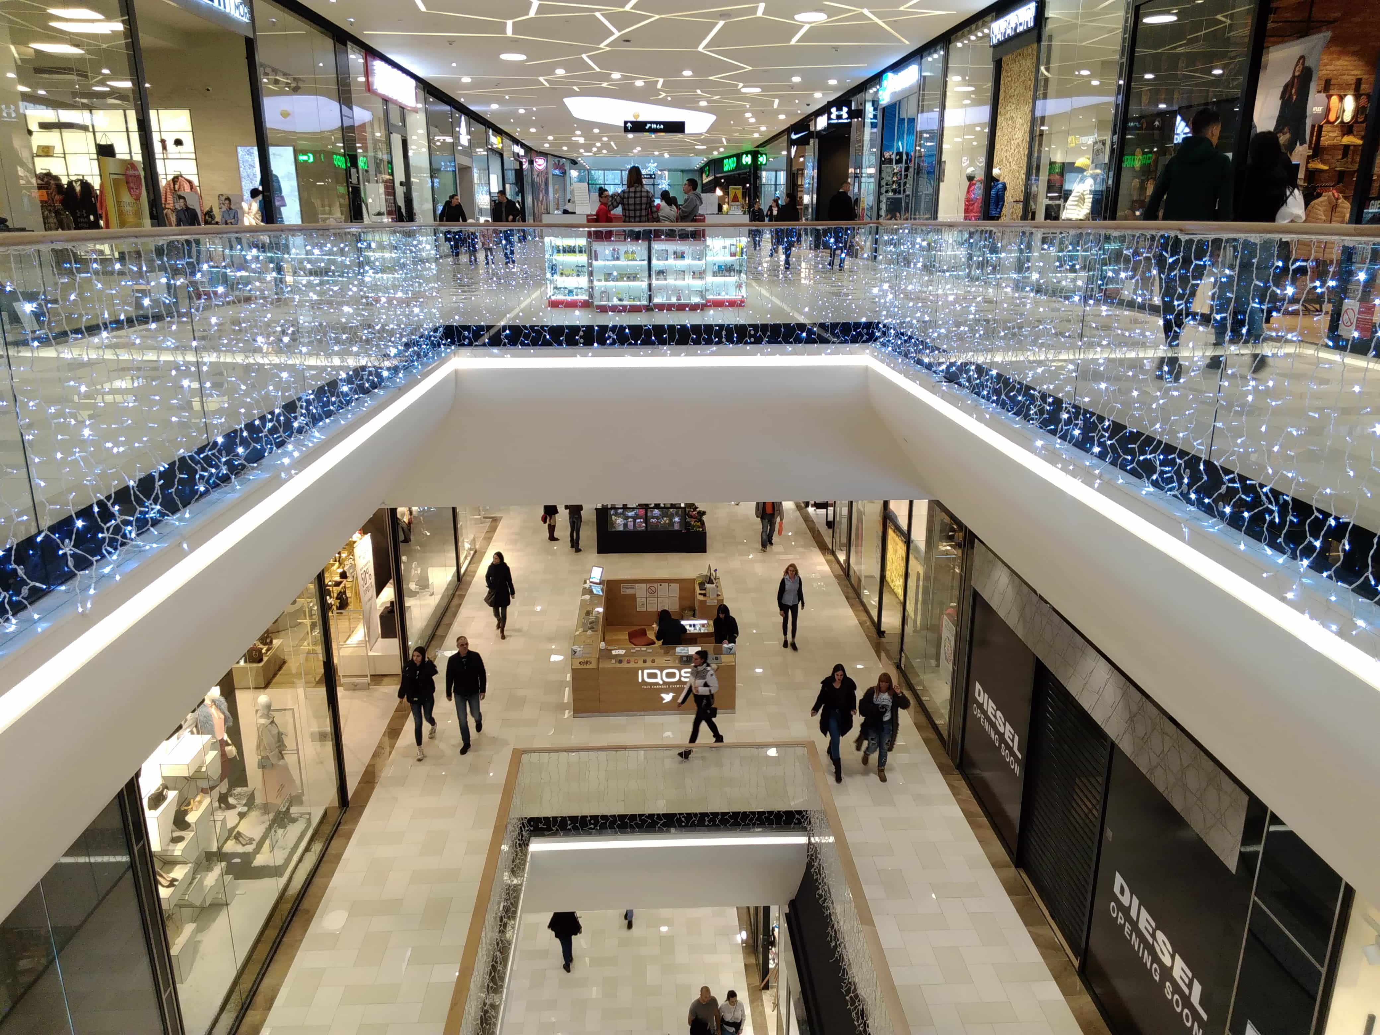
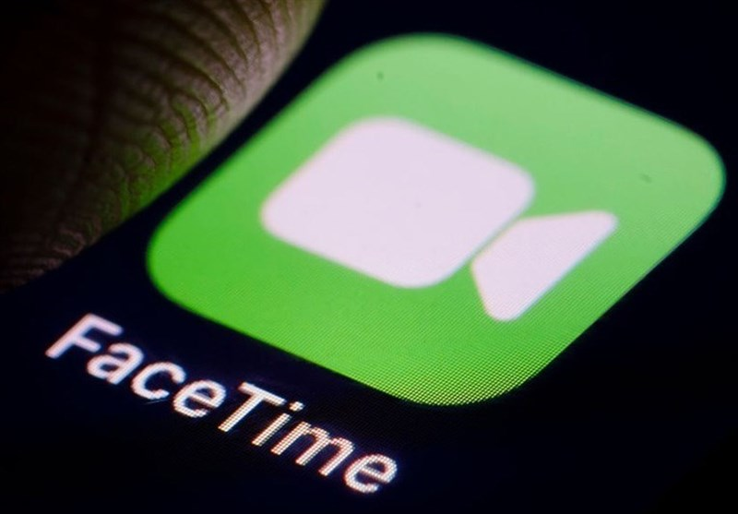
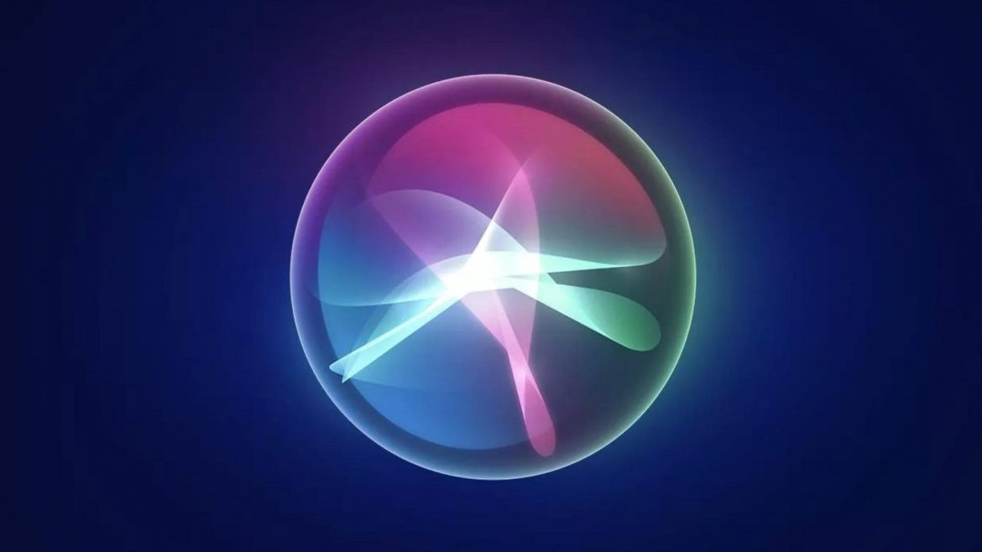
Microphone Jammer – Risks in Public Places
Cafe
Street
Shopping Mall
This Photo by Unknown Author is licensed under CC BY-SA
911 Call
Notes:
However, those microphone jammers cannot be used in public areas such as a café, street, or shopping mall because they pose serious risks to public communications. For example, all affected users cannot make a 911 call, and cannot use their microphone powered applications such as facetime, siri and voice reminder because the microphone jammer will produce powerful noise towards all the microphones.

Slide 4
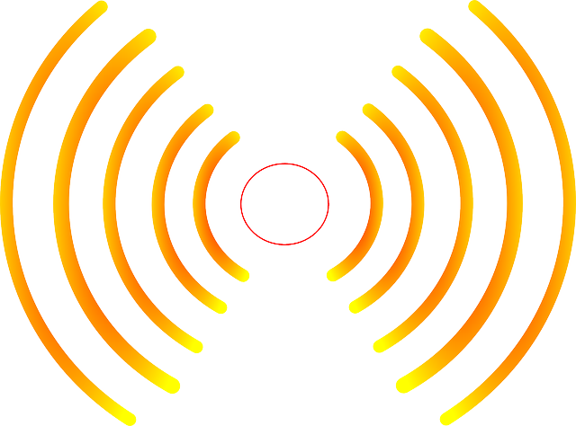
Microphone Jammer – Insecure
Adversary
Speech
+
denoising
Constant Noise Pattern
Jammer
Recover Speech
Notes:
Besides, the conventional microphone jammers are insecure because the noise design is simple. For example, In a meeting room with a conventional jammer, the adversary will record the benign speech with different noise pattern. For smart adversary, he can utilize denoise algorithms to eliminate some white noise, or learn the frequency pattern of the noise, so that reduce the noise level of recording, and therefore recovering the benign speech.

Slide 5
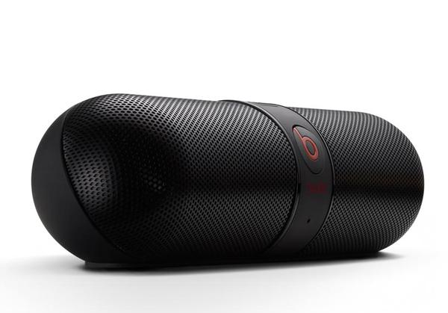
Design Goal
Portable: Easy to take
Private: Only protect user’s voice, not affect others’ use
Secure: The noise pattern is complex
Portable
Private
Secure

Slide 6
System Design

Slide 7
Background – Ultrasonic Jamming
Eavesdropper
User
Inaudible to human
Ultrasound
Noise
Jammer
Sensed by microphone [2]
Non-linearity of the amplifier
[2] Roy, N., Hassanieh, H., & Roy Choudhury, R. (2017, June). Backdoor: Making microphones hear inaudible sounds. MobiSys’17
Notes:
Let me give some backgrounds about microphone jamming. A jammer first produces ultrasounic noise, and those ultrasounic noise can not be heard by humans. However, it can be sensed by the microphone because of the non-linear effect. The non linear effect is first reported in mobiSys senventeen, they found that the amplifier in the microphone will amplify signals in a non-linear manner, which will generate the harmonic of the original signal. If the original signal is ultrasound, then the harmonic will retain its baseband information.

Slide 8
Our idea – User-Specified Noise
I can’t record what Bob is talking about
Bob
Constant Noise Pattern
Eavesdropper
Bob’s Jammer
I can use my microphone
User-Specified
Noise
Alice
Alice
Only destroy Bob’s sound
Notes:
In our work, say bob is the user who want protect his voice, and alice is someone else close to Bob. We use a neural network model to differentiate the owner of the sound, then we use ultrasound speaker to generate the user-specified ultrasound noise. So that bob’s sound is invisible to all microphones, and Alice’s sound would be retained on her microphone side. With this idea, we can enable to usage of microphone jammer in public area.

Slide 9
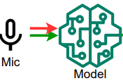
Our idea – Workflow
Generate user-specified noise
User: Bob
NEC
1
Ultrasound speaker
2
Inaudible
Alice
Overshadowing
Notes:
Our device, called NEC, contains a microphone, a machine learning model and an ultrasound speaker. In our work, say bob is the user who want protect his voice, and alice is someone else close to Bob. We use a neural network model to differentiate the owner of the sound, then we use ultrasound speaker to generate the user-specified ultrasound noise. So that bob’s sound is invisible to all microphones, and Alice’s sound would be retained on her microphone side. With this idea, we can enable to usage of microphone jammer in public area.

Slide 10
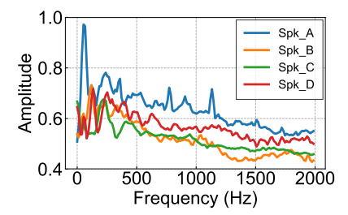
Stage1: Why can model separate user’s sound?

Slide 11
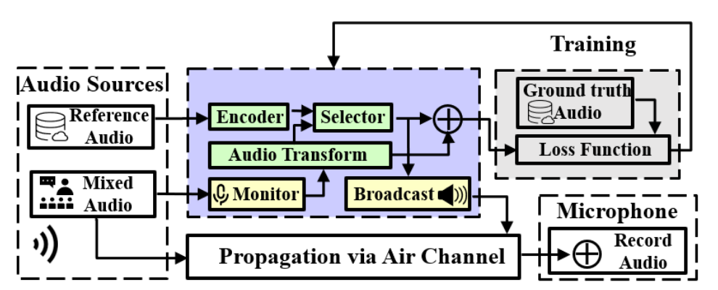
Stage1: Offline training

Slide 12
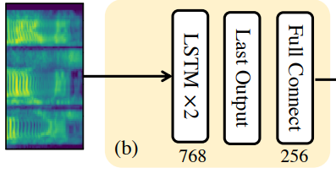
Stage1: Encoder
Bob’s embedding
Reference audio
[3] Heigold, G., Moreno, I., Bengio, S., & Shazeer, N. (2016, March). End-to-end text-dependent speaker verification. ICASSP from Google Speaker Verification

Slide 13
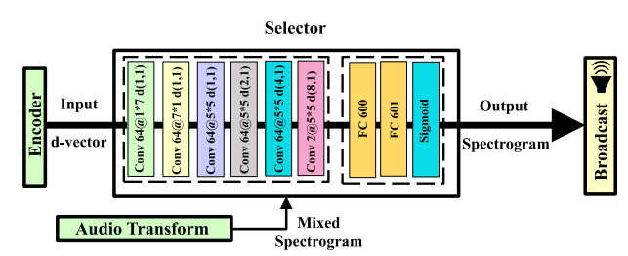
Stage1: Selector
Bob’s embedding
Reference audio
+

Slide 14
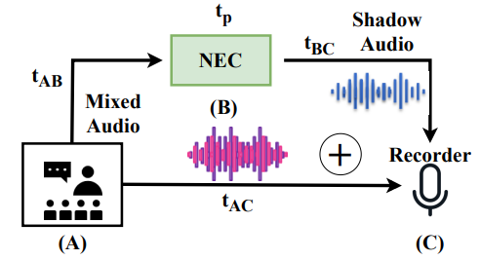
Stage2: Overshadowing
How to handle the time offset and power offset?
Modulate to ultrasound band

Slide 15
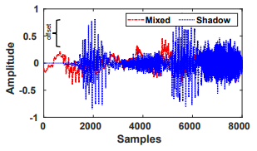
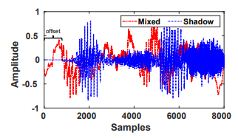
Stage2: Overshadowing

Slide 16
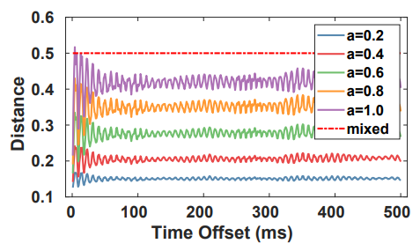
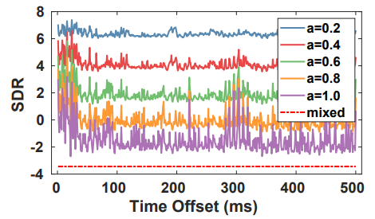
Stage2: Overshadowing
Good audio quality
Similar to the Alice’s clean sound
a < 0.6, time offset < 500ms can assure a good overshadow result

Slide 17
Experiments

Slide 18
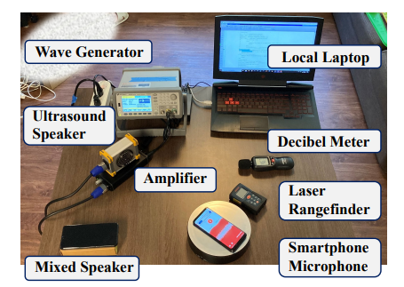
Setup

Slide 19
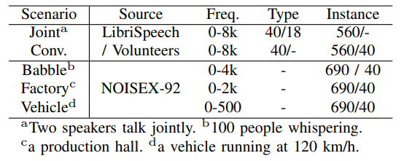
Dataset & Metrics
Source to Distortion Ratio (SDR)
Word Error Rate (WER)
User Rating Score (URS)
Sound Noise Ratio (SONR)

Slide 20
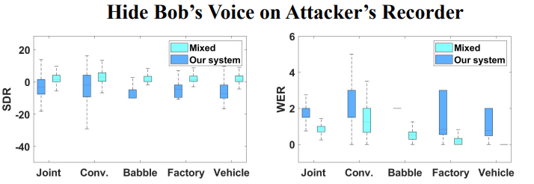
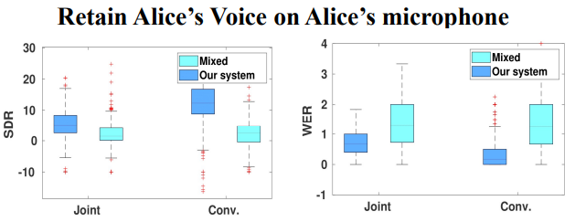
Benchmark Results
Low SDR & High WER:
Bob’s voice is disrupted
High SDR & Low WER:
Alice’s voice is retained

Slide 21
User Study 1 – Hide Bob’s sound in the wild
Bob uses NEC with noisy environment
The adversary can only record noise with very low SDR!
Most reviewers cannot recognize Bob’s voice (score 5)

Slide 22
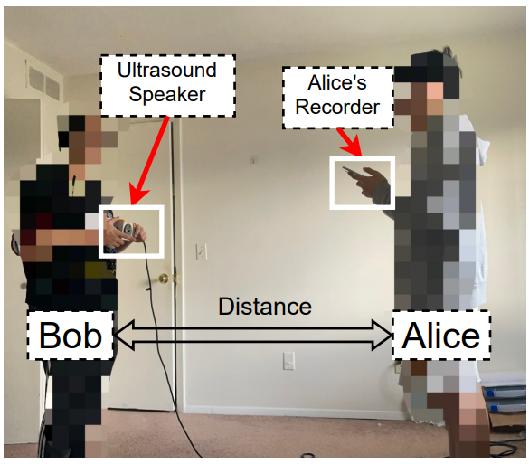
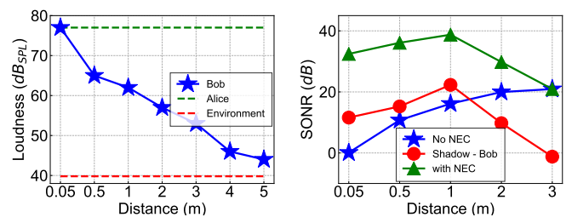
User Study 2 – Reasonable distance
Bob’s voice is canceled at Alice’s phone
SONR = Mixed - Bob
Bob and mixed are equal loud

Slide 23
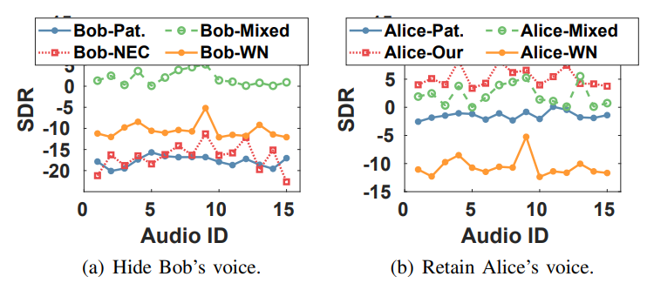
Compare to other work
Bob-Pat.: [4] WN: 10dB white noise
[4] Li, L., Liu, M., Yao, Y., Dang, F., Cao, Z., & Liu, Y. (2020, November). Patronus: Preventing unauthorized speech recordings with support for selective unscrambling SenSys’20

Slide 24
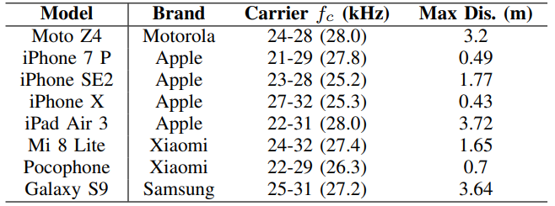
Time Consumption
Platform | Encoder | Selector | Broadcast
PC (1080Ti) | 0.467ms | 1.51ms | 11.96ms
Rasp. Pi | 12.7ms | 293.7ms | 11.96ms
Non-linear Factors

Slide 25
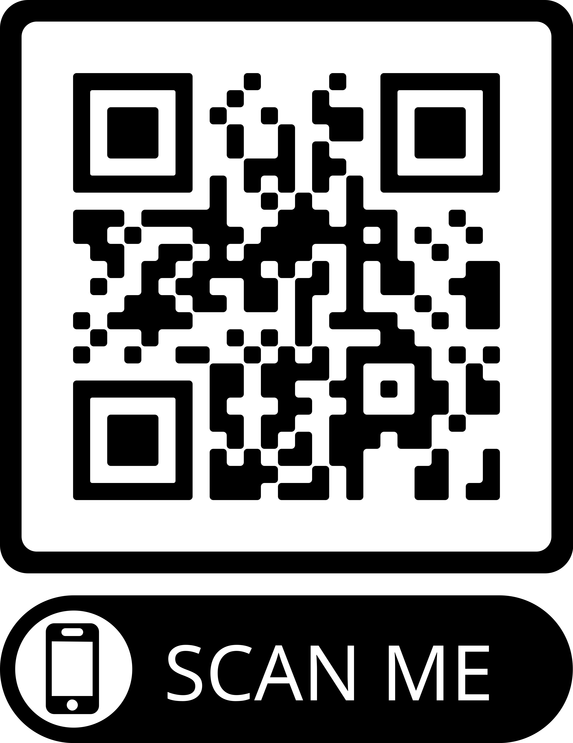
Thank you! Question?
https://nec-app.github.io/
SEIT Lab@MSU

