Slide 1
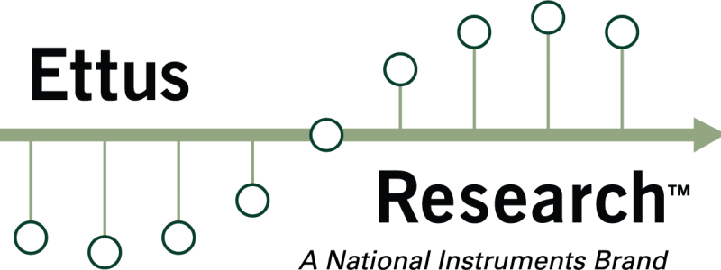
Secure-IRS: Defending Against Adversarial Physical-Layer Sensing in ISAC System
Ziyu Chen, Denny Lendika, Alvin Yang, Yizhu Wen, Haofan Cai, Yao Zheng, Hanqing Guo

Slide 2
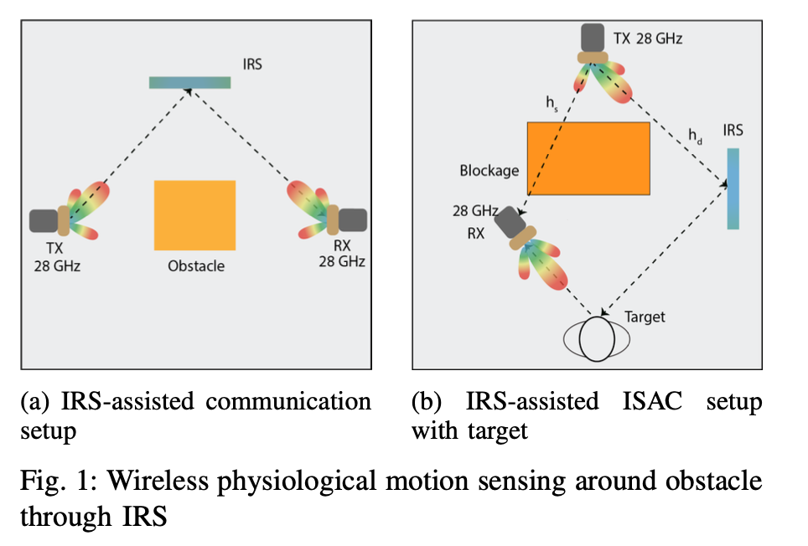
ISAC systems assisted by the IRS
ISAC: Integrated sensing and communication
IRS: Intelligent Reflective Surface
Notes:
It involves a planar surface composed of numerous passive reflecting elements, each capable of independently controlling the amplitude and phase of incoming signals. By manipulating these signals, IRS can optimize wireless propagation environments, significantly improving sensing accuracy and communication performance
IRS can create virtual LoS links by reflecting impinging radio signals, thus compensating for power loss and enhancing signal coverage.

Slide 3
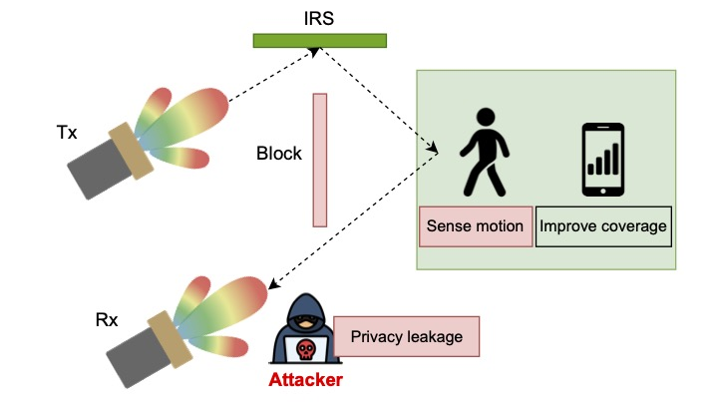
ISAC systems with an IRS are prone to attacks
An adversary could potentially use IRS-enhanced sensing to track the occupancy of a home by detecting signals reflected from human bodies, such as breathing patterns, even through walls.

Slide 4
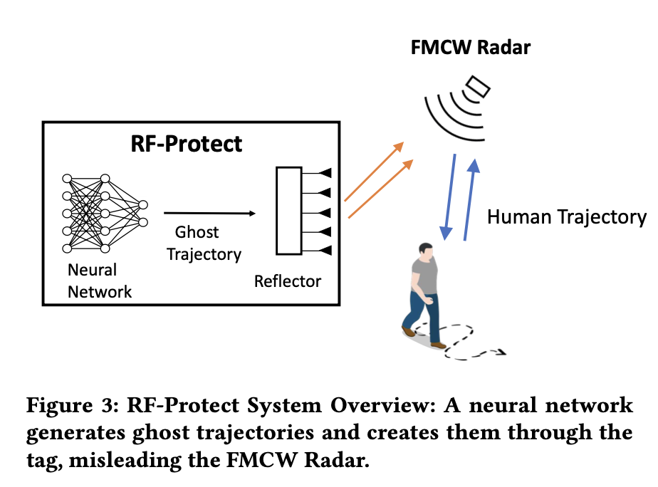
Existing countermeasures
Pros: effective, does not require complex signal processing
Cons: requires additional crafted hardware
RF-Protect: Privacy against Device-Free Human Tracking [Sigcomm 2022]
Notes:
Traditional methods:
Jamming: requires a significant amount of power and is subject to regulatory restrictions
Attenuation: limit the functionality of legitimate communication systems
Rf-protect: Generate fake/ghost human data points by deploying a neural network and a reflector

Slide 5
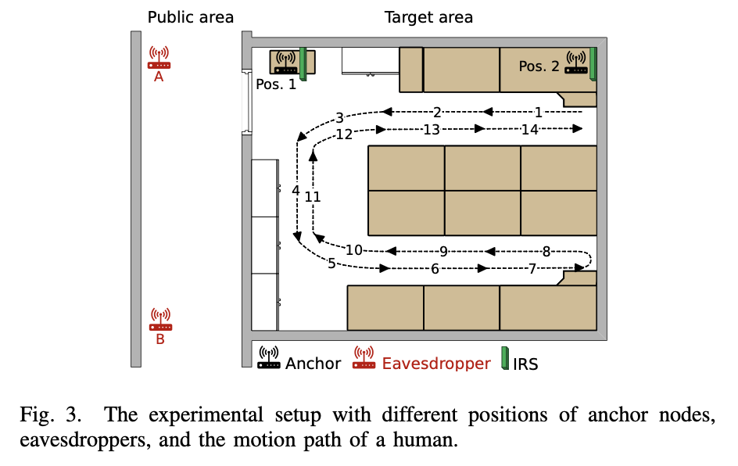
Existing countermeasures
Pros: effective, does not affect the wireless communication performance
Cons: require expensive devices (programmable IRS), complex to implement in practical scenarios
IRShield: A Countermeasure Against Adversarial Physical-Layer Wireless Sensing [IEEE S&P 2022]
Notes:
design an IRS configuration algorithm to obfuscate wireless channels

Slide 6
System design
We use the channel state information (CSI) between the transmitter and the receiver to perform motion detection
The CSI is formulated as:
The dominant frequency and phase are determined by

Slide 7
System design
With an IRS, the phase of each IRS element is
This way the CSI between Tx and Rx is
where $h_{i,IRS}(t)$ is formulated as
Under this scenario, where the signal is almost unable to transmitted directly from Tx to Rx, $\left|h_{i,IRS}\left(t\right)\right|≫|h_{i,d}\left(t\right)|$, so that
$$h_{i}\left(t\right)≈h_{i,IRS}(t)$$
Notes:
where d_k(t) is the length of the reflected path via the k-th IRS element, λ_i is the wavelength at the i-th sub-carrier, and θ_k is the phase shift introduced by the k-th IRS element.

Slide 8
System design
When the IRS moves, $d_{k}(t)$ changes, making both the amplitude and the phase of $h_{i,IRS}(t)$ change.
Thus, the CSI is not only determined by the target, but also by the movement of the IRS. This leads to inaccurate sensing

Slide 9
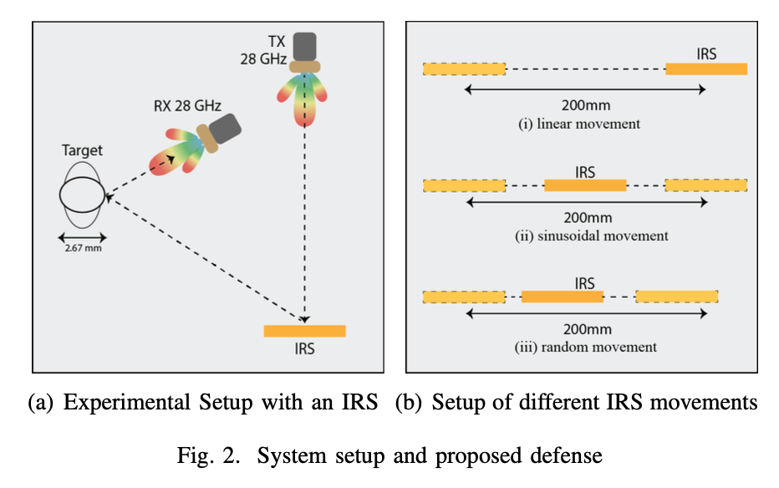

Slide 10
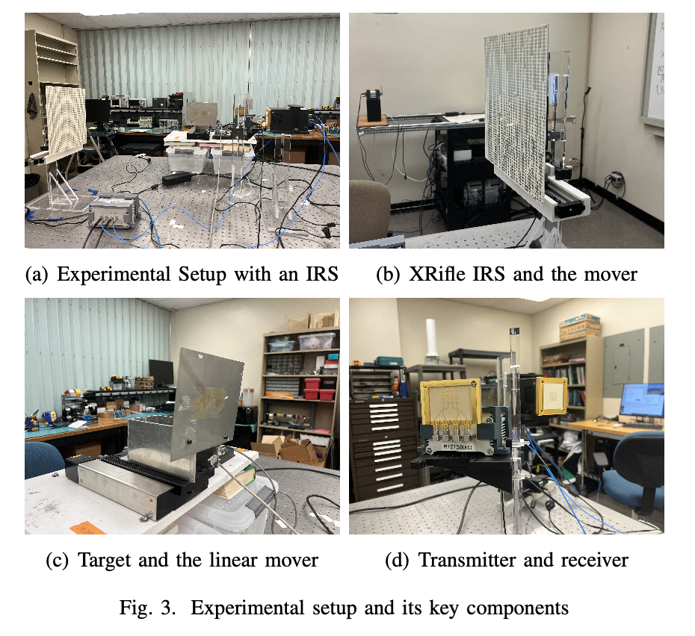
Experimental setup
The Tx sends an OFDM signal with 52 pilot subcarriers and 128 data subcarriers at a sample rate of 625 Hz.
The signal transmitts at 3.5 GHz, then upsampled to 28 GHz.
The IRS‘s introduce angle is 0° and reflection angle is 60°.
The target oscillates at 0.3 Hz to mimic typical breathing rates.
The CSI of channel 1, 26, 52 is recorded into a text file in each experiment.

Slide 11
Evaluation metrics
Detection Error Rate (DER)
Attack Success Rate (ASR)

Slide 12
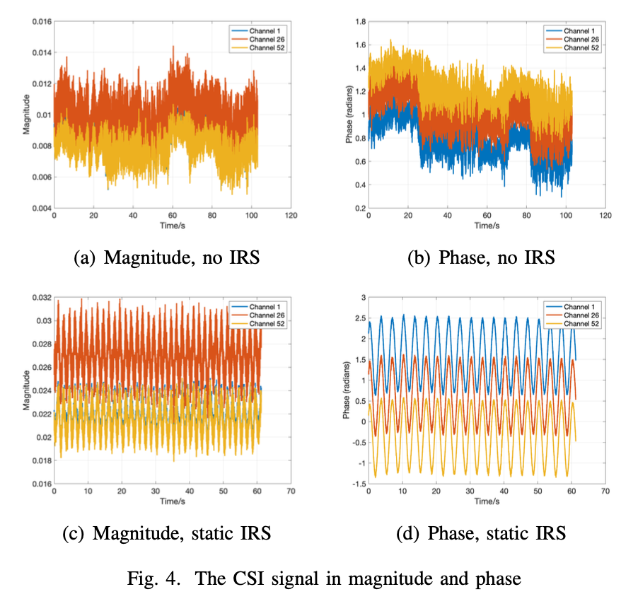
1. The efficacy of the IRS
Notes:
With an IRS, higher magnitude, clearer signal

Slide 13
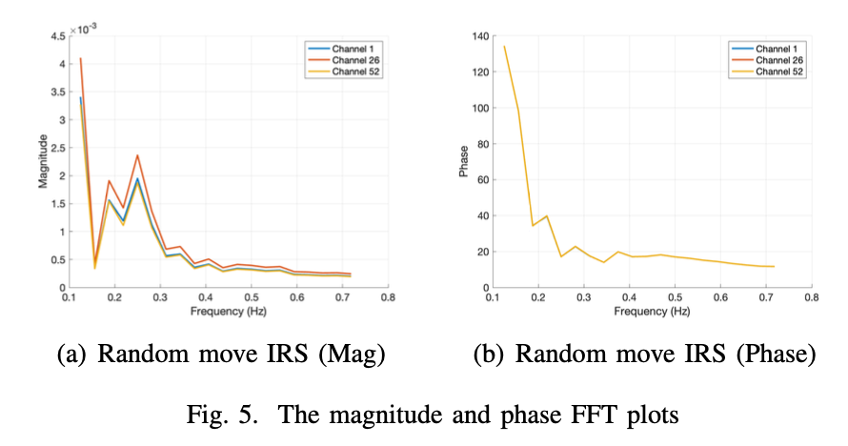
2. Effect of our countermeasure
Random movement of the IRS almost cancels the sensing.

Slide 14
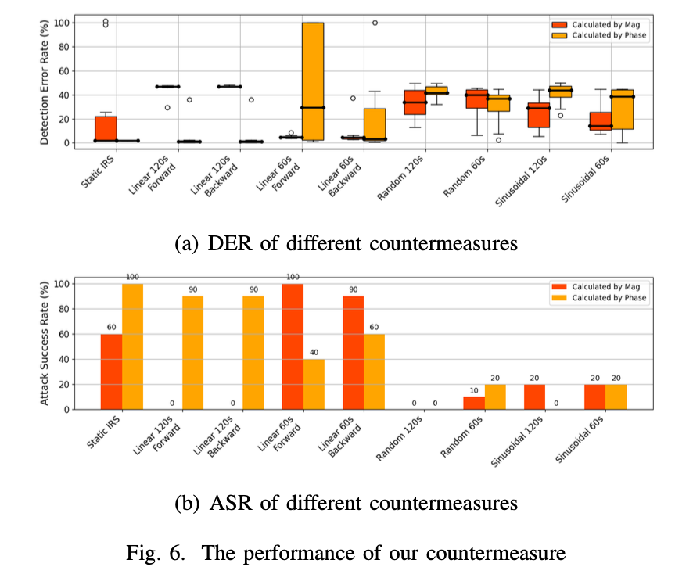
2. Effect of our countermeasure
Notes:
in the static IRS scenario, both Mag and Phase can derive the correct target frequency, with a median DER as 0%, while the calculation by magnitude has some variance.
In comparison, with the IRS movement, the DER increases significantly. In most settings, our defense can cause around 40% DER. Specifically, for the random movement, our defense makes it impossible for the the eavesdropper to detect physiological data using both the magnitude and phase approaches.
In the static IRS condition, the attack success rate is high, with 60% for magnitude and 100% for phase, note that harmonics are detected sometimes.
For comparison, when the IRS is set in motion, the attack success rate drops significantly. For example, in the Linear 60s Forward movement, the attack success rate calculated by magnitude falls to 0%, while for phase, it drops to 40%. Remarkably, in the Random 120s and Sinusoidal movements, the attack success rate is dramatically reduced, reaching as low as 0%.

Slide 15
Thank you!

