Slide 1
GhostTalk: Interactive Attack on Smartphone Voice System Through Power Line
Yuanda Wang, Hanqing Guo, Qiben Yan
Michigan State University

Slide 2
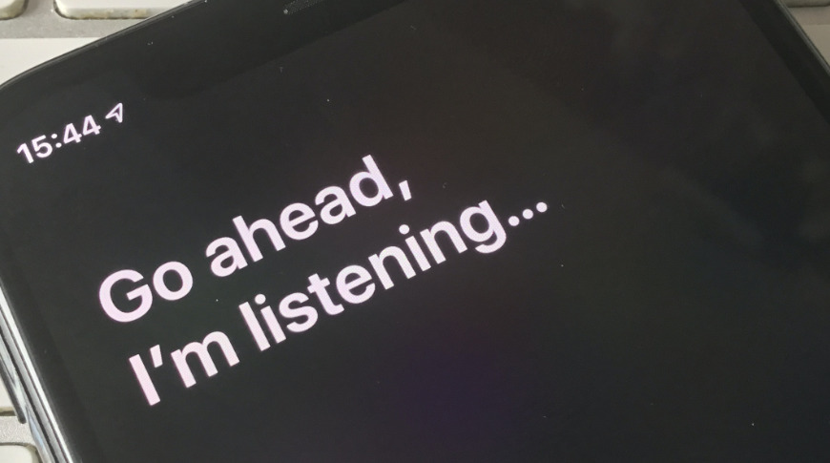
Smartphone Voice Assistants
Read my message
What’s my schedule today?
Calling Alice
Where am I?
Send a message to Bob
What is my address?
Open the door
What is my car plate number?

Slide 3
Challenges of Traditional Voice Command Attacks
Hey Siri, where is my home?
Your home address is…
Unauthenticated!
?
Noisy environments
Voice recognition
Interaction

Slide 4
How do we address these challenges?
Notes:
Here comes the first question:

Slide 5
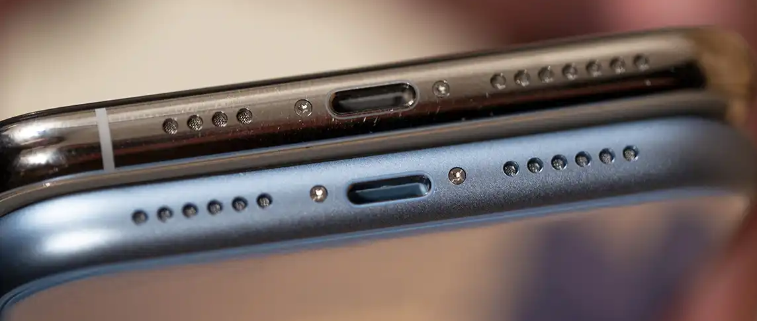
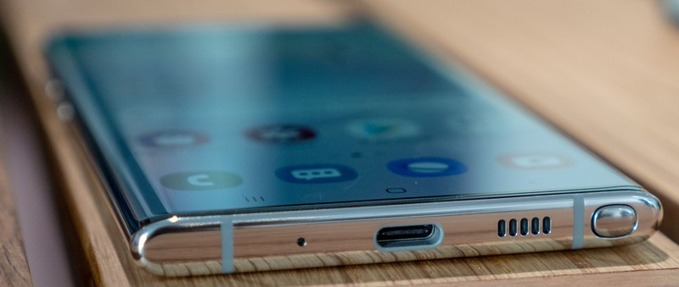
Design of Charging Ports
Audio signal
transmission
1
2
3
4
5
6
7
8
8
7
6
5
4
3
2
1
Power supply
Audio signal
transmission
1
2
3
4
5
6
7
8
9
10
11
12
1
2
3
4
5
6
7
8
9
10
11
12
Power supply

Slide 6
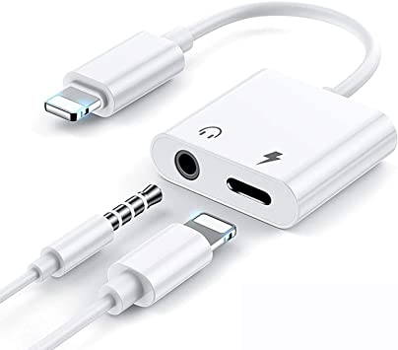
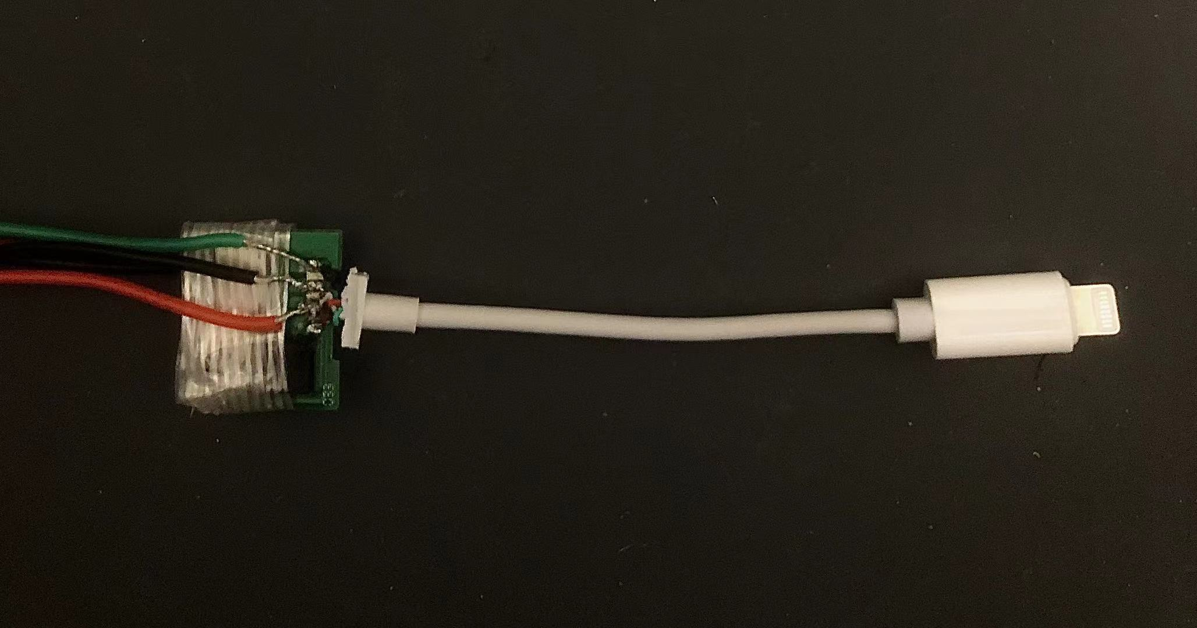
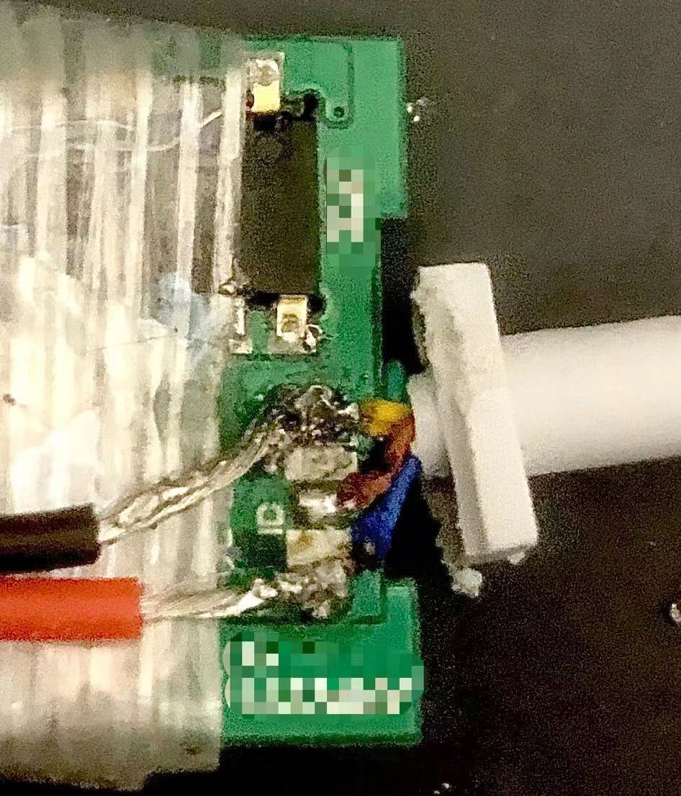
Inaudible Attack through Charging Ports via Malicious Cable
Charging cables
Audio cables
MIC
Backside
GND
Speaker
Microchip

Slide 7
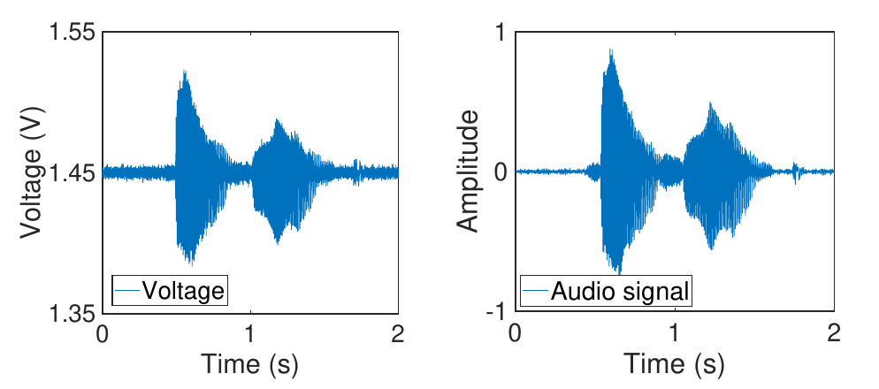
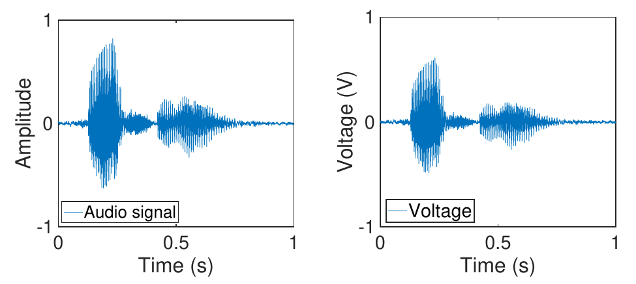
Preliminary Observations
Inject
Electric signals can be converted to audio signals, and vice versa.
Electric signal
Audio input
Eavesdrop
Audio output
Electric signal

Slide 8
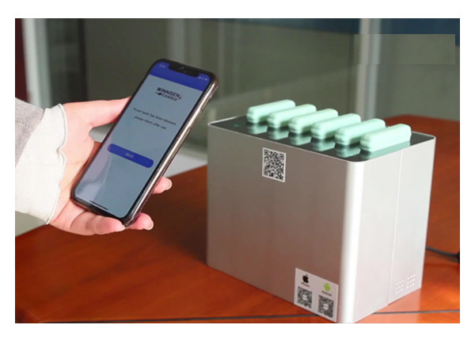
GhostTalk Attack
Shared power bank raise the potential risk of such attack!
Your address is…
Where is my home?
Modified cable
Open the door.
Shared power bank
Remote attacker

Slide 9
GhostTalk System Design
Audio chip
Noisy environments
Modified Cable
R_{m}
R_{s}
V_{cc}
GND
Interaction
Mic
GND_{A}
Speaker
MOSFET
5V DC power
_{DC voltage}
_{offset}
_{DC voltage}
_{offset}
Power bank
_{Modulation}
_{Demodulation}
Voice recognition
_{Injected audio}
_{Switch control}
_{Eavesdropped audio}
Attacker

Slide 10
GhostTalk System Design
Noise Robustness:
GhostTalk injects voice command through electric signals, so that environmental noise has no impact on the injection.
Audio chip
Modified Cable
Interactivity:
GhostTalk uses resistances to emulate a fake “headphone” and make the smartphone play audio through it. And it can hack the output audio signals by measuring the voltage on the speaker cable.
R_{m}
R_{s}
V_{cc}
GND
Mic
GND_{A}
Speaker
5V DC power
MOSFET
_{DC voltage}
_{offset}
_{DC voltage}
_{offset}
Power bank
Bypass speaker recognition:
GhostTalk adds a MOSFET between the microphone and ground, to emulate a fake “press button” on the headphone and activate the voice assistant.
_{Modulation}
_{Demodulation}
_{Injected audio}
_{Switch control}
_{Eavesdropped audio}
Attacker

Slide 11
GhostTalk Attack Scenarios
“What is my name?”
Scenario 1: Privacy information query
“You are Yuanda, that’s what you told me.”
“Call my mom.”
Scenario 2: Ghost phone call
“Calling mom….”
“Hi mom, what’s the password of your apartment?
Scenario 3: Hacking verification code
“Send the verification code by phone call.”
“The code is 000-000.”
“..000-000..”

Slide 12
What if attackers CANNOT modify the charging cable?
Notes:
However, sometimes the users do not use shared power bank.
Here comes another question, what if attacker cannot modify the charging cable? Can we launch attack through standard cables?

Slide 13
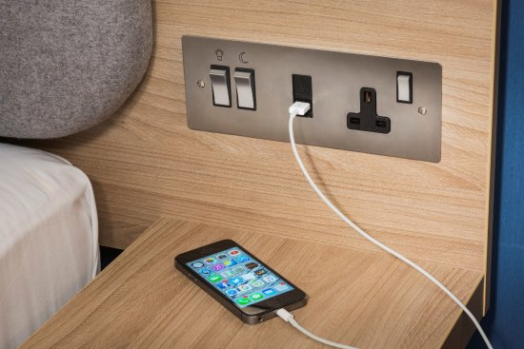
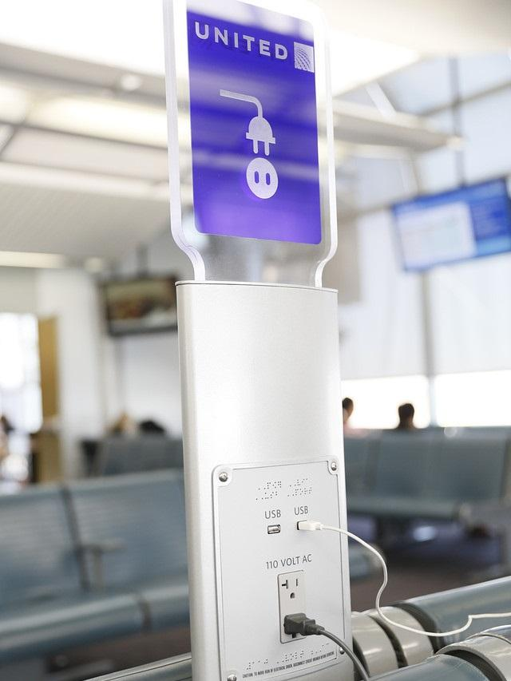
Eavesdrop from Public Charging Ports
Public USB charging ports in hotels and airports.
Notes:
For example, in hotels and airports, the users charge their smartphones through public USB charging ports. Is it possible to launch any attack through these USB ports?

Slide 14
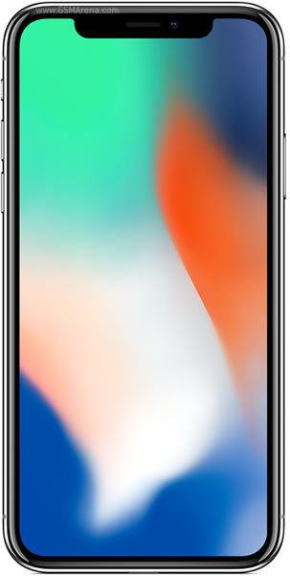
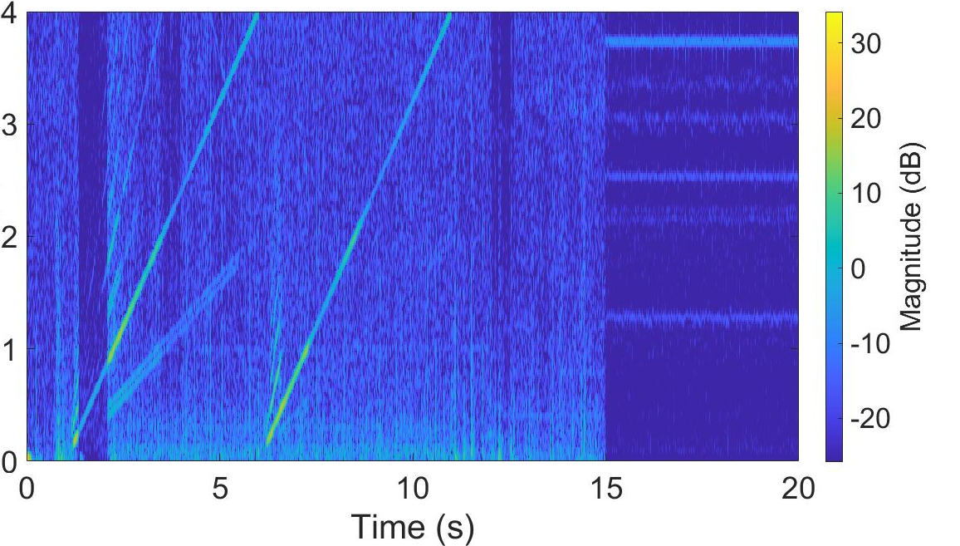
Audio Signal in Power Side-channel
Top loudspeaker
Bottom Speaker
Top Speaker
No Signal
Shut Off
①
②
③
④
Bottom loudspeaker
The audio signal patterns in the charging current is leaked due to the high-power profile of the loudspeaker

Slide 15
GhostTalk-SC System Design
Current waveform when playing “seven”.
Filtered waveform
Spectrum
High-pass
filter
Standard
cable
STFT
V_{cc}
GND
5V DC power
Noise reduction & Grey scale
Current measurement
Power
source
96
96
256
256
256
256
10
I_{m}
Password
“Seven.”
Spectrum
recognition
SSN
64×64
32×32
16×16
Verification code
128×128
130×130
Spectrum
CNN Architecture
Attacker

Slide 16
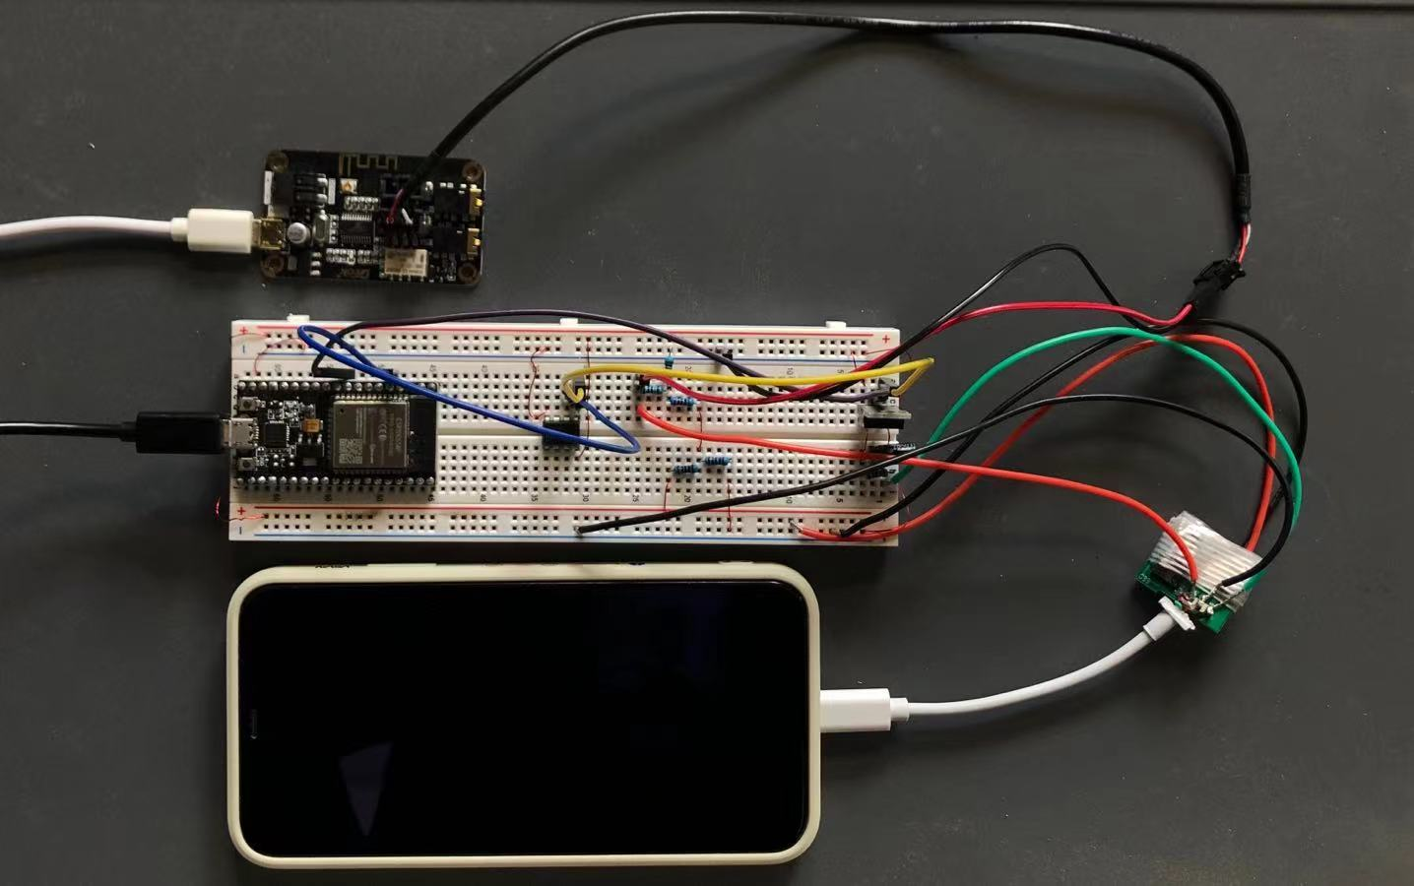
Evaluation
Attack hardware
Audio chip
Amplifier & MOSFET
Low-cost
Portable
Small enough to be hidden in a power bank
Microcontroller
Victim phone
Modified cable

Slide 17
GhostTalk Evaluation
Manufacturer | Model | OS | Assistants | fs (kHz) | GhostTalk |  |  | SNR (dB) | ASR
 |  |  |  |  | Act. | Inj. | Eav.
Apple | iPhone 5s | iOS 12.5 | Siri | 44.1 | √ | √ | √ | 19.7 | 100%
Apple | iPhone X | iOS 14.5 | Siri | 48.0 | √ | √ | √ | 21.3 | 100%
Huawei | Honor 10 | Android 9.0 | Google | 48.0 | √ | √ | √ | 20.4 | 100%
Xiaomi | MI 8 Lite | Android 9.0 | Google | 44.1 | √ | √ | √ | 18.9 | 100%
Xiaomi | Pocophone | Android 9.0 | Google | 48.0 | √ | √ | √ | 21.8 | 100%
Samsung | Note 10 | Android 10.0 | Google | 44.1 | √ | √ | √ | 21.2 | 100%
Samsung | S9 | Android 10.0 | Google | 44.1 | √ | √ | √ | 20.1 | 100%
Google | Pixel 1 | Android 10.0 | Google | 44.1 | √ | √ | √ | 19.3 | 100%
Google | Pixel 4XL | Android 11.0 | Google | 32.0 | √ | √ | √ | 15.4 | 100%
We evaluate GhostTalk on 9 different smartphones, and the results show that our attack can successfully compromise all smartphones with 100% success rate.

Slide 18
GhostTalk User Study
20 listeners, 10 question for each listener. And 150 answers are indistinguishable.
Our injected audio signal can fool human ears!

Slide 19
GhostTalk’s Robustness against Liveness Detection
GhostTalk attack can bypass existing liveness detection models with high success rate.

Slide 20
GhostTalk’s Robustness in Noisy Environment
GhostTalk injection and eavesdropping attacks are robust in noisy environments.

Slide 21
GhostTalk-SC Evaluation
Model | Charging port | Loudspeaker | SNR(dB) | Accuracy
iPhone 5s | Lightning | Single | 5.41 | 93.0%
iPhone X | Lightning | Dual | 4.75 | 92.7%
Honor 10 | USB-C | Single | 5.75 | 93.3%
MI 8 Lite | USB-C | Single | 4.93 | 92.7%
Note 10 | USB-C | Dual | 4.46 | 91.0%
S9 | USB-C | Dual | 4.21 | 90.7%
Pixel 1 | USB-C | Single | 3.83 | 89.7%
Pixel 4XL | USB-C | Dual | 3.72 | 90.0%
Pocophone | USB-C | Dual | 1.51 | 36.0%
For most of smartphones, GhostTalk-SC can recognize the spoken digits with high accuracy.
Notes:
Next, we evaluate GhostTalk-SC attack performance.
We launch the attack on the same smartphones as GhostTalk. For most of smartphones, the recognition accuracy is high.
The only exception is Pocophone. One possible reason is that its power consumption from other firmware is too high. And We cannot extract clear audio signal from it.

Slide 22
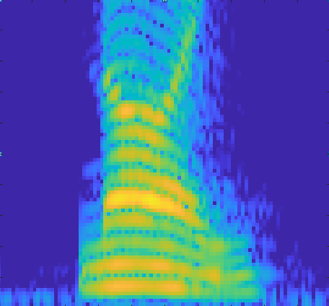
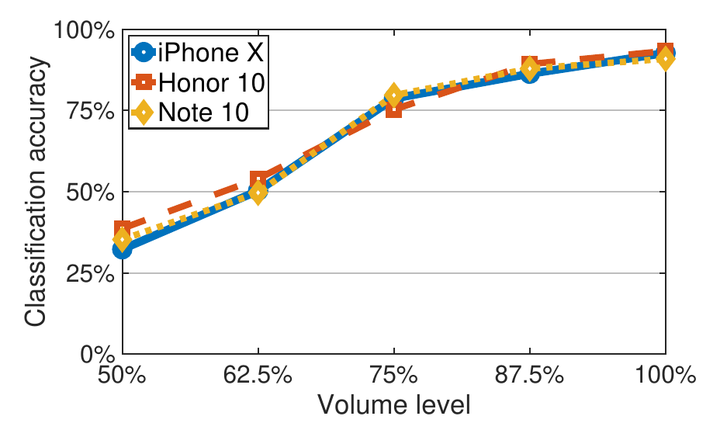
GhostTalk-SC Evaluation - Cont.
2
2
Ori
L16
Frequency/kHz
Frequency/kHz
0
0
0
Time/s
1
0
Time/s
1
2
L12
2
L8
Frequency/kHz
Frequency/kHz
0
0
0
Time/s
1
0
Time/s
1
Loudspeaker volume and classification accuracy are positively correlated.

Slide 23
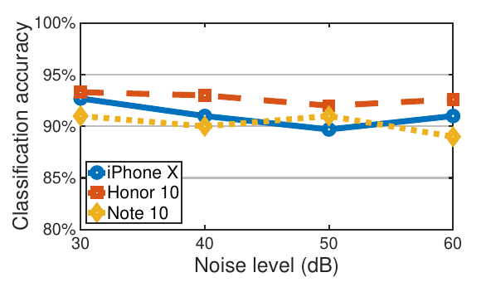
GhostTalk-SC Robustness
GhostTalk-SC attack also maintains high classification accuracy in noisy environments.

Slide 24
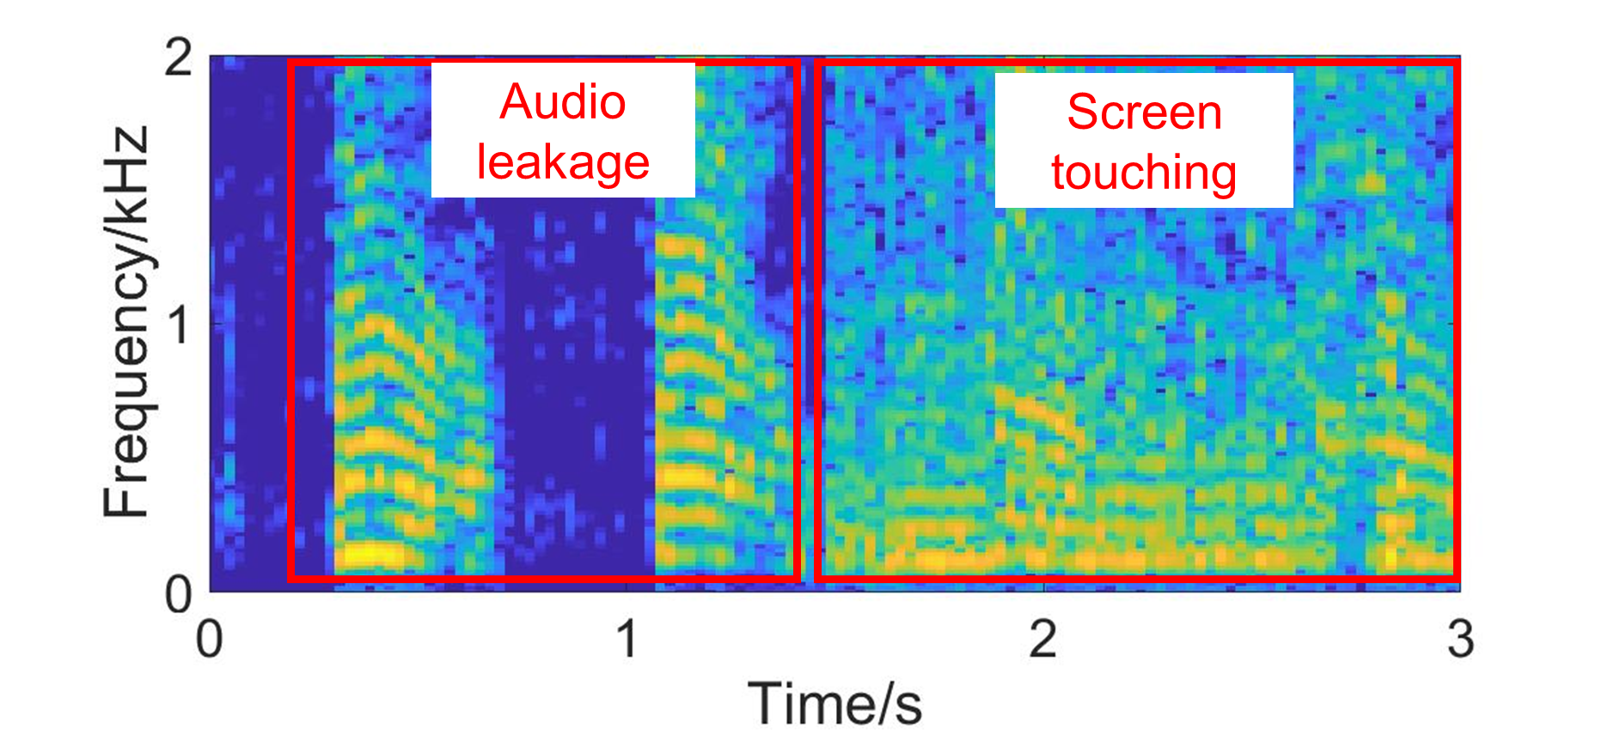
Countermeasure and Discussion
Disable voice assistant activation by headphone.
Enable headphone notification.
Stop charging after reaching high battery level.

Slide 25
Conclusion
GhostTalk is the first interactive and inaudible voice command attack towards smartphone voice assistants over the charging cables.
We also propose GhostTalk-SC, an eavesdropping attack capturing audio signals from power side-channel.
We test GhostTalk and GhostTalk-SC attacks on 9 different models of smartphones. And the evaluation results show that both attacks achieve high attack success rate and resilient to environmental noise.
Our website: http://ghosttalkattack.github.io/
Notes:
Here is the conclusion:<><><>

Slide 26
Notes:
Thanks for listening. <>And I am ready to answer questions.

Slide 27
Questions?
Notes:
Thanks for listening. <>And I am ready to answer questions.

