Slide 1



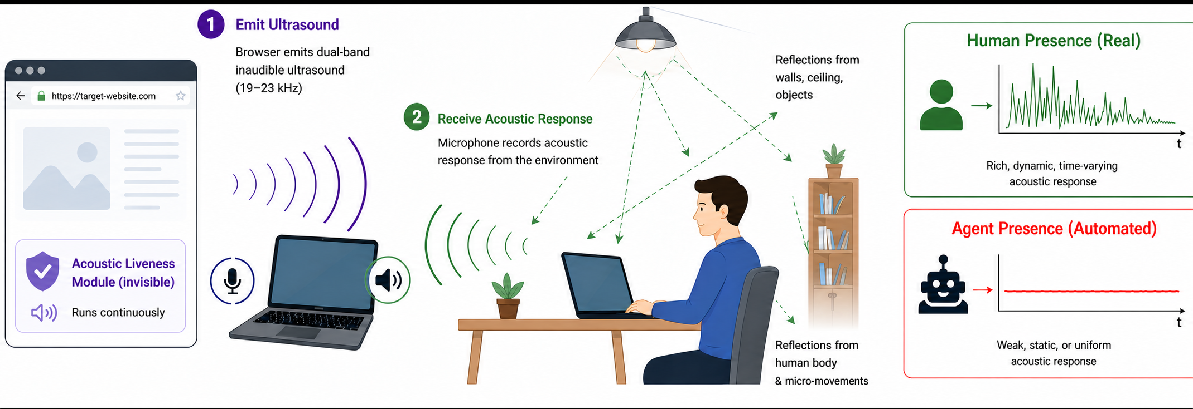
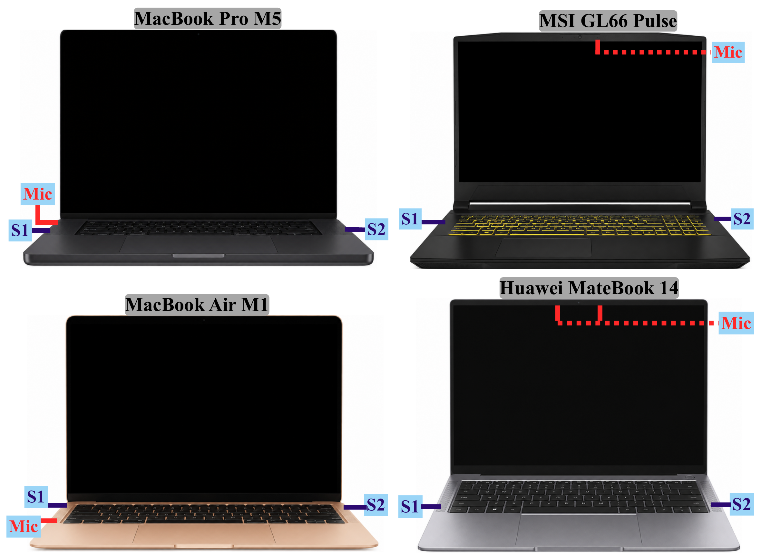
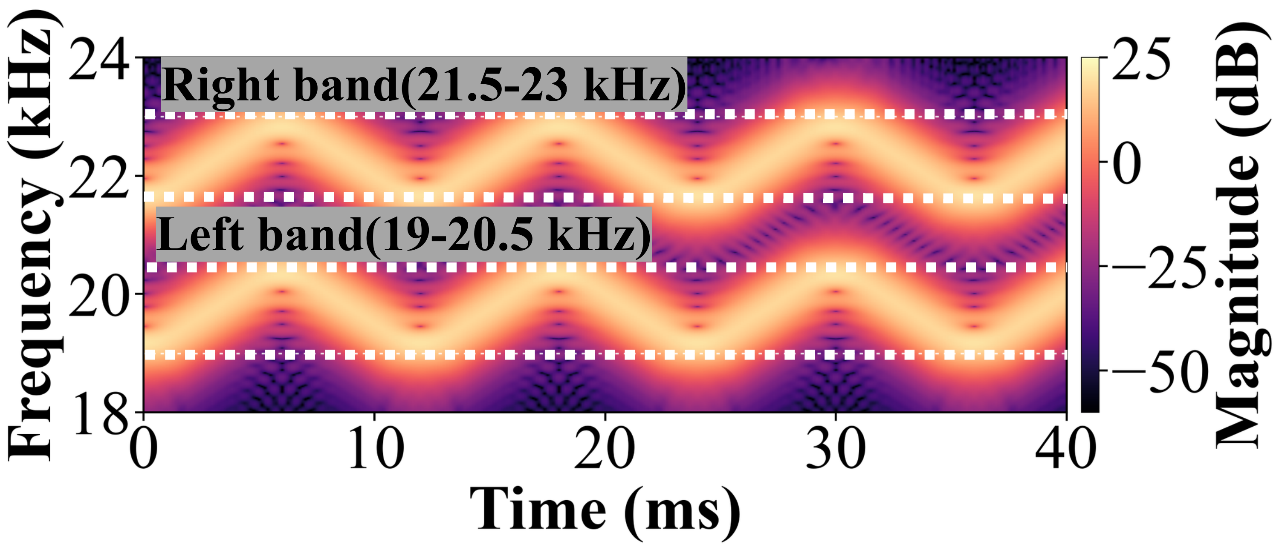
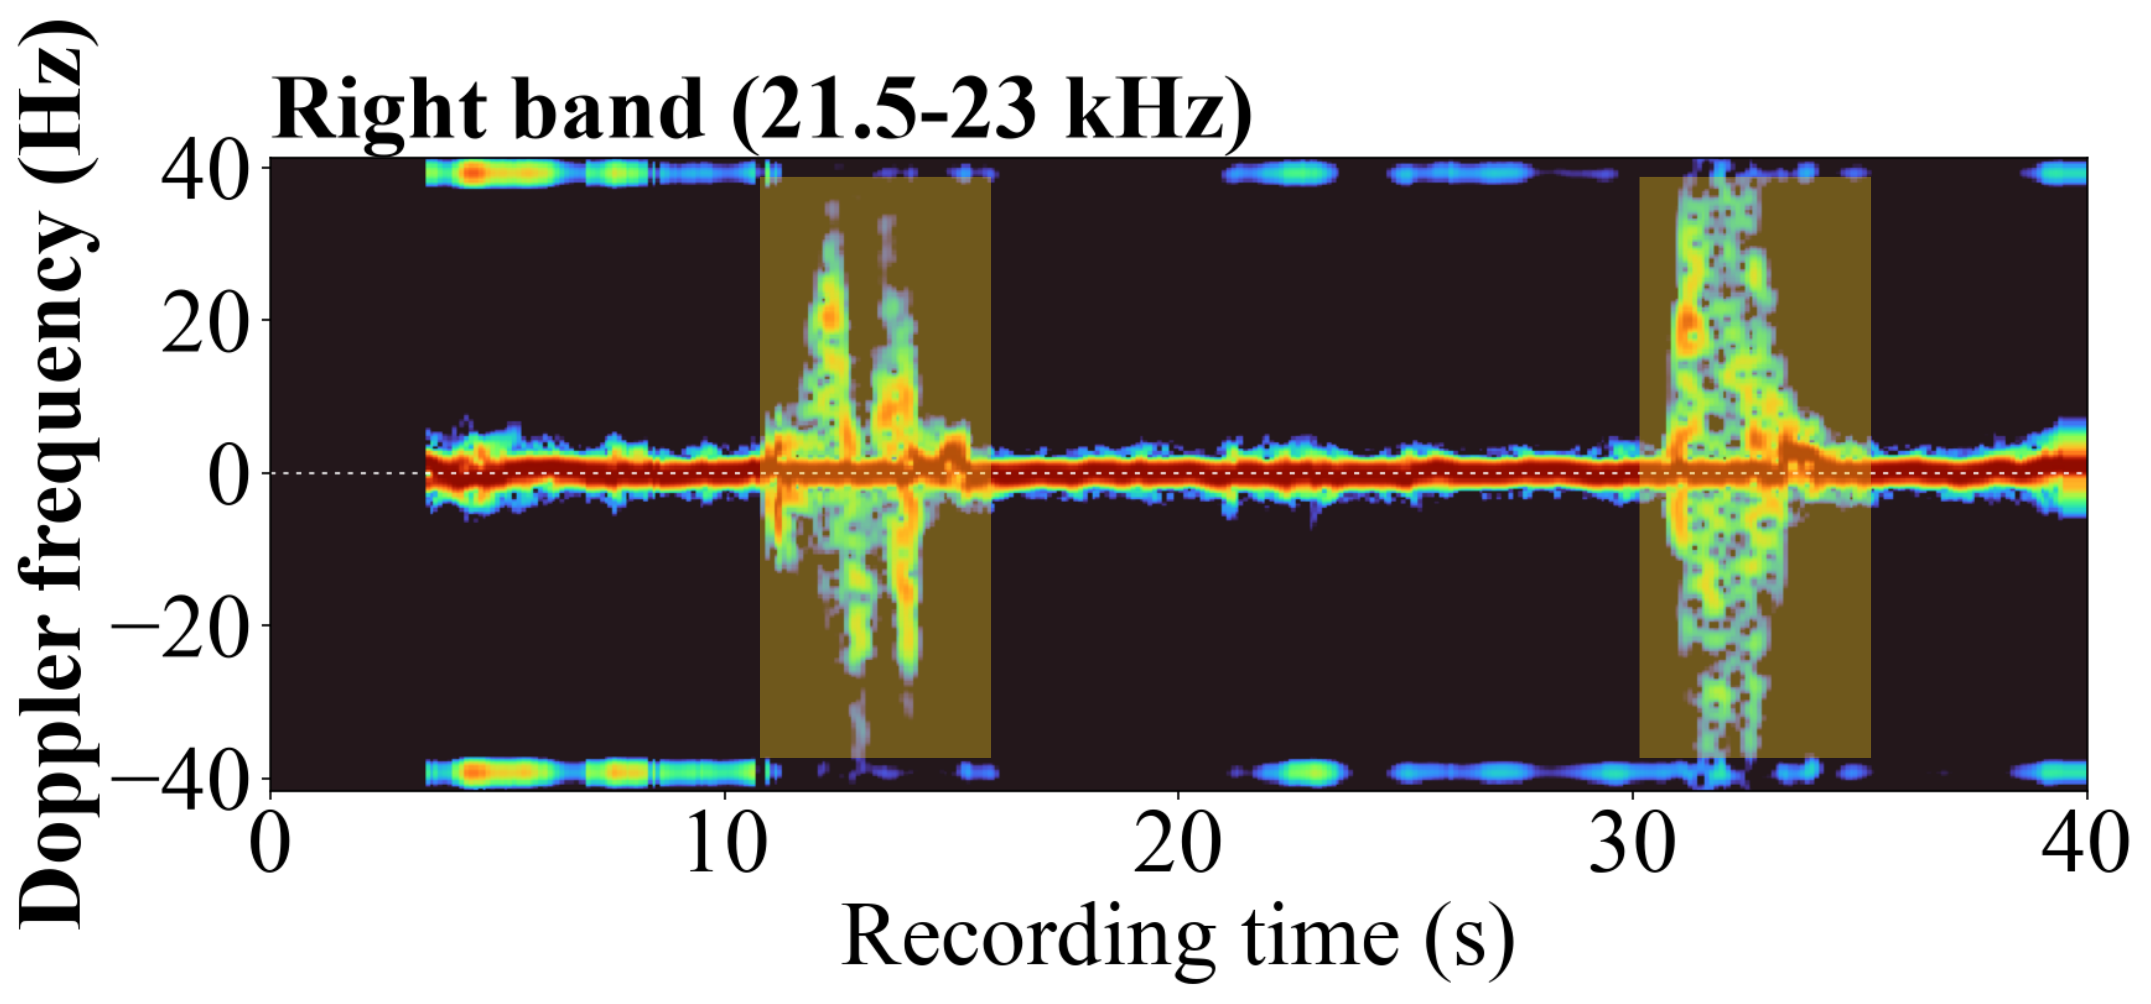
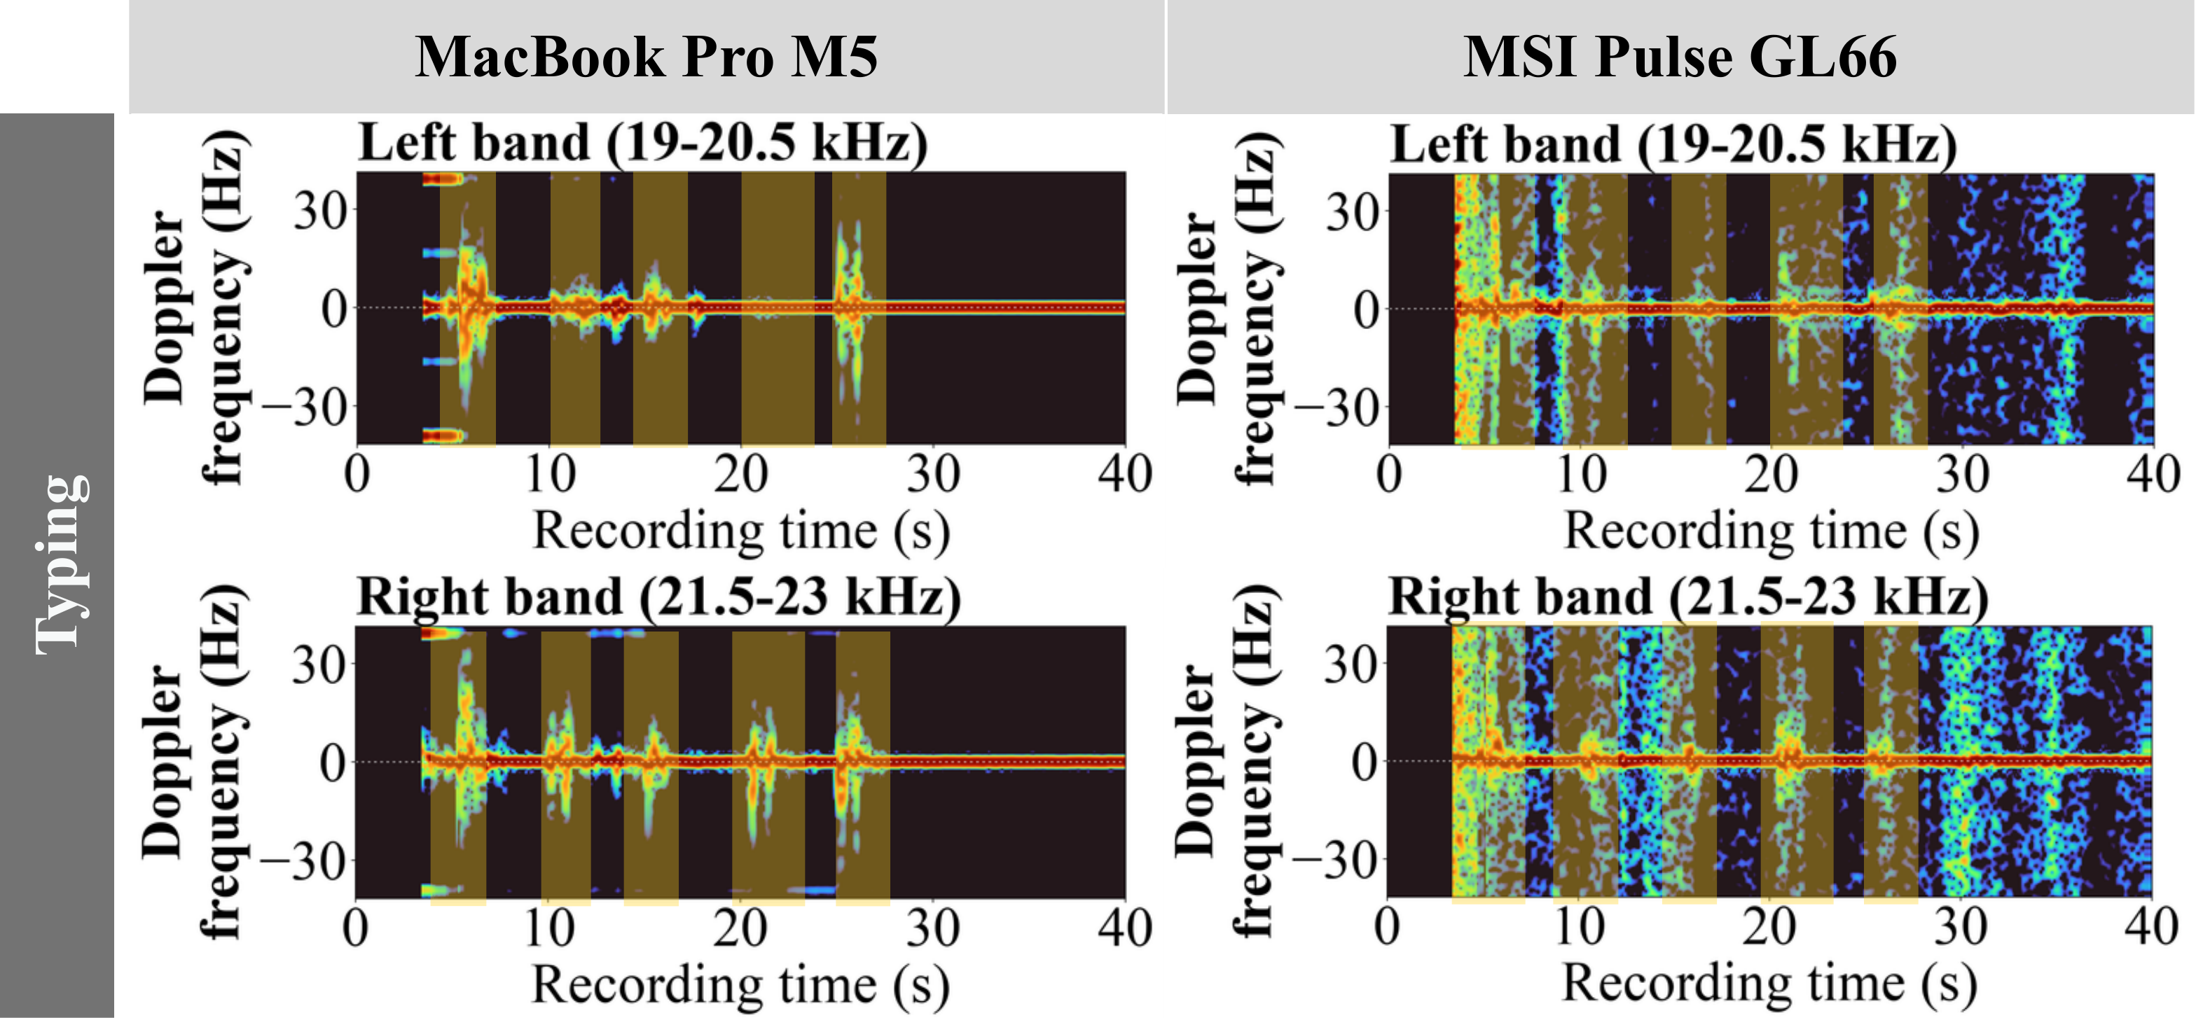
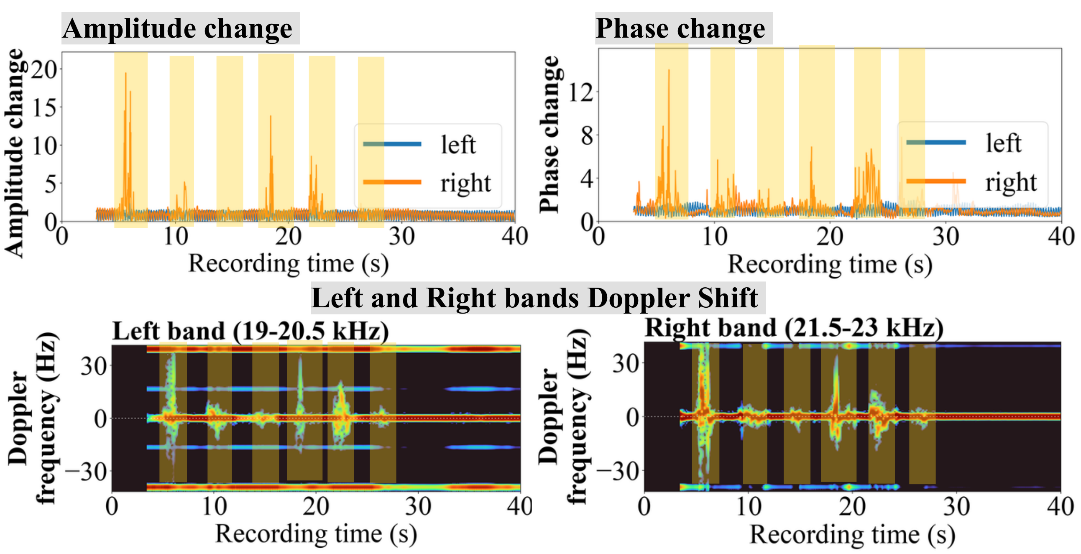
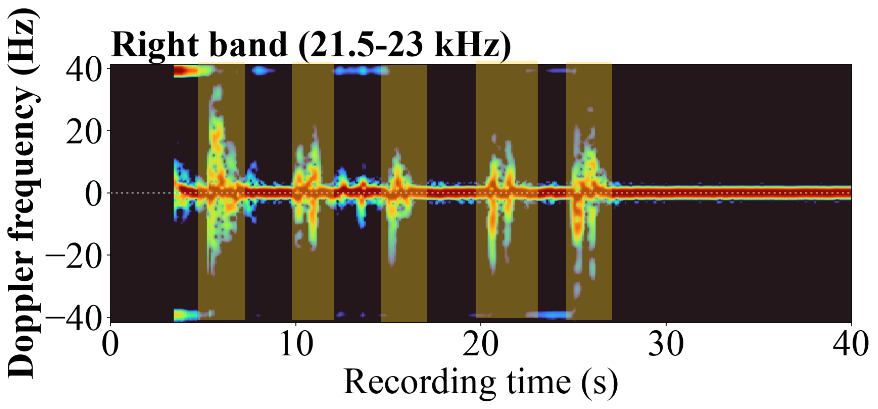
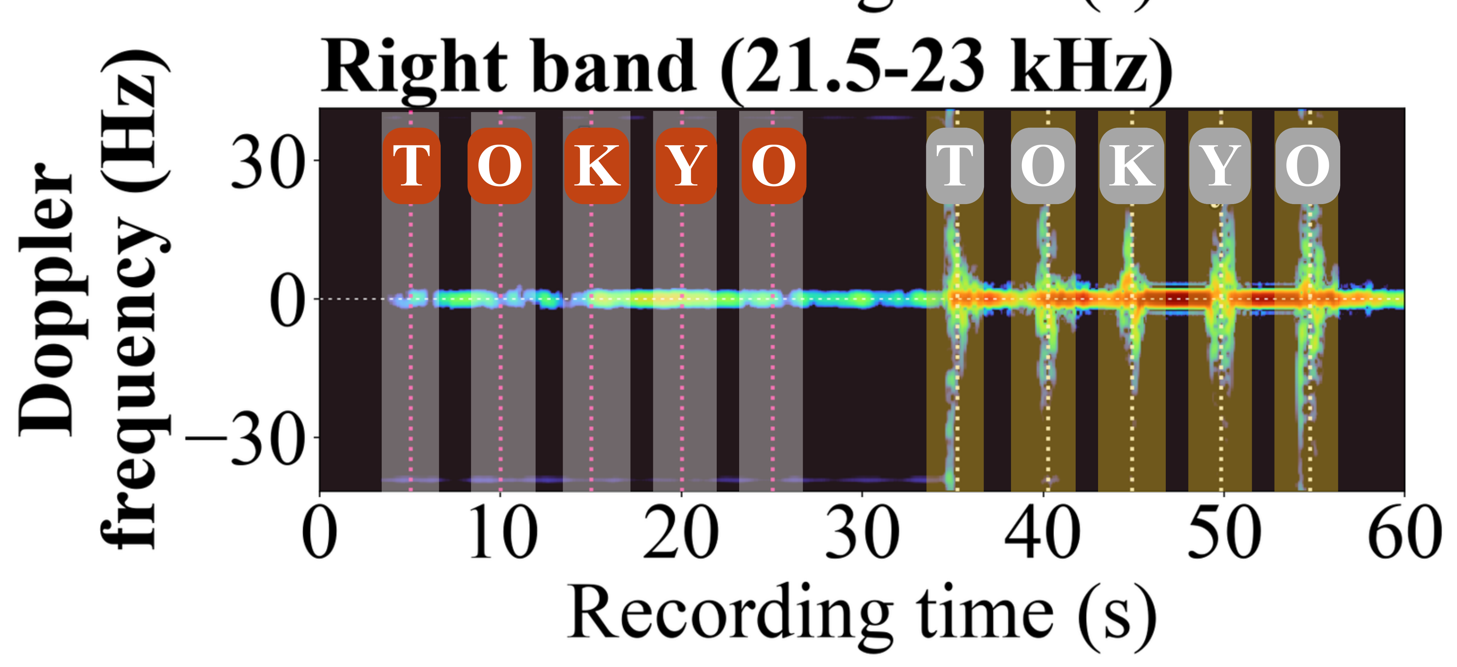
EchoGuard: Continuous Ultrasound-based Human Presence Verification
Against AI Agents
Yizhu Wen¹, Dharani Nadendla², Shirui Cao³, Renzhi Hao⁴, Dong Li², Hanqing Guo¹
Indiana University Bloomington¹, University of Maryland, Baltimore County², University of Massachusetts Amherst³, Independent Researcher⁴
Motivation:
Physical presence as a second signal:
AI agents can imitate browser input;
CAPTCHA and Multi-Factor Authentication (MFA) can be bypassed;
RQ: Can complementary sensing verify human interaction without disrupting website use?
Laptop layouts and Dual-band Signal signal
EchoGuard uses a laptop’s speakers and microphone to sense hand motion with near-ultrasonic, dual-band FMCW signals, then matches that motion to website events as continuous evidence of human interaction.
Left speaker: 19.0–20.5 kHz
Right speaker: 21.5–23.0 kHz
Chirp duration: 12 ms
Laptops vary in speaker-microphone placement.
Finding 3: Doppler response is consistent across laptops.
Walking
Finding 4: Human and agent Doppler response differ across laptops.
Typing
Finding 2: Direct interaction and nearby motion show distinct Doppler patterns.
Finding 1: Doppler best reveals event-aligned motion.
Human vs. agent typing classification: ≈ 88% accuracy

