Slide 1




EchoGuard
Continuous ultrasound based human presence verification against AI agents
Yizhu Wen, Dharani Nadendla, Shirui Cao, Renzhi Hao, Dong Li, Hanqing Guo
01
Notes:
Introduce the paper and the central question. Web agents can produce convincing browser events. EchoGuard asks whether each event is accompanied by physical motion at the laptop. The talk covers the sensing design, a controlled feasibility study, and the limits of the current evidence

Slide 2
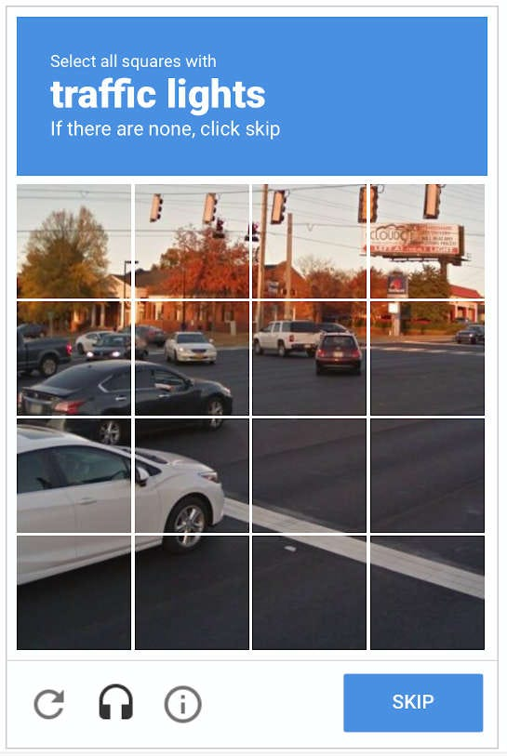
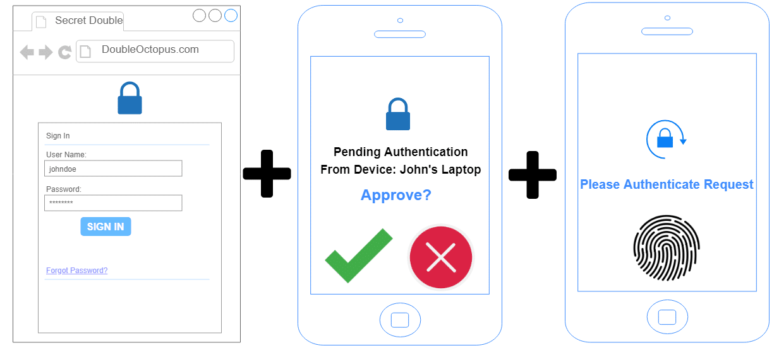
Motivation
Can a browser event prove a person is present?
CAPTCH
Multi-Factor Authentication (MFA)
02
Notes:
A web service sees clicks, keystrokes and pointer events, but autonomous agents can generate those same events in software. Point in time challenges do not establish that a person remains present for every sensitive action.

Slide 3
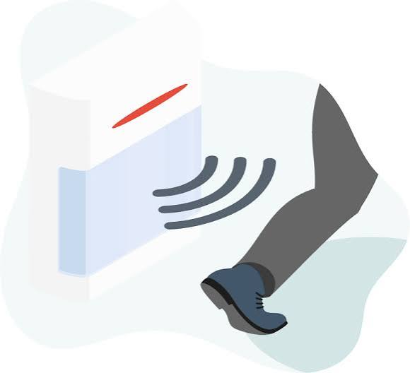
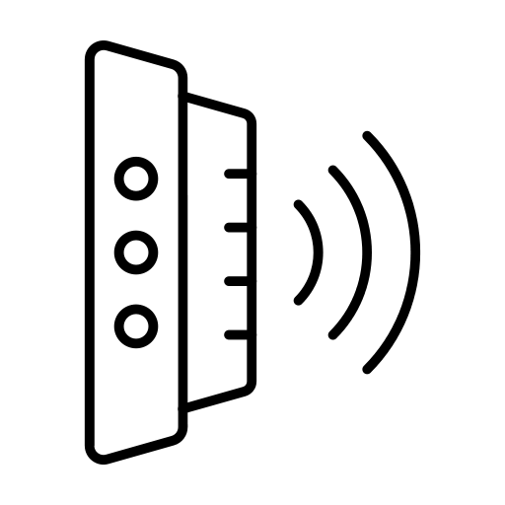

Motivation
Question: does a digital action have a matching physical response?
Sensing signal -> Motion
Sensing signal -> Typing
No extra sensors required
Minimal impact on usability
Privacy-preserving
02

Slide 4
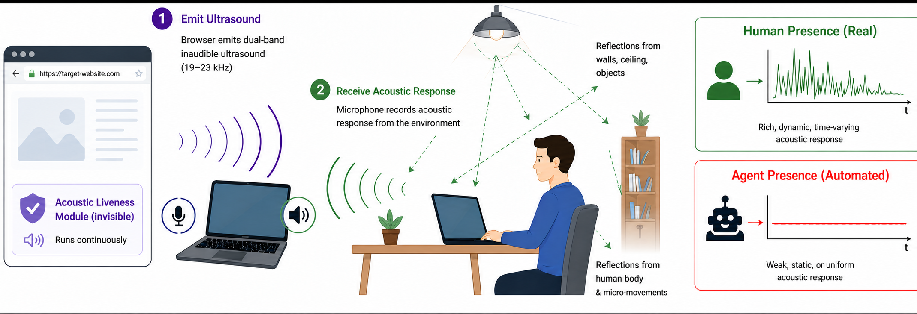
Framework
Ultrasound-based sensing framework (For laptop users).
02
Notes:
The proposed extra signal is physical activity near the laptop, synchronized to the event. This illustration is conceptual: the paper evaluates feasibility, not a deployed liveness service.

Slide 5
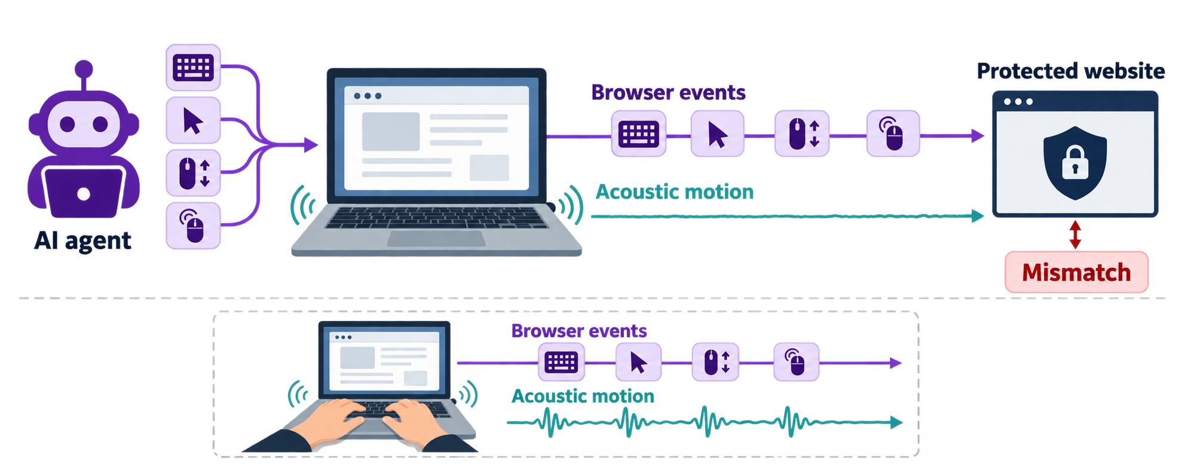
Threat Model
Attacker
AI agent generates keyboard, pointer movement, scroll and click events.
Defender
Website checks whether events coincide with nearby physical motion
03
Notes:
The attacker uses an autonomous web agent that generates browser inputs, potentially with humanlike timing. The defender is a website that can request speaker and microphone access and look for a physical correlate to each event. The study excludes deliberate acoustic replay and spoofing. This matters when interpreting the results: software only agents are the evaluated adversary.

Slide 6
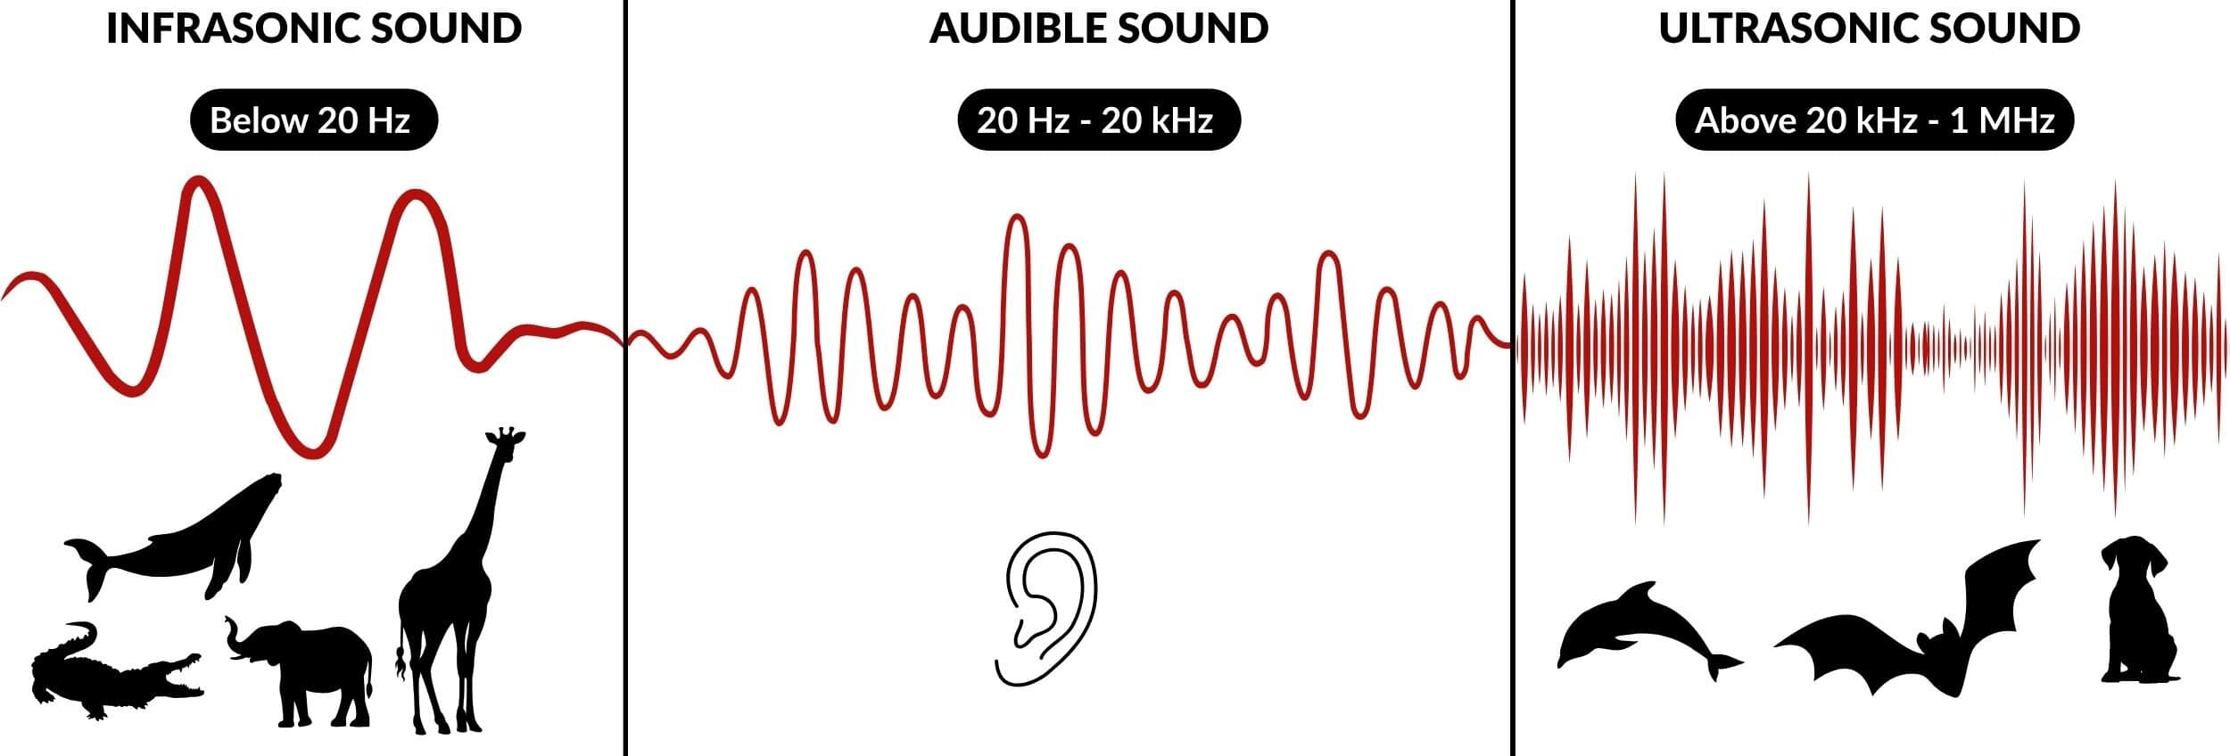
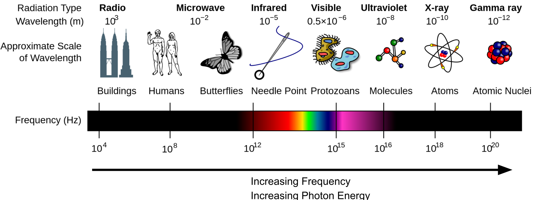
Challenges:
What sensing signal should we use?
Mechanical: Sonar, motion sensing, medical ultrasound.
Electromagnetic: RF/Wi‑Fi, microwave radar, infrared, visible light, X-rays, LiDAR
04
Notes:
A mechanical wave is a disturbance that travels through a material, such as air, water, or a solid, carrying energy. It needs a medium to travel. Sound and ultrasound are mechanical waves: they move through vibrations and pressure changes in the material.
An electromagnetic wave is a traveling disturbance of electric and magnetic fields. It can travel through a vacuum. Radio waves, visible light, X-rays, and gamma rays are all electromagnetic waves.

Slide 7

Challenges:
What sensing signal should we use?
RF waves: Wi-Fi and Bluetooth
Visible light: screen
Why near ultrasound?
Near Ultrasound wave: Speaker
04

Slide 8
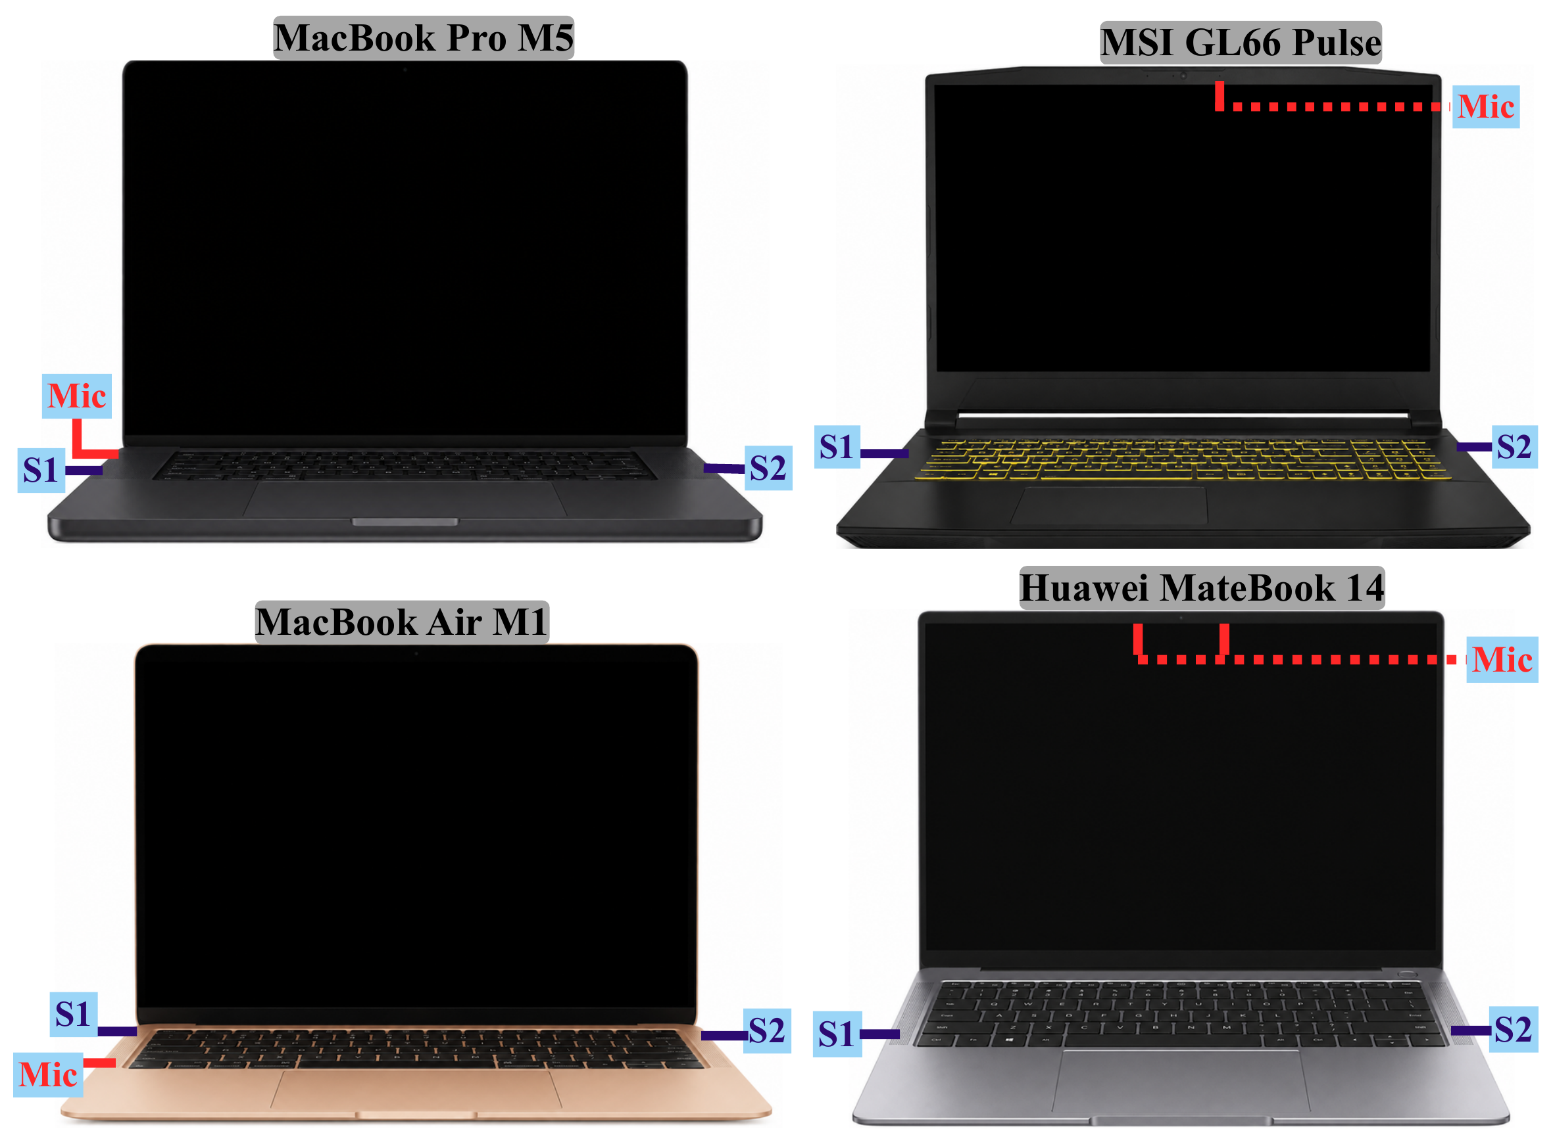
Challenges:
How can we reliably sense different activities across different speaker and microphone layouts?
S: speaker,
Mic: Microphone
04
Notes:
1:10. EchoGuard plays a repeating 12 millisecond triangular FMCW chirp through built in stereo speakers. The left band sweeps from 19 to 20.5 kilohertz and the right from 21.5 to 23 kilohertz. The one kilohertz guard band separates the paths. With two speaker microphone paths, an interaction that is weak in one band can remain visible in the other. The lower edge is at 19 kilohertz, so describe the signal as near ultrasonic rather than guaranteeing that every listener cannot hear it.
Source: EchoGuard manuscript (main.tex and section files in the supplied folder).

Slide 9
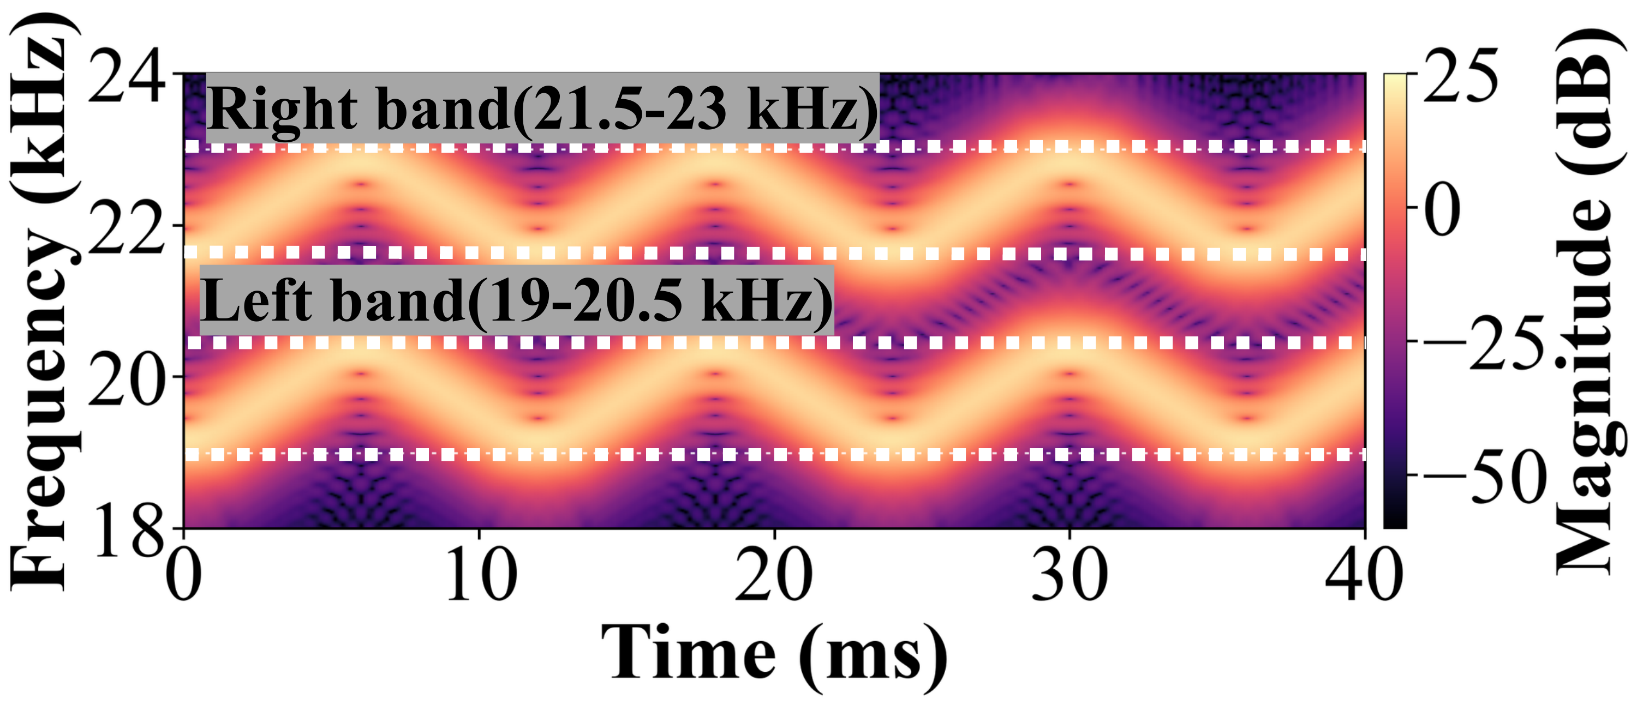
Challenges:
Dual band ultrasound provides two acoustic views
Left speaker transmits the left band: 19-20.5 kHz;
Right speaker transmits the right band: 21.5-23 kHz
12 ms per chirp
04
Notes:
Two frequency bands give us complementary views from the laptop’s two speakers: when an interaction is weak along one acoustic path, it may remain visible along the other. Repeated FMCW chirps then reveal the motion associated with each input event.

Slide 10
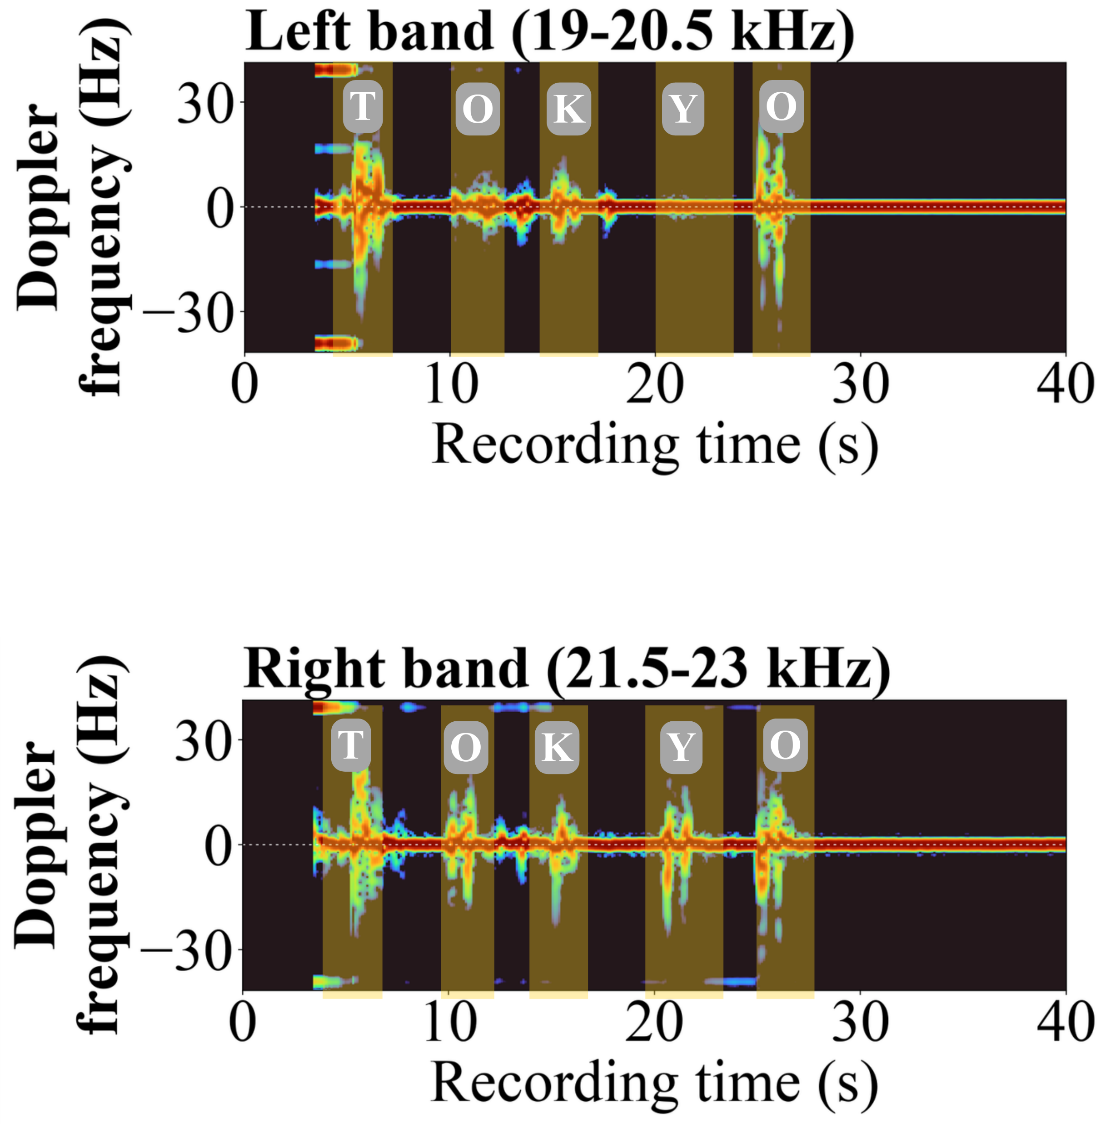
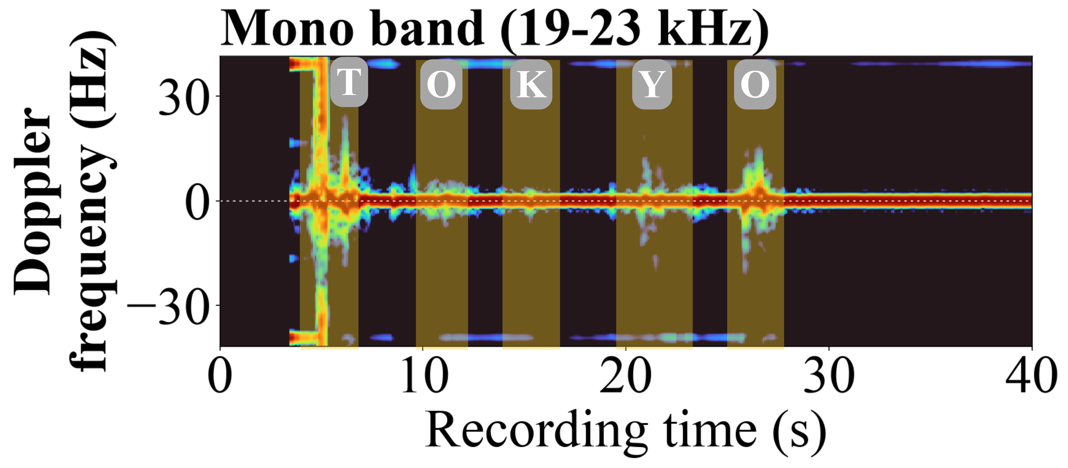
Challenges:
Doppler frequency feature of keystrokes (MacBook Pro M5): the same keystroke can appear weak in the left-band Doppler response but remain clearly visible in the right-band response.
Dual band sensing provides a second acoustic path: keystrokes that appear weak with the left speaker can remain visible with the right speaker. The keys “O,” “K,” “Y,” and “O” were likely typed with the right hand and have weaker responses.
04
Notes:
Dual-band sensing introduces path diversity and makes interaction-related Doppler responses more consistently observable

Slide 11
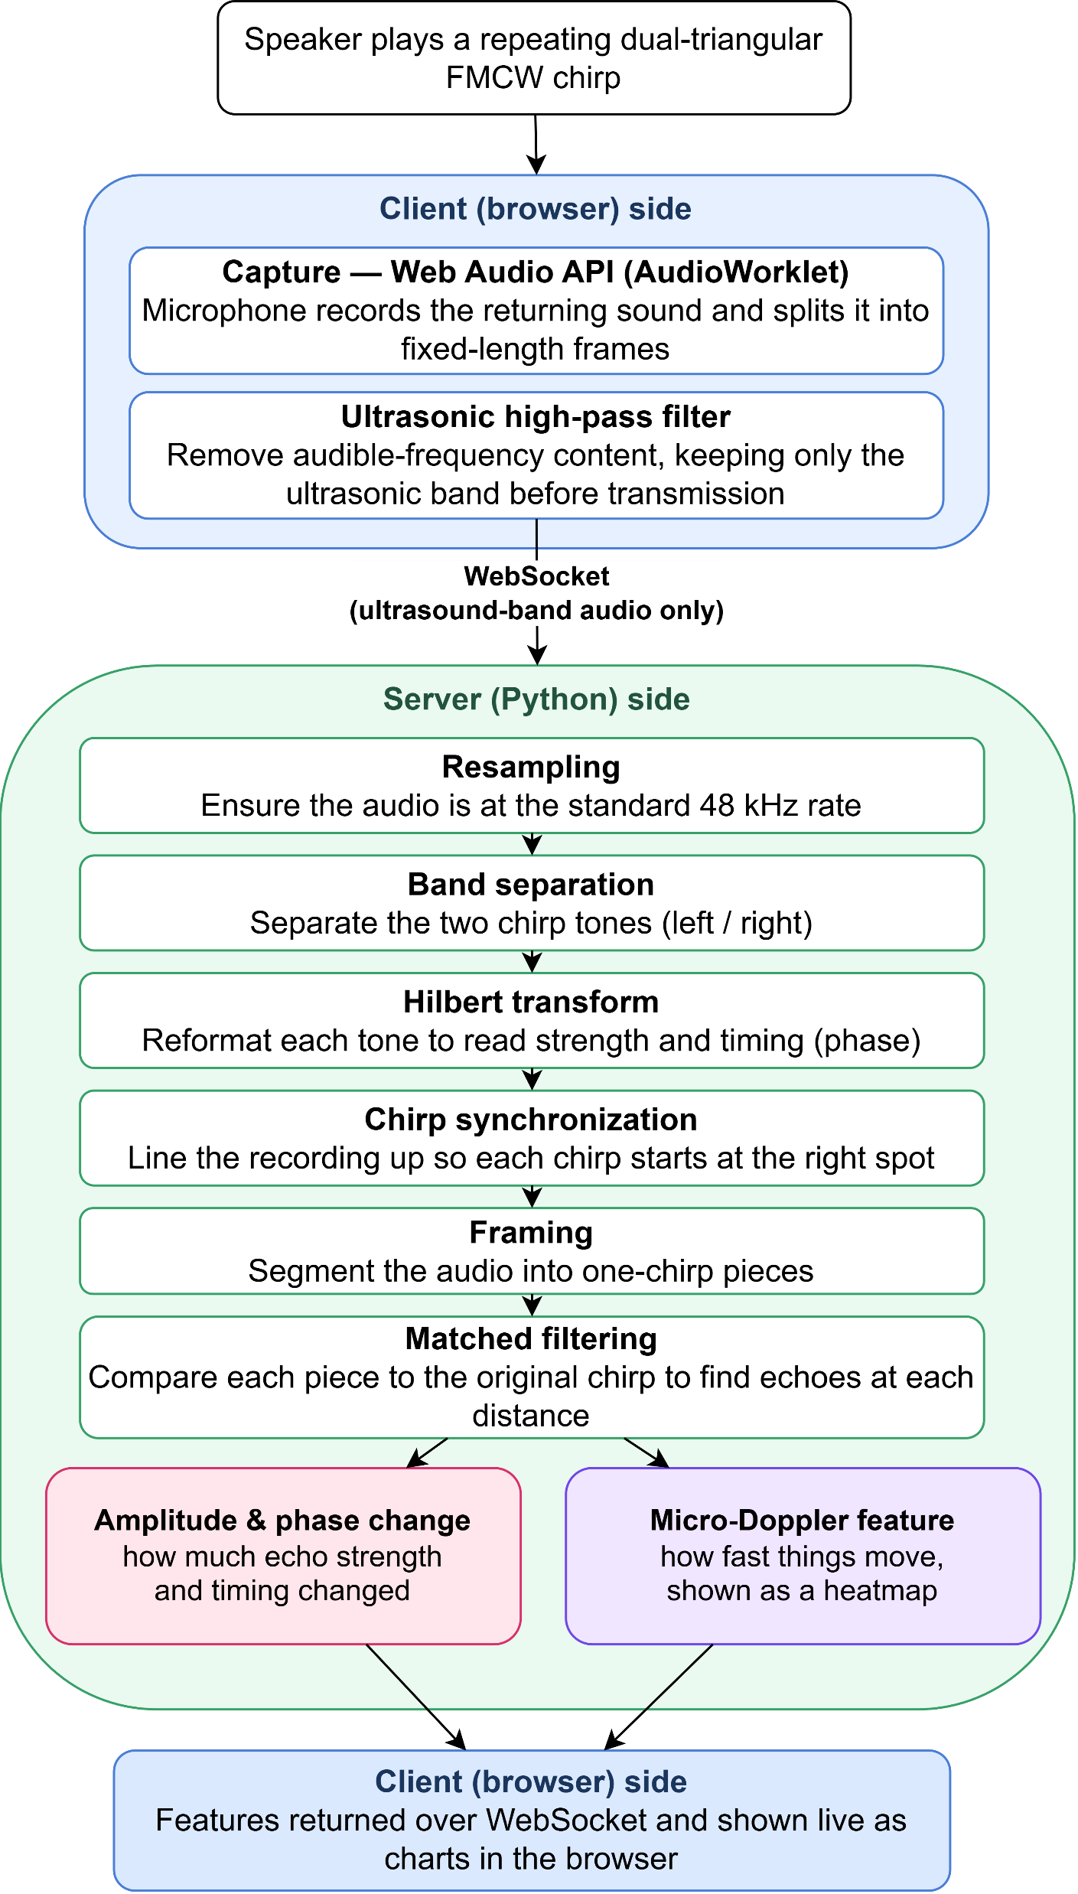
EchoGuard Sensing Pipeline
Browser plays chirps and captures reflections.
Remove audible frequency content before upload.
Server computes amplitude, phase and Doppler.
Returned computed feature to Client for visualization.
05
Notes:
The browser continuously plays the chirp and records the return through the built in microphone. It filters audible frequency components locally before sending the sensing stream to a server. It also logs timestamps for keyboard, pointer, scroll and click events. The server separates the two bands and computes amplitude, phase and micro Doppler features. Event timestamps then define windows for comparison. The processing is causal in this prototype.

Slide 12


Evaluation:
We conduct the sensing experiment on 4 laptops with 2 human participants with 7 activities.
Typing,
Clicking,
Pointer movement,
Scrolling,
Sitting still,
Hand waving,
Walking
4 laptops
2 human participants
7 activities
06
Notes:
The study uses MacBook Pro M5, MacBook Air M1, MSI Pulse GL66 and Huawei MateBook 14, with no external acoustic hardware. Two participants made 82 human recordings across the four laptops. Software generated agent interactions contributed 10 recordings. Trials lasted 40 seconds and included a still baseline around the action sequence. The same room and timing were kept fixed to make comparisons controlled. This small, controlled sample limits generalization.

Slide 13
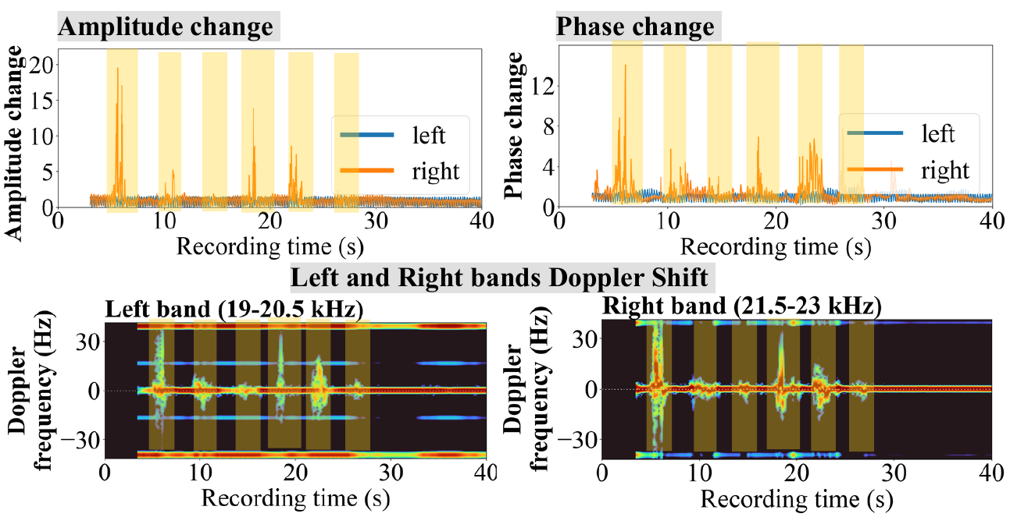
Evaluation:
Feature visualization of the touchpad activities. Touchpad activity sequence: scroll, move, click, scroll, move, click
Key finding 1: Doppler best reveals event aligned motion
07
Notes:
This is one representative touchpad trial on the MacBook Pro M5. Yellow intervals mark scroll, move, click, then the sequence repeats. Amplitude and phase change around some actions, but the Doppler panels show the clearest localized responses around event times. This motivated the paper to use Doppler for the later comparisons. The conclusion is specific to these recordings, not a claim that Doppler is universally superior.

Slide 14
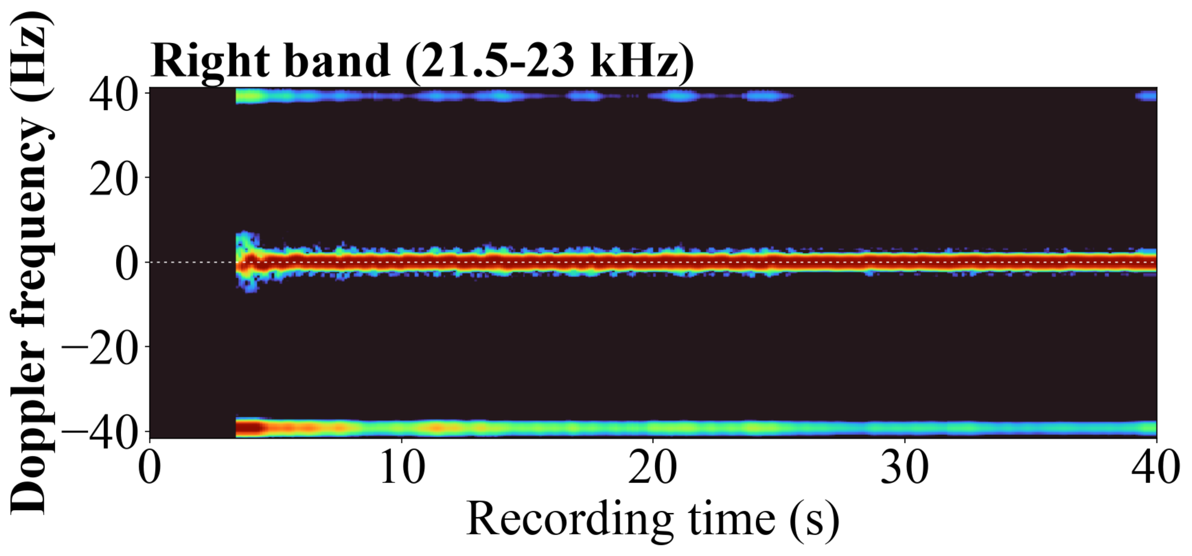
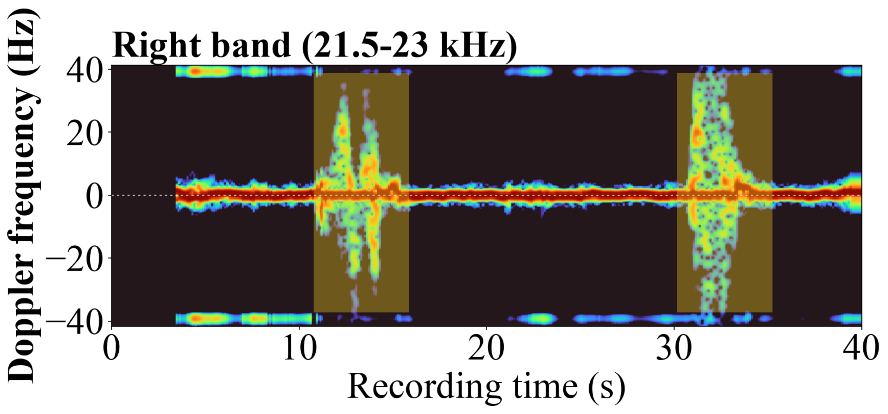
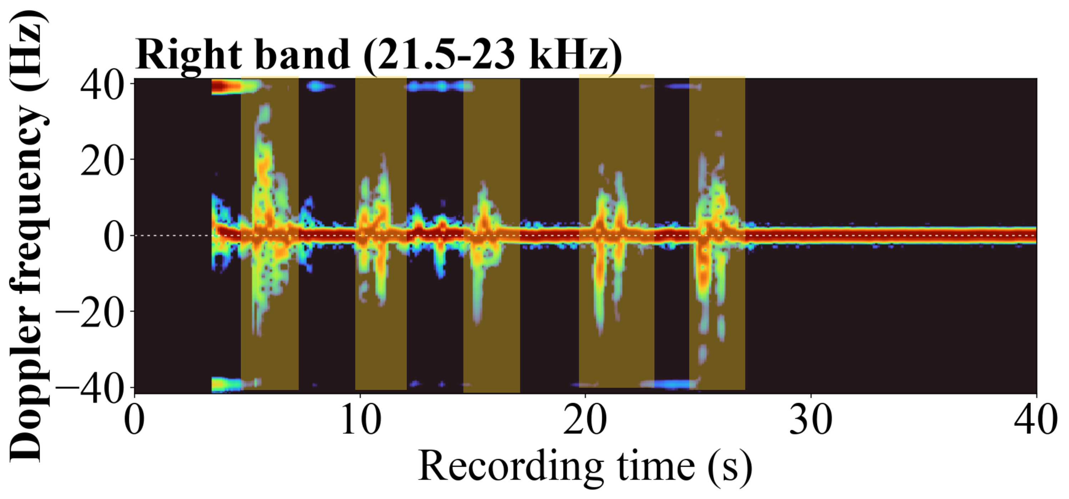
Evaluation:
Direct interaction vs. nearby motion:
Still
Walking nearby
Typing
Key finding 2: Direct interaction differs from nearby motion
08
Notes:
The sensing signal also responds to unrelated motion. A still participant produces little variation. Walking near the device makes broad disturbances, while typing creates repeated activity aligned with keystrokes. In the paper, typing with a person walking in the background contains both responses. Event timing helps, but surrounding people are an important source of interference. The displayed panels are from the same right sensing band.

Slide 15
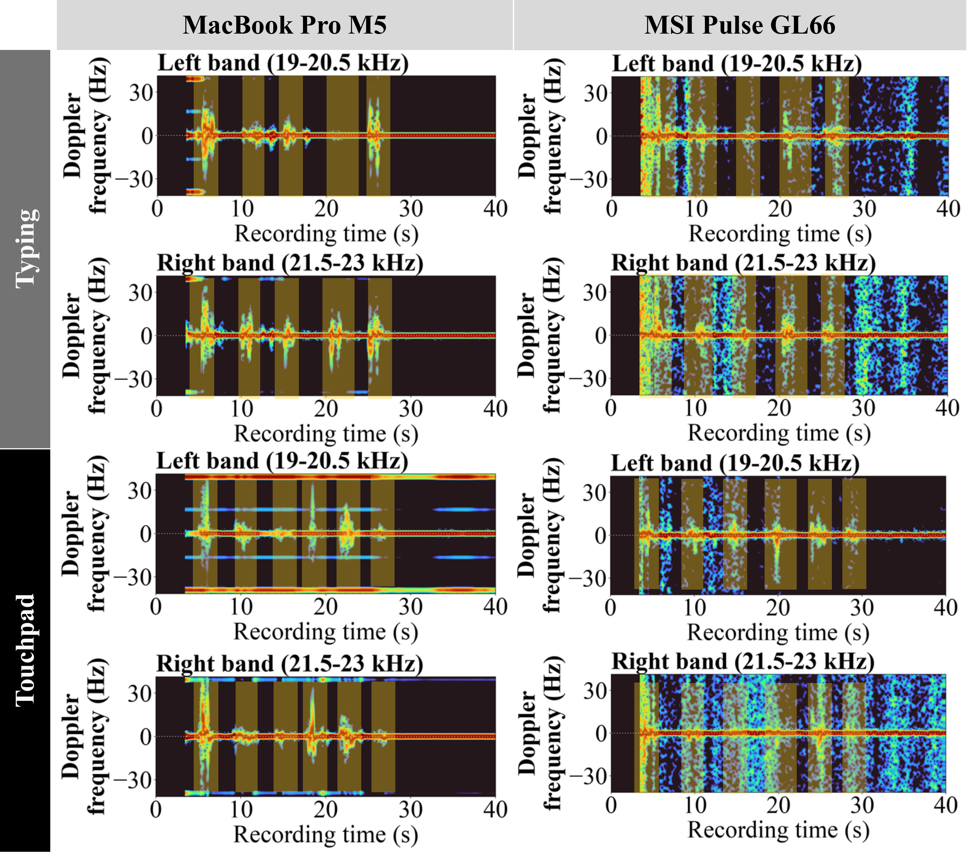
Evaluation:
Same activity across 2 laptops:
Key finding 3: Interaction-aligned Doppler response is consistent across different laptops.
09
Notes:
The paper compares a MacBook Pro M5 with an MSI Pulse GL66 here. Their acoustic responses differ substantially in magnitude and background texture because speaker, microphone and hardware characteristics differ. Even so, typing actions remain event aligned on both devices. The paper also reports the same pattern for touchpad use. This supports pipeline feasibility across layouts, while it does not establish device independent calibration or accuracy.

Slide 16
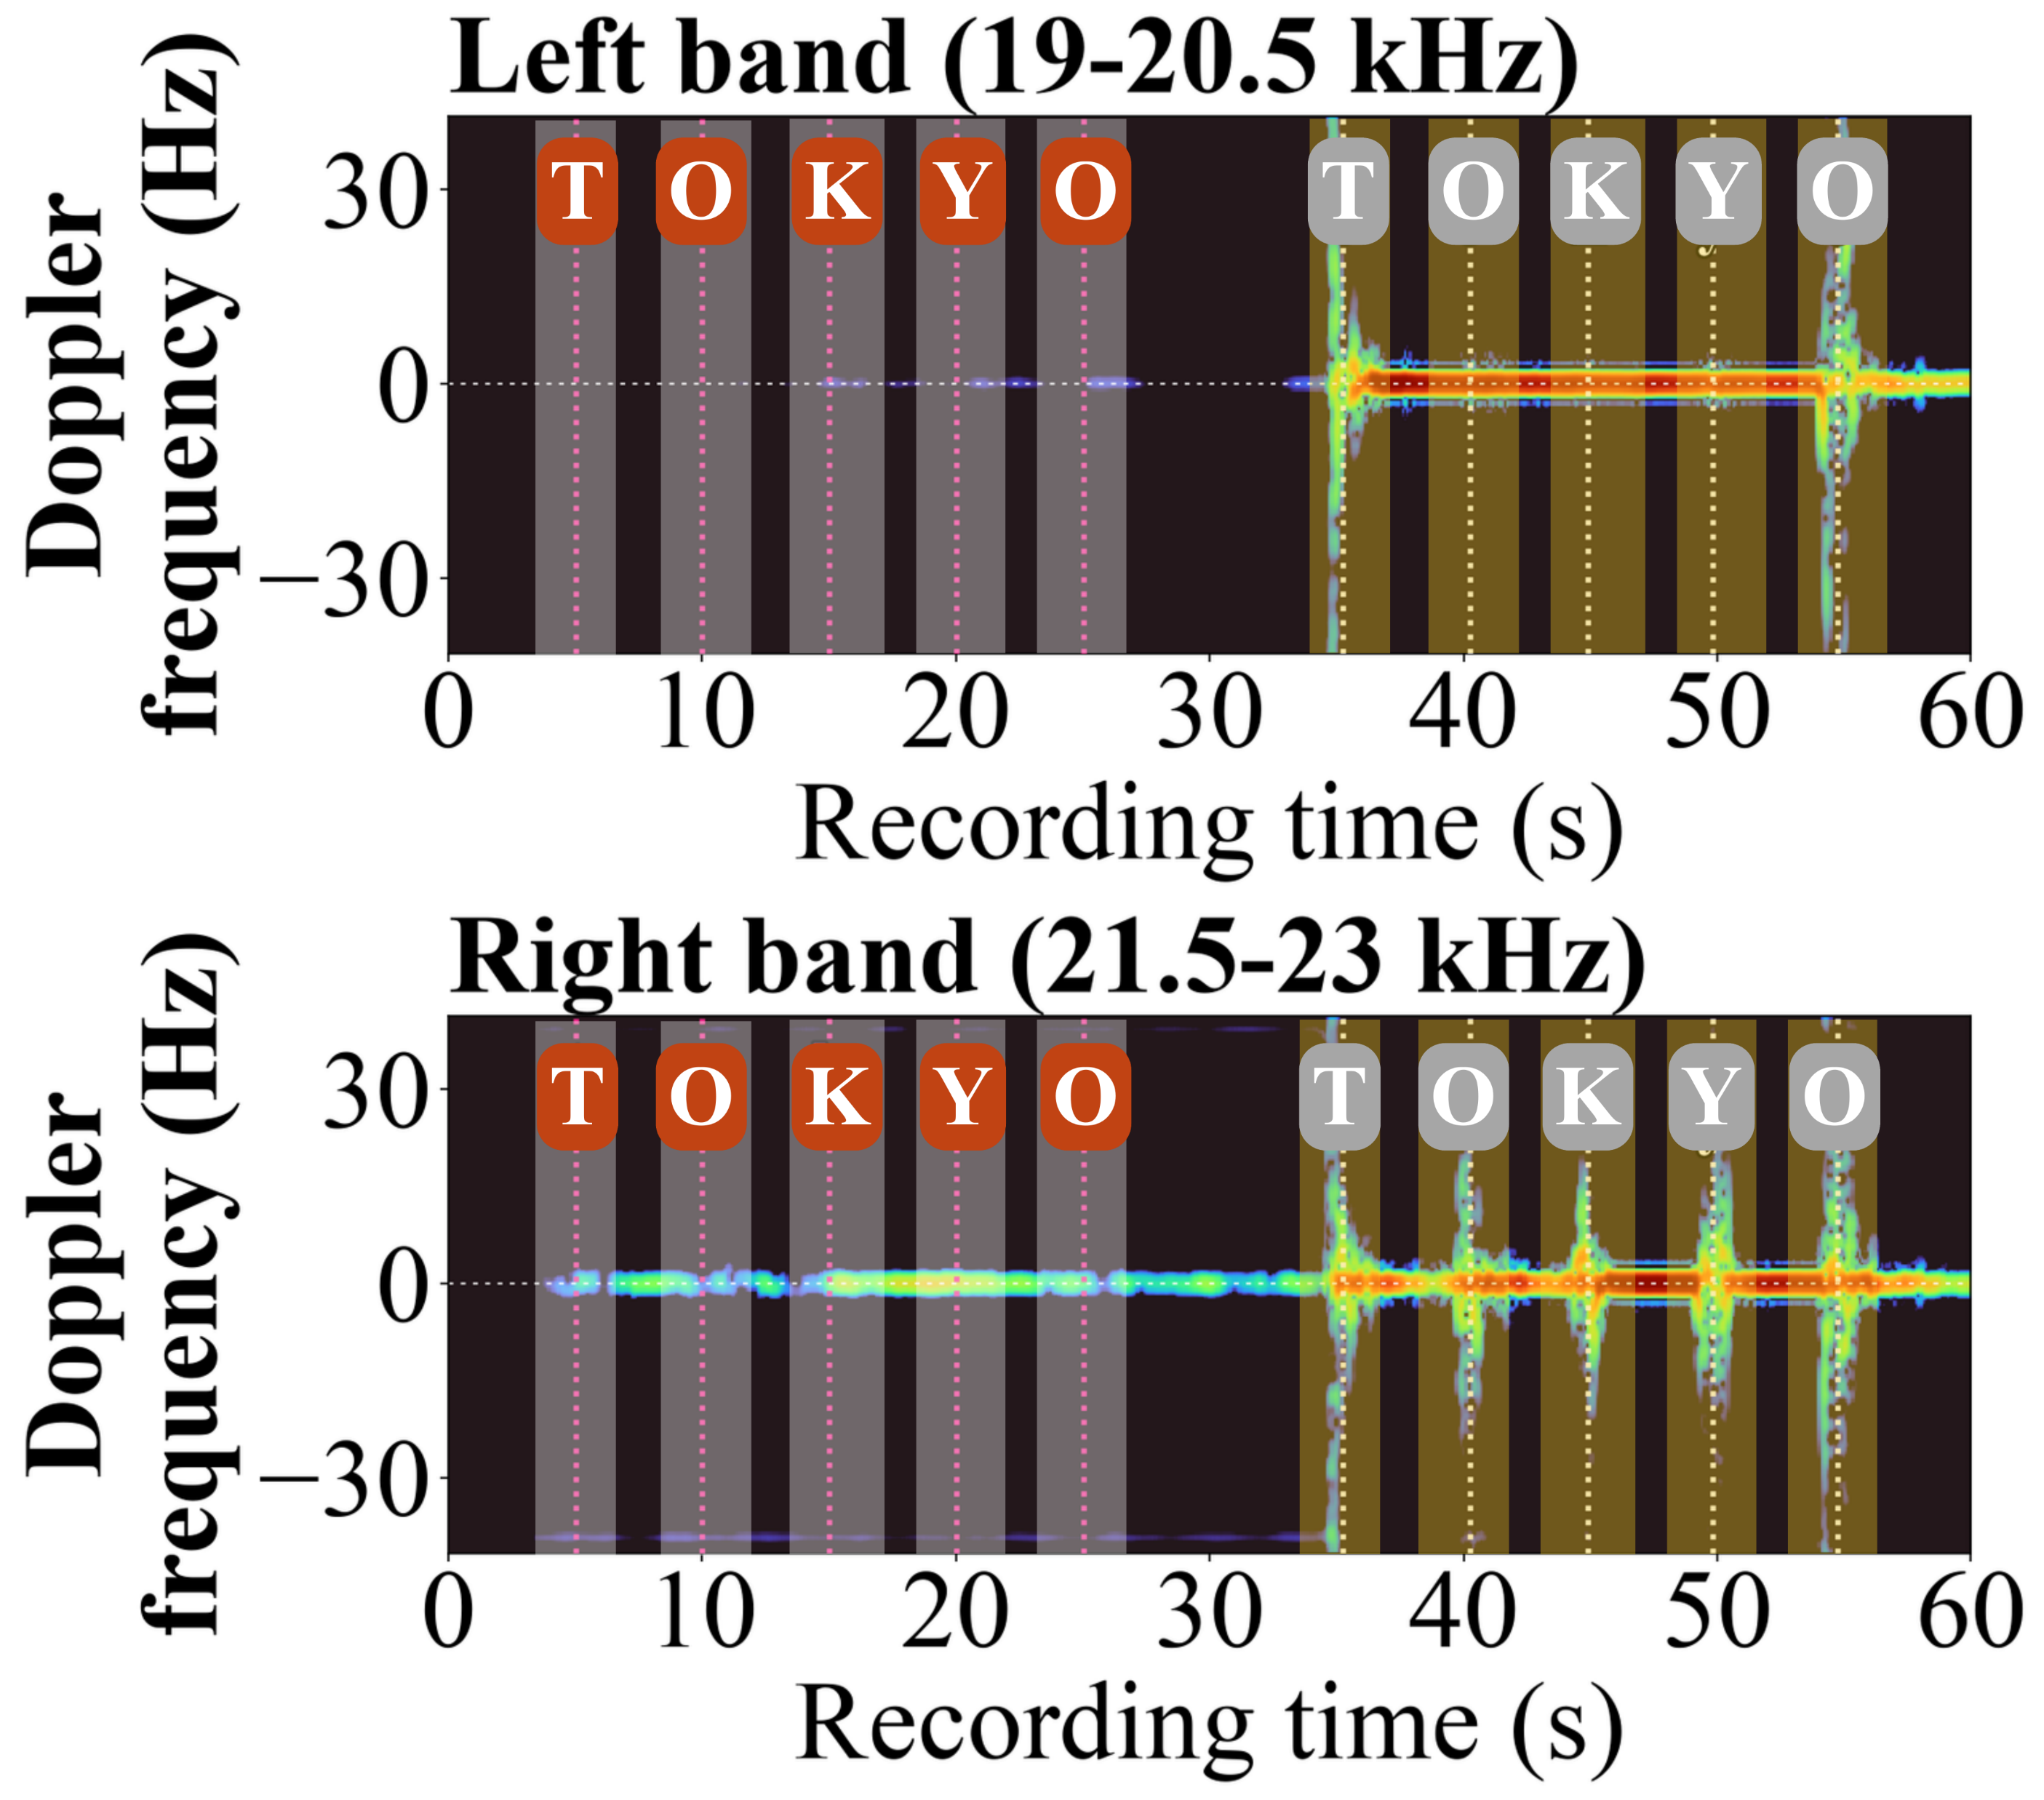
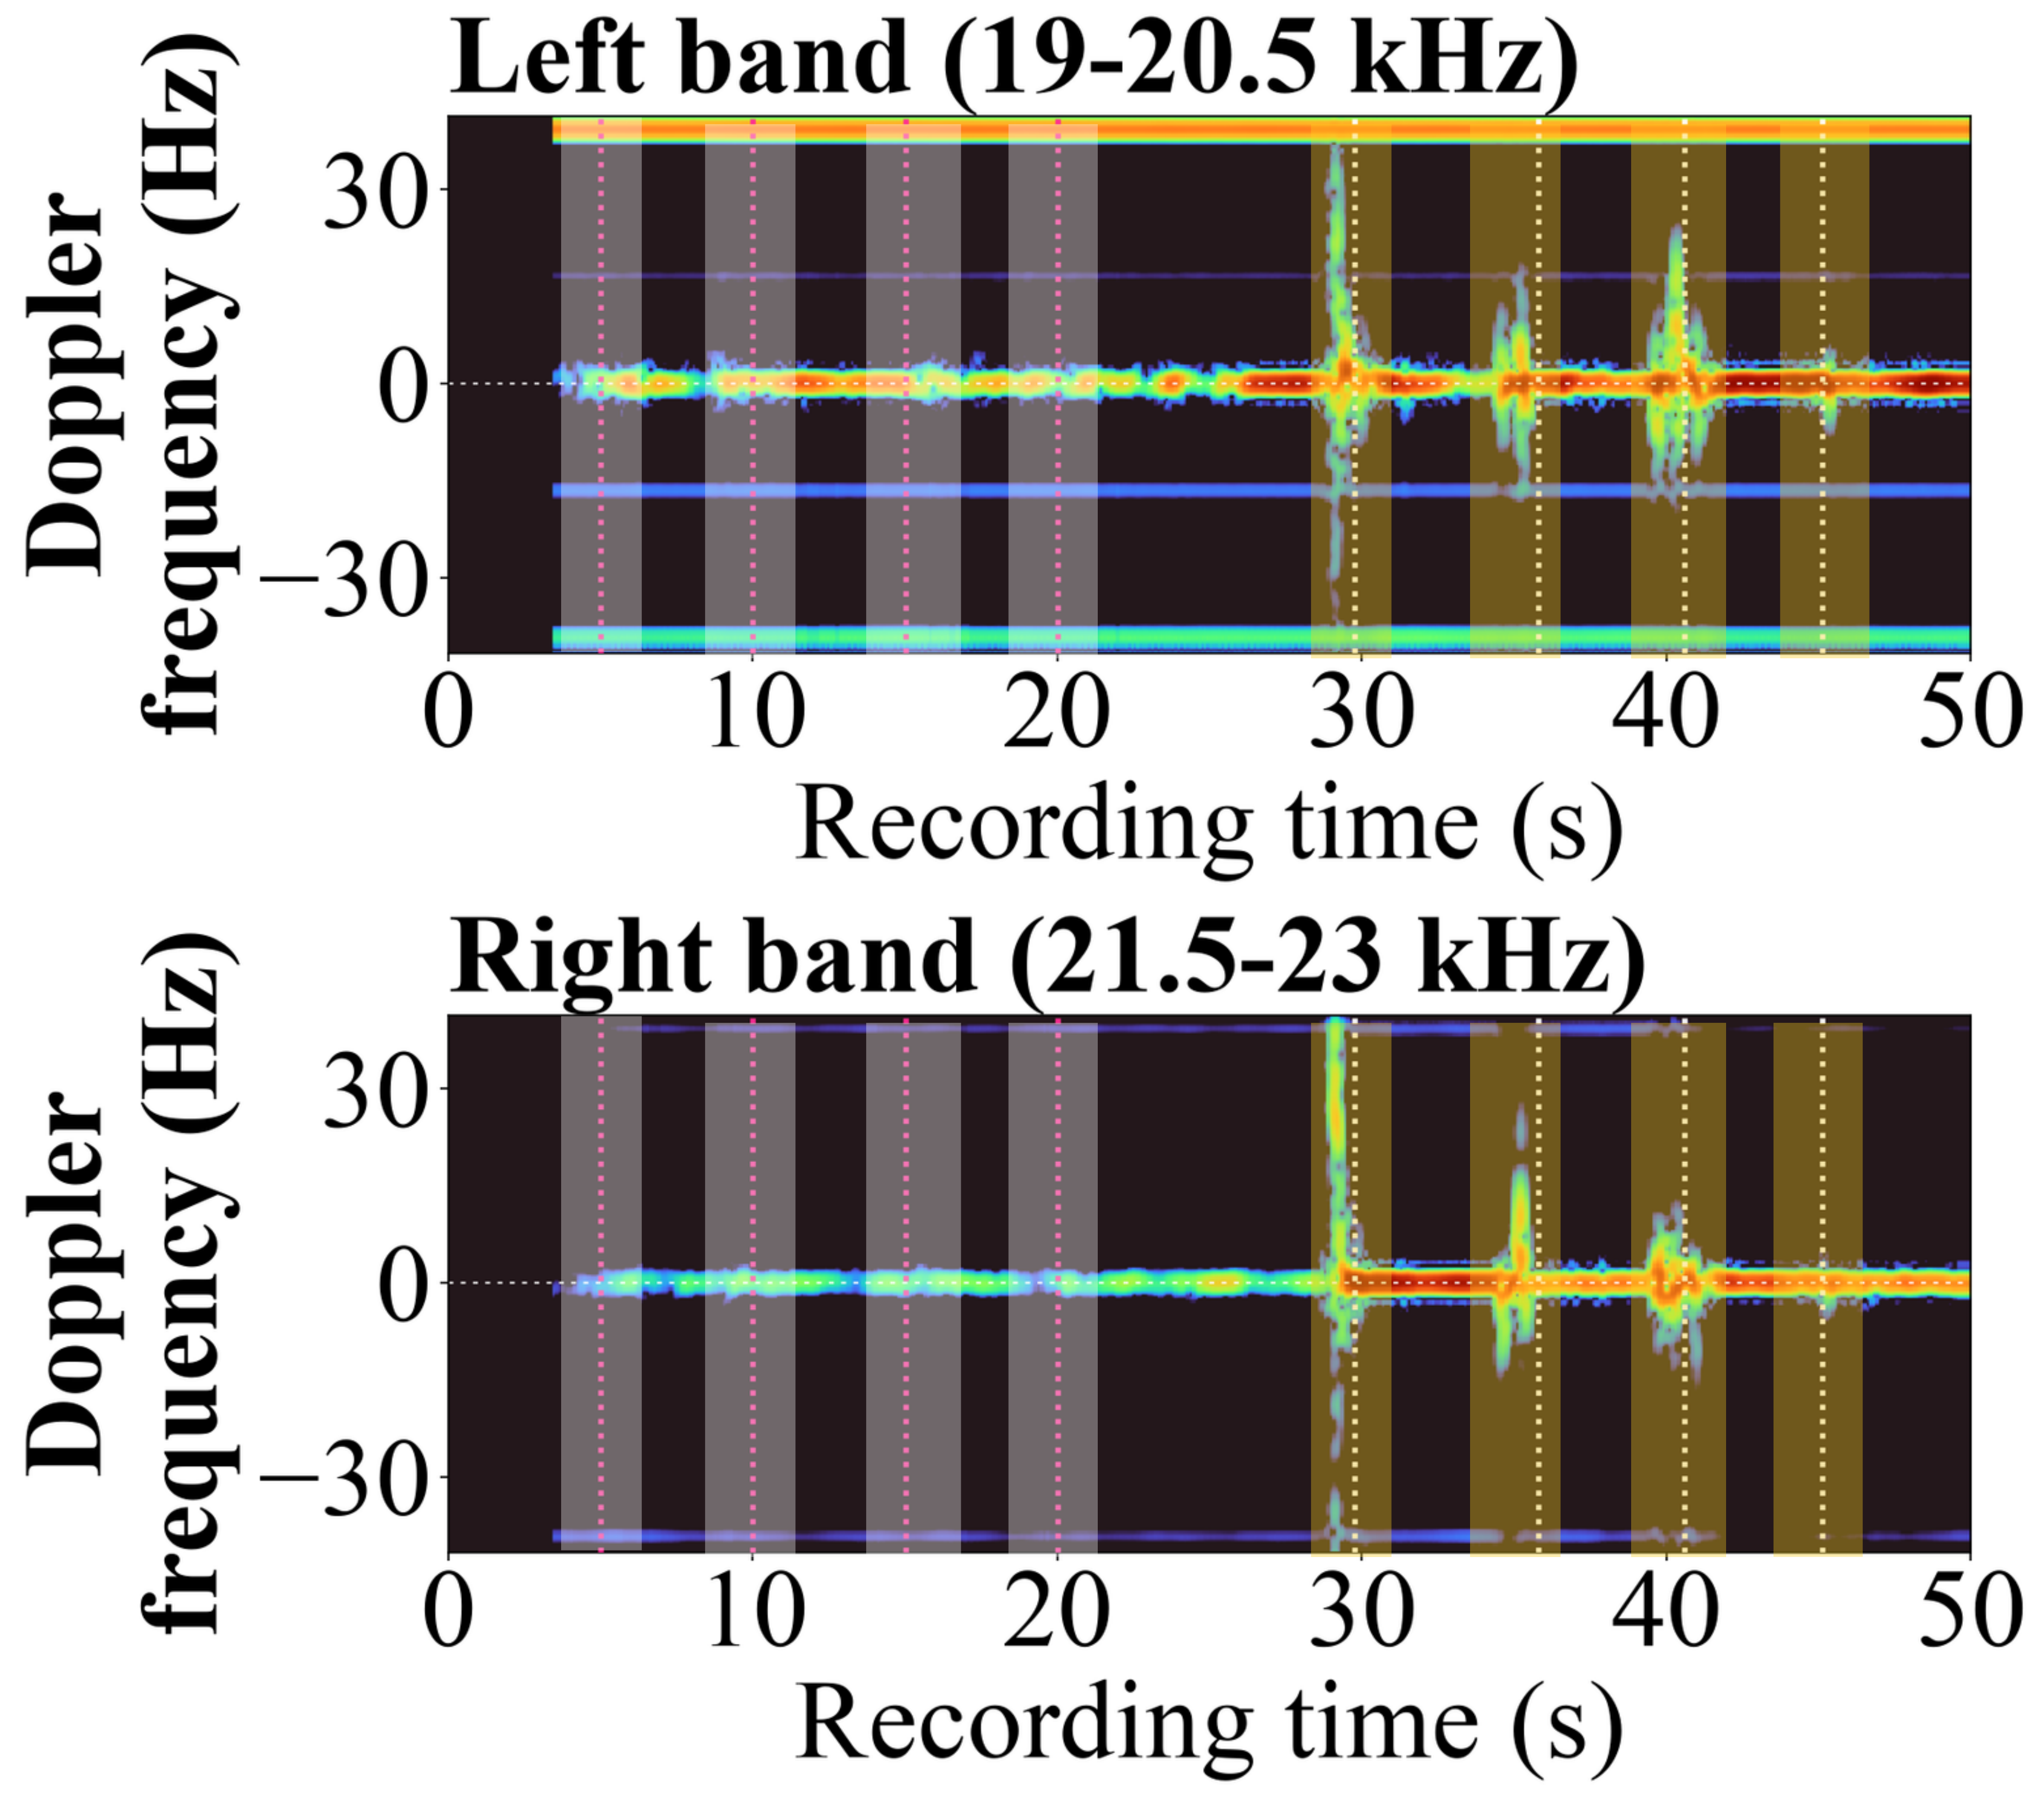
Evaluation:
We compare the agent activities and the human activities with the Doppler feature.
Typing
Pointer movement
Key finding 4: Doppler features reveal differences between human- and agent-generated interactions across laptops.
10
Notes:
This example compares software generated agent typing on the left with human typing on the right. The browser event pattern is the same T O K Y O sequence. Agent events show little matching physical response, whereas human keystrokes have visible motion energy around the event intervals. This is the central observation of the feasibility study. This slide shows the right sensing band, one illustrative recording; the next slides move to event features and classification

Slide 17
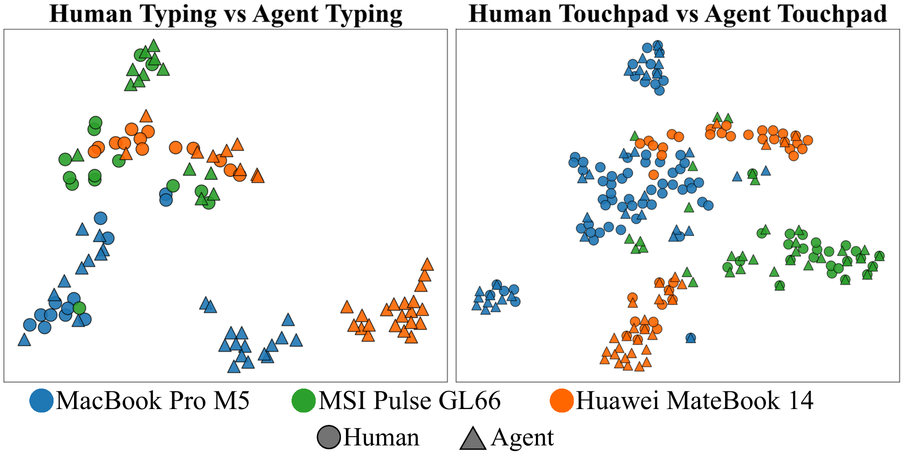
Evaluation:
Two-dimensional t-SNE projections of event-level Doppler features for typing and touchpad interactions across three laptops.
10
Notes:
This example compares software generated agent typing on the left with human typing on the right. The browser event pattern is the same T O K Y O sequence. Agent events show little matching physical response, whereas human keystrokes have visible motion energy around the event intervals. This is the central observation of the feasibility study. This slide shows the right sensing band, one illustrative recording; the next slides move to event features and classification

Slide 18
Evaluation:
To assess whether these differences enable automated classification, we trained three classifiers on a small dataset of 16 human and 10 agent typing recordings. We divided the recordings into short event windows, yielding 80 human and 96 agent typing windows.
Model | Accuracy | Macro F1 | AUC
Logistic Regression | 89.6% | 0.793 | 0.759
Random Forest | 87.0% | 0.720 | 0.757
CNN | 89.6% | 0.793 | 0.749
The preliminary results show that we can distinguish human from agent-generated typing events.
10
Notes:
This example compares software generated agent typing on the left with human typing on the right. The browser event pattern is the same T O K Y O sequence. Agent events show little matching physical response, whereas human keystrokes have visible motion energy around the event intervals. This is the central observation of the feasibility study. This slide shows the right sensing band, one illustrative recording; the next slides move to event features and classification

Slide 19
Conclusion
What this study establishes:
Evidence: Event aligned Doppler appears for direct interaction across laptop layouts.
Current limit: Small controlled study with software only agents and no acoustic replay.
Future work: Larger cohorts, varied environments and deliberate spoofing.
13
Notes:
EchoGuard shows that commodity laptop audio hardware can capture motion patterns tied to input events, and those patterns differ from software only agent events in the controlled study. The best typing classifiers reached 89.6 percent accuracy. The next steps are a larger and more varied sample, continuous end to end verification, tests with background motion, and deliberate replay or spoofing attempts. The takeaway is feasibility of a physical companion signal, not a ready to deploy authentication system. Close here and invite questions.

